Slide 1
GE6252 BASIC ELECTRICAL AND ELECTRONICS ENGINEERING V.MOHAN, VICE PRINCIPAL, EGSPEC

Slide 2
SYLLABUS
GE6252 BASIC ELECTRICAL AND ELECTRONICS ENGINEERING
UNIT I ELECTRICAL CIRCUITS & MEASURMENTS 12
Ohm’s Law – Kirchoff’s Laws – Steady State Solution of DC Circuits – Introduction to AC Circuits –
Waveforms and RMS Value – Power and Power factor – Single Phase and Three Phase Balanced
Circuits- Operating Principles of Moving Coil and Moving Iron Instruments (Ammeters and Voltmeters),
Dynamometer type Watt meters and Energy meters.
UNIT II ELECTRICAL MECHANICS 12
Construction, Principle of Operation, Basic Equations and Applications of DC Generators, DC Motors,
Single Phase Transformer, single phase induction Motor.
UNIT III SEMICONDUCTOR DEVICES AND APPLICATIONS 12
Characteristics of PN Junction Diode – Zener Effect – Zener Diode and its Characteristics – Half wave
and Full wave Rectifiers – Voltage Regulation. Bipolar Junction Transistor – CB, CE, CC Configurations and Characteristics – Elementary Treatment of Small Signal Amplifier.

Slide 3
UNIT IV DIGITAL ELECTRONICS 12
Binary Number System – Logic Gates – Boolean Algebra – Half and Full Adders – Flip-Flops –
Registers and Counters – A/D and D/A Conversion (single concepts)
UNIT V FUNDAMENTALS OF COMMUNICATION ENGINEERING 12
Types of Signals: Analog and Digital Signals – Modulation and Demodulation: Principles of Amplitude
and Frequency Modulations. Communication Systems: Radio, TV, Fax, Microwave, Satellite and Optical Fibre (Block Diagram Approach only).

Slide 4
Text Book
Premkumar N, “Basic Electrical Engineering”,
Anuradha Publishers, (2003).

Slide 5
Course Objectives
1. To understand the basic laws and concepts related to electrical and electronics engineering.
2. To understand the measurement of electrical parameters.
3. To understand the operation and applications of electrical machines and semiconductors.
4. To analyze the simple electrical and digital circuits.

Slide 6
Course Outcomes
On completion of the course students will be able to
(a)Summarize the basic laws and concepts related to electric circuits, electrical machines, semiconductors, digital and communication systems.
(b)Explain about the operation of various measuring instruments
(c) Describe the construction, operation and applications of Electrical Machines.
(d) Describe the construction, operation and applications of semiconductor devices.
(e)Analyze circuits containing logic gates and flip flops.

Slide 7
Why should Engineers learn the basics of EEE?
Electrical Engineering
Electronics Engineering
Communication Engineering

Slide 8
Importance of Electrical Engineering

Slide 9
OVERVIEW OF POWER SYSTEM

Slide 10
Electric circuits
Active elements
Passive elements R L C

Slide 11
SOURCES
AC & DC SOURCES
(Alternating current –AC
Direct current – DC)
VOLTAGE & CURRENT SOURCES
Voltage source – voltage constant
Current source – current constant

Slide 12
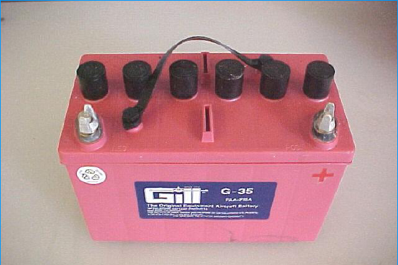
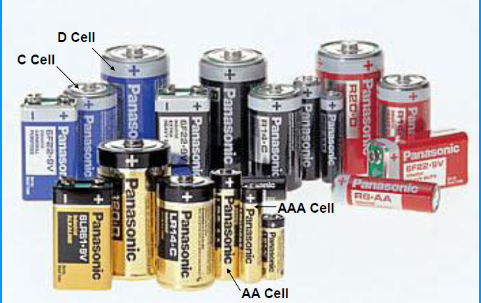
SOURCES

Slide 13
OHMS LAW

Slide 14
OHM’S LAW
The current flowing through the electric current is directly proportional to the potential difference across the current and inversely proportional to the resistance of the current at constant temperature.
I = V/R
i.e., V = IR (Volts)
LIMITATIONS OF OHM’S LAW
Not applicable to non-linear devices such as diodes, zener diode, voltage regulators etc.

Slide 18
MEASURING INSTRUMENTS
AMMETER
VOLTMETER
WATTMETER
ENERGYMETER

Slide 19
ELECTRICAL MACHINES
TRANSFORMERS
DC MOTORS
DC GENERATORS
INDUCTION MOTORS

Slide 20
WHAT IS TRANSFORMER ?
HAVE YOU SEEN THE TRANSFORMER IN DAY TO DAY LIFE ?
DO YOU HAVE TRANSFORMER IN YOUR HOME ?

Slide 21
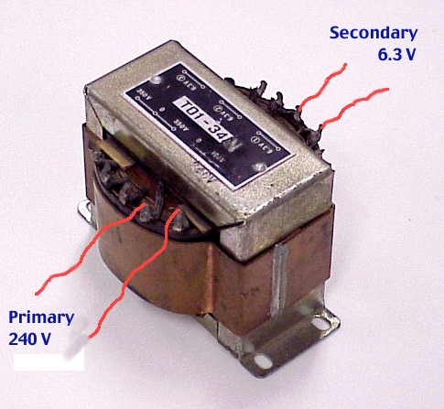
TRANSFORMER

Slide 22
TRANSFORMER

Slide 23
TRANSFORMER

Slide 24
TRANSFORMER

Slide 25
HOW MANY MOTORS DO YOU HAVE IN YOUR HOUSE?

Slide 26
DC MOTOR

Slide 27
HAVE YOU EVER SEEN THE GENERATOR IN DAY TO DAY LIFE

Slide 28
Semiconductors
Silicon and germanium

Slide 29
SEMICONDUCTOR DEVICES
DIODE
ZENER DIODE
TRANSISTOR

Slide 30
APPLICATIONS OF SEMICONDUCTOR DEVICES
RECTIFIERS
REGULATORS
AMPLIFIERS

Slide 31
DIGITAL ELECTRONICS
GATES
FLIP FLOPS
REGISTERS
COUNTERS
ADC
DAC

Slide 32
COMMUNICATION SYSTEMS
RADIO
TV
FAX
SATELLITTE COMMINICATION
FIBER OPTICAL COMMINICATION
MICROWAVE COMMINICATION

