Slide 16
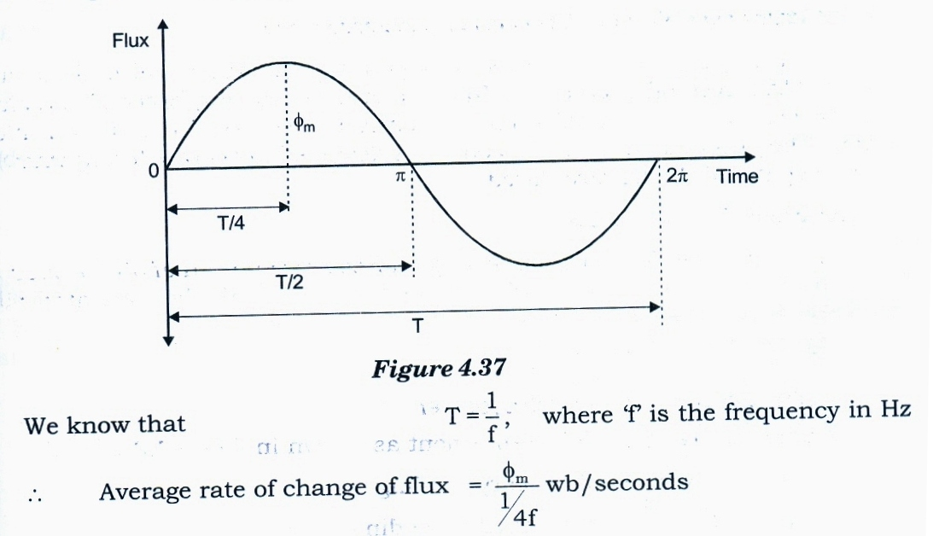

Slide 24
SPLIT PHASE MOTORS

Slide 26
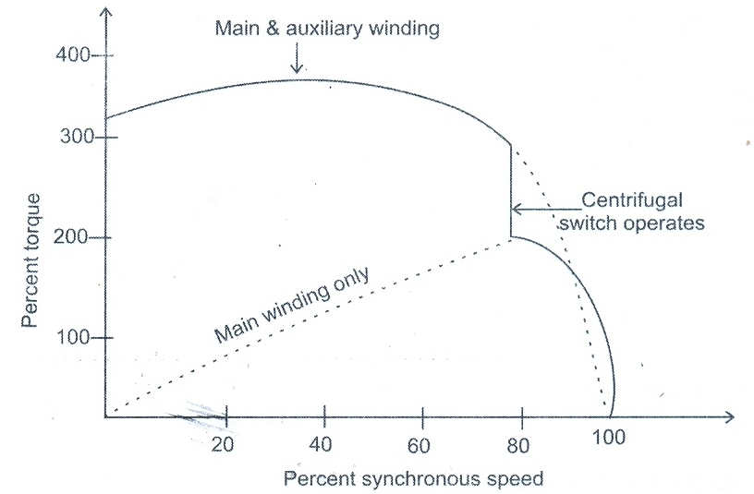
CAPACITOR START SINGLE PHASE INDUCTION MOTOR

Slide 28
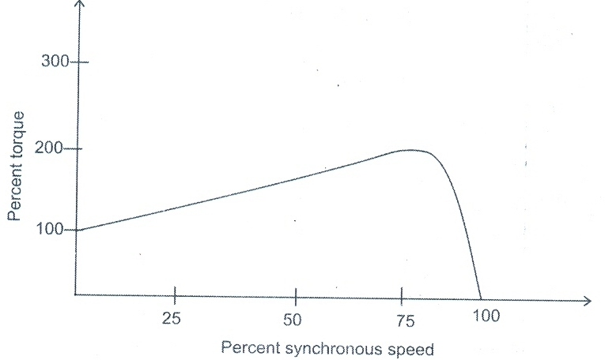
CAPACITOR RUN MOTOR

Slide 30
CAPACITOR START CAPACITOR RUN MOTOR

Slide 32
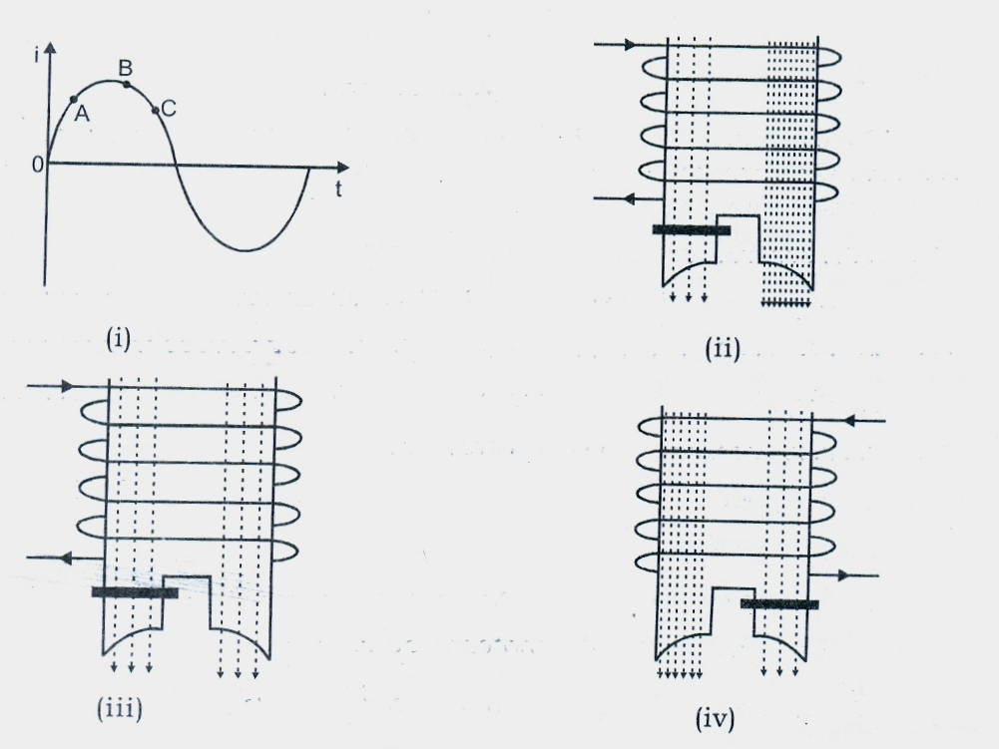
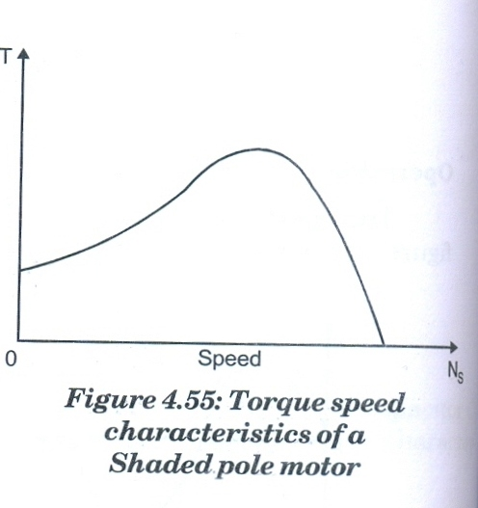
SHADED POLE MOTOR

