Slide 1
3.TRANSISTOR CIRCUIT CONFIGURATION
Basically three types of circuit connections for operating a transistor,
Common base (CB)configuration.
Common emitter (CE)configuration.
Common collector (CC)configuration.
‘common’ denotes an electrode that is common to input and the output circuit, because the common electrode is generally grounded.

Slide 2
3.1 COMMON BASE CONFIGURATION
In this configuration the base terminal is common to input to output.
The current gain: The ratio of collector current to emitter current is called as current gain or dc alpha

Slide 3
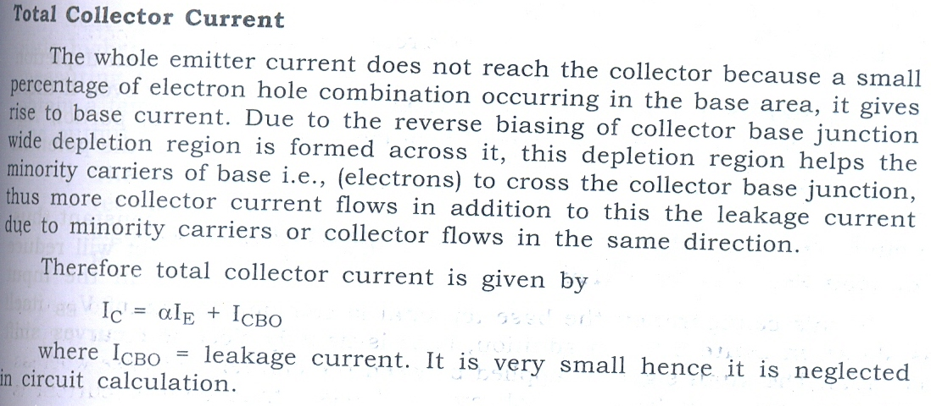

Slide 4
Characteristic of configuration
Two types of characteristics are available in each configuration circuit.
1.Input characteristics.
The input characteristics is output voltage constant and relation between input voltage and current.
2. Output characteristics.
The output characteristics is input current constant and relation between output voltage and current.

Slide 5
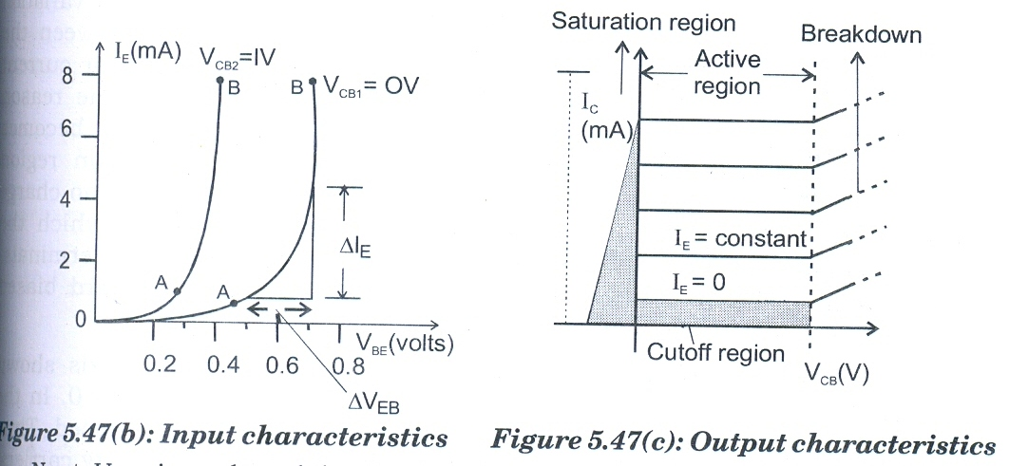
Characteristics of CB configuration

Slide 6
1.Input characteristics:
Collector –base voltage constant.(VCB )
Ratio between VEB and IE is called as input resistance.
2.Output characteristics
The emitter current should be in constant.
Ratio between VCB and IC is called as output resistance.

Slide 7
3.2.Common Emitter Configuration

Slide 8
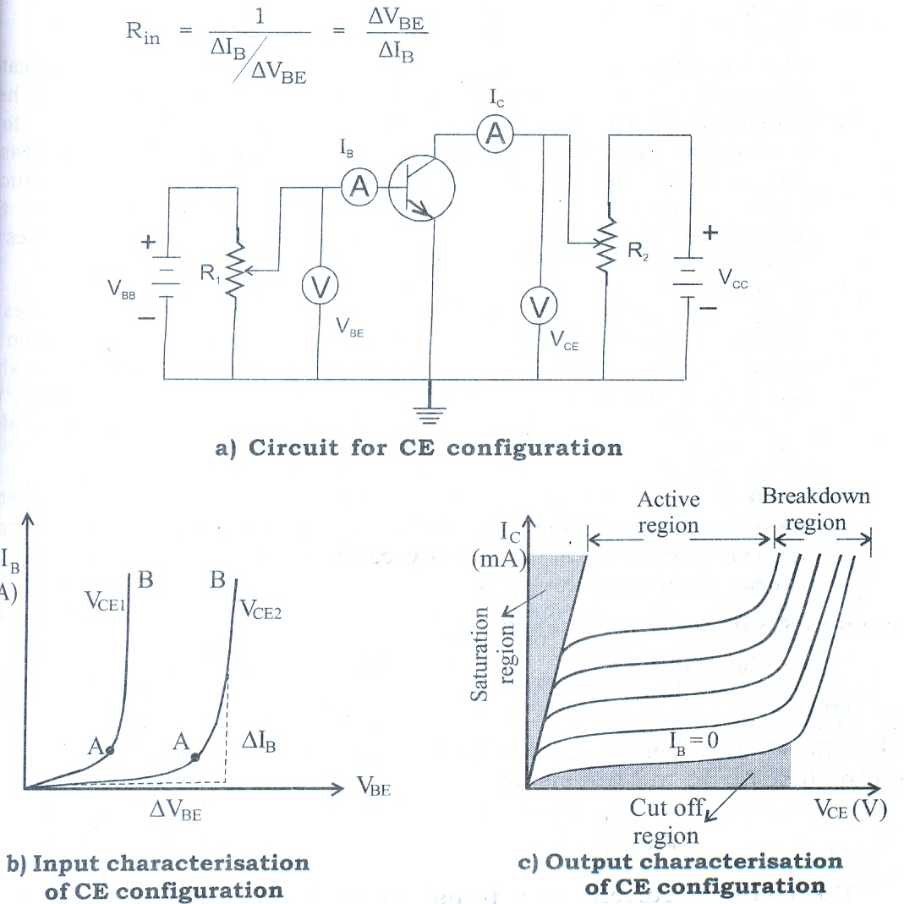
characteristics of CE configuration

Slide 9
3.3 Common Collector Configuration

Slide 11
Comparison of three configurations

