Slide 1
SOLID STATE DRIVES
UNIT 4: SYNCHRONOUS MOTOR DRIVES

Slide 2
CLASSIFICATION OF SYNCHRONOUS MOTOR
Wound field motor
  Cylindrical rotor wound field motor
  Salient pole rotor wound field motor
Permanent magnet motor
  Surface mounted PM motor
  Interior or buried PM motor
Synchronous reluctance motor
Hysteresis motor

Slide 3
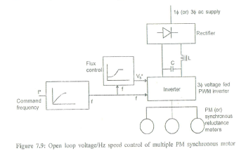
SEPARATE CONTROLLED SYNCHRONOUS MOTOR

Slide 4
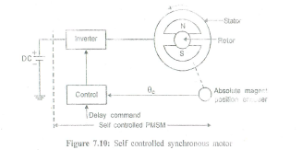
SELF CONTROLLED SYNCHRONOUS MOTOR

Slide 5
Comparison between self & separately controlled synchronous Motor drives
Sl. No. | Separate control | Self control
1. | Hunting oscillations are present | Hunting is eliminated
2. | Damper winding is required | No need of a damper winding
3. | Stator supply frequency is controlled from an independent oscillator | No need of independent oscillator for frequency adjustment.
4. | Multiple no. of machines can be controlled. | Single machine is controlled.

Slide 6
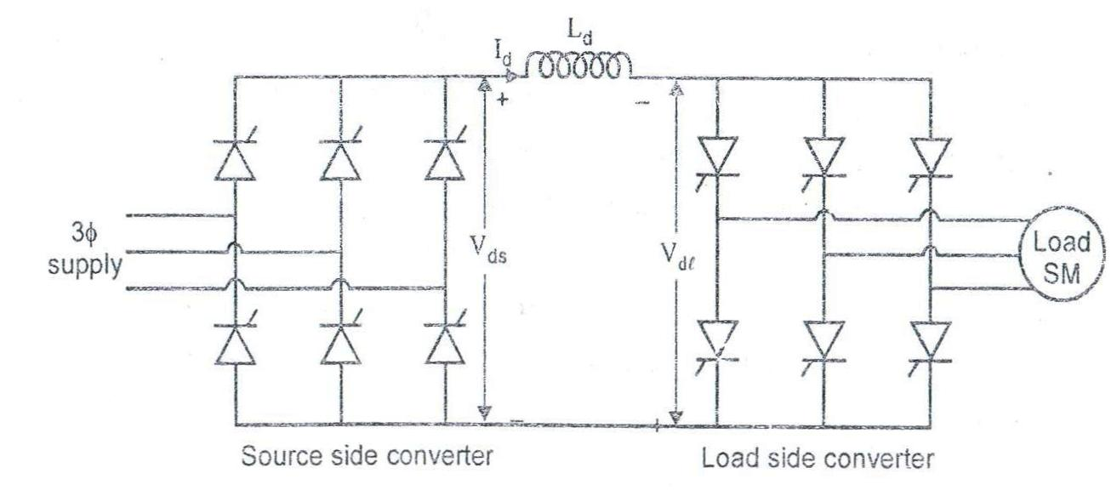
SELF CONTROLLED SM DRIVE EMPLOYING LOAD COMMUTATED THYRISTOR INVERTER

Slide 7
VOLTAGE SOURCE INVERTER (VSI) FED SM
Three ways of producing VVVF supply using VSI:
1. Square wave inverters
PWM inverters
Chopper with square wave inverters
In all the cases the SM can be operated either in self or separate controlled mode

Slide 8
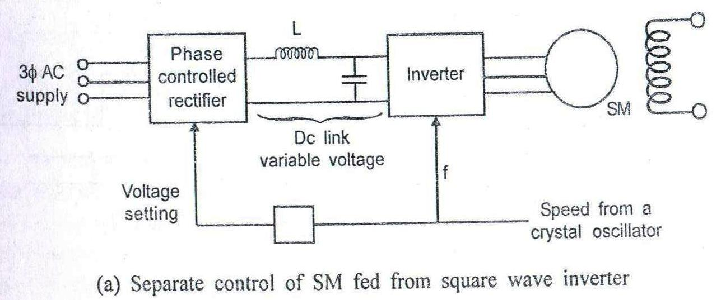
SEPARATE CONTROL OF SM FED FROM SQUARE WAVE INVERTER
Medium to high speed applications.
Output is a square wave
Variable DC link voltage
Commutation is difficult at low speeds

Slide 9
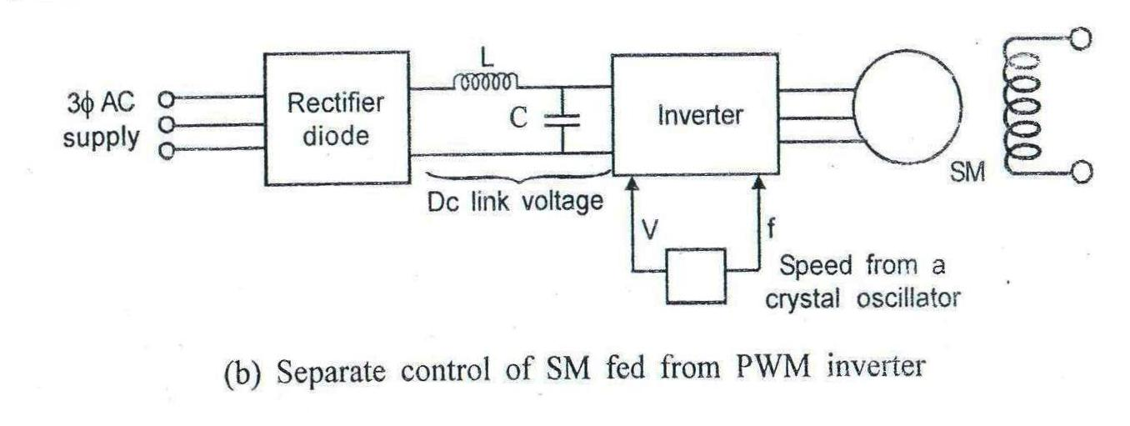
SEPARATE CONTROL OF SM FED FROM PWM INVERTER
Voltage control within the inverter
DC link voltage is constant
Wide range of speed applications

Slide 10
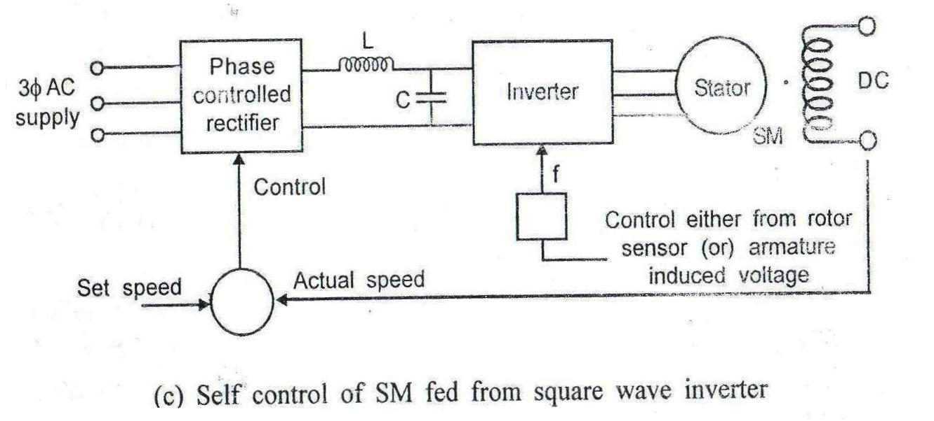
SELF CONTROL OF SM FED FROM SQUARE WAVE INVERTER

Slide 11
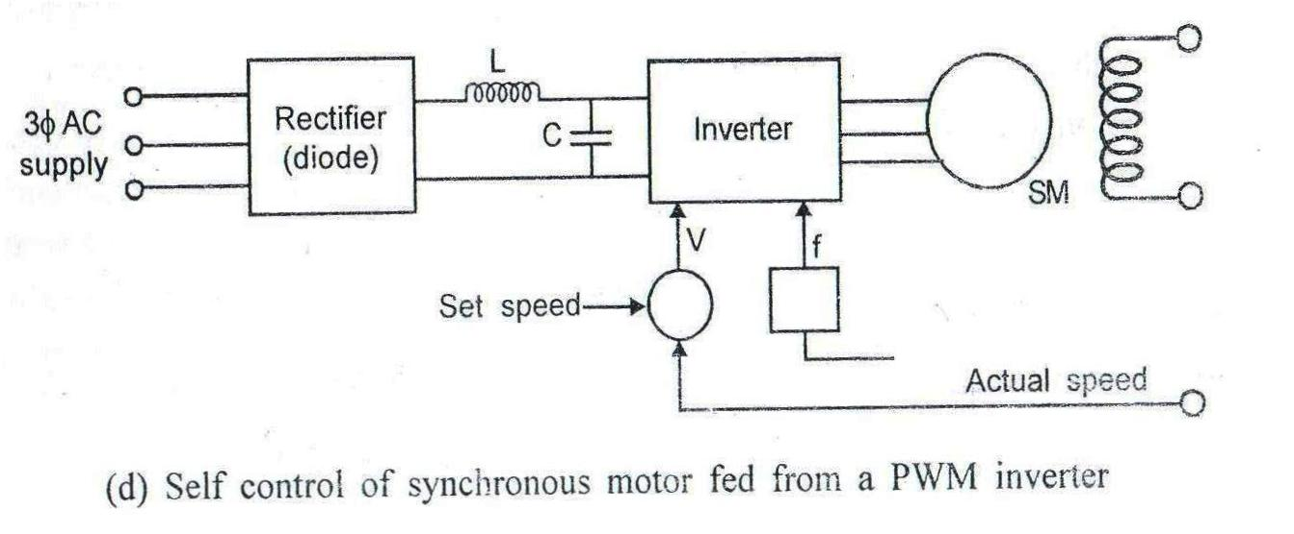
SELF CONTROL OF SM FED FROM PWM INVERTER

Slide 12
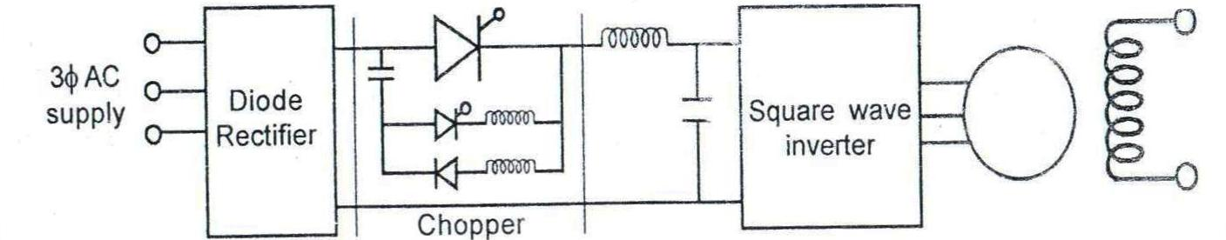
SM FED BY CHOPPER WITH INVERTER
Non sinusoidal output voltage
Stator current has sharp peaks and is rich in harmonic content
Pulsating torque
Additional heating

Slide 13
CURRENT SOURCE INVERTER (CSI) FED SM
The flux and torque of SM can be controlled by stator current control
CSI SM can be operated in leading pf and hence machine voltage can be used for commutation ( load commutation)
Voltage spikes in terminal voltage at the instant of commutation
Voltage spikes limited by damper winding and hence CSI fed SM always provided with damper winding
Four quadrant operation is simple
Speed range - above 10% of base speed for load commutated
- zero t max speed for forced commutation

Slide 14
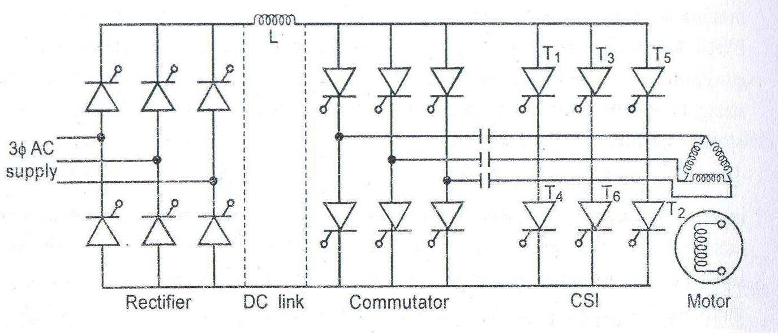
CSI WITH INDIVIDUAL COMMUTATION
Forced commutation circuitry is required only for the low speed( 0 t0 10 %)
Motor operated at UPF
Large inductance in DC link makes source current fed to inverter a constant
Each main thyristor has an auxiliary thyristor for commutation

Slide 15
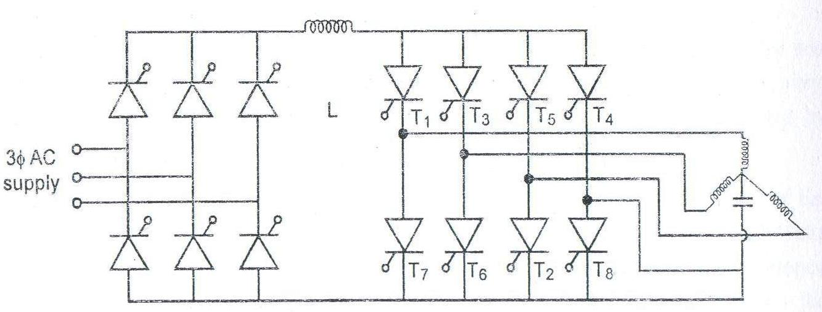
THIRD HARMONIC COMMUTATED ASCSI
T7 and T8 are aux. thyristors and C is the commutation capacitor
At low speed, voltage across the Capacitor is used to commutate the main thyristor
When the machine achieves the speed where load commutation is applicale, the fourth leg is cut off.

Slide 16
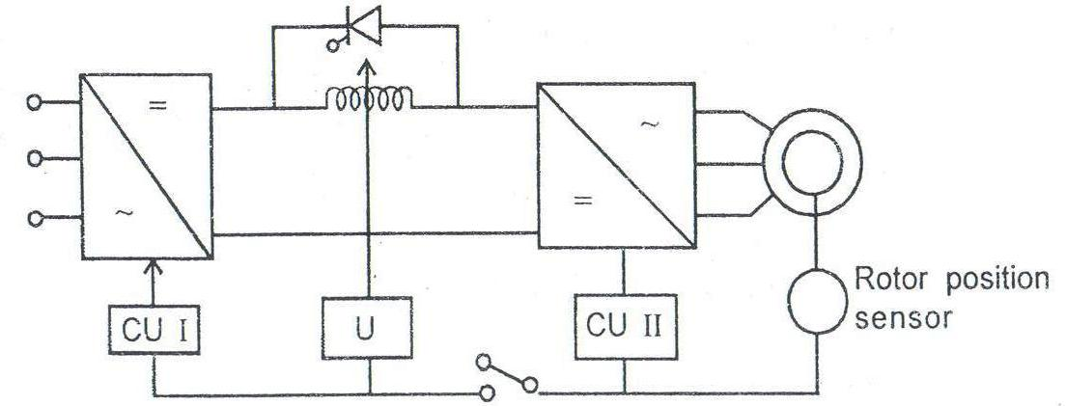
DC LINK CONTROL CURRENT INTERRUPTION
At low speeds the DC link current is interrupted at the instant of commutation
During commutation :
The line side converter operates in inversion mode
The RPS sends control signal to load side converter to block firing pulses to outgoing SCRs and to provide pulses to incoming SCRs
Polarity of DC link voltage changes and hence current decays to zero and is maintained for a time greater than the turn off time of SCR
Again the line side converter is operated in conversion mode and the sequence is repeated.

Slide 17
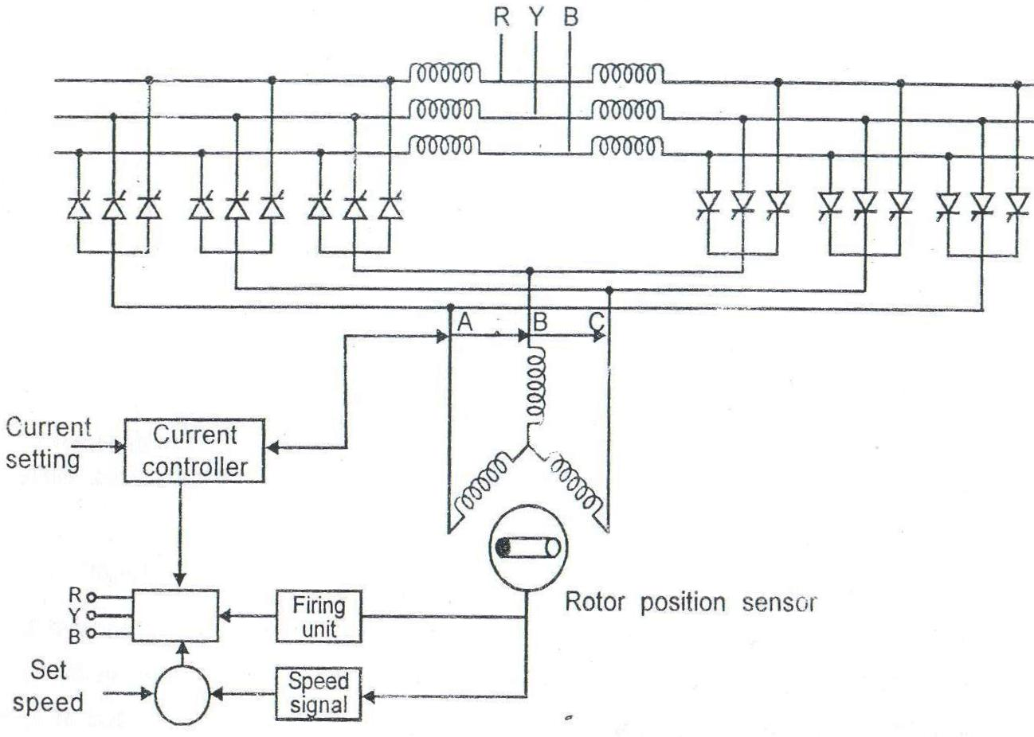
CYCLOCONVERTER FED SM (SELF CONTROL)

Slide 18
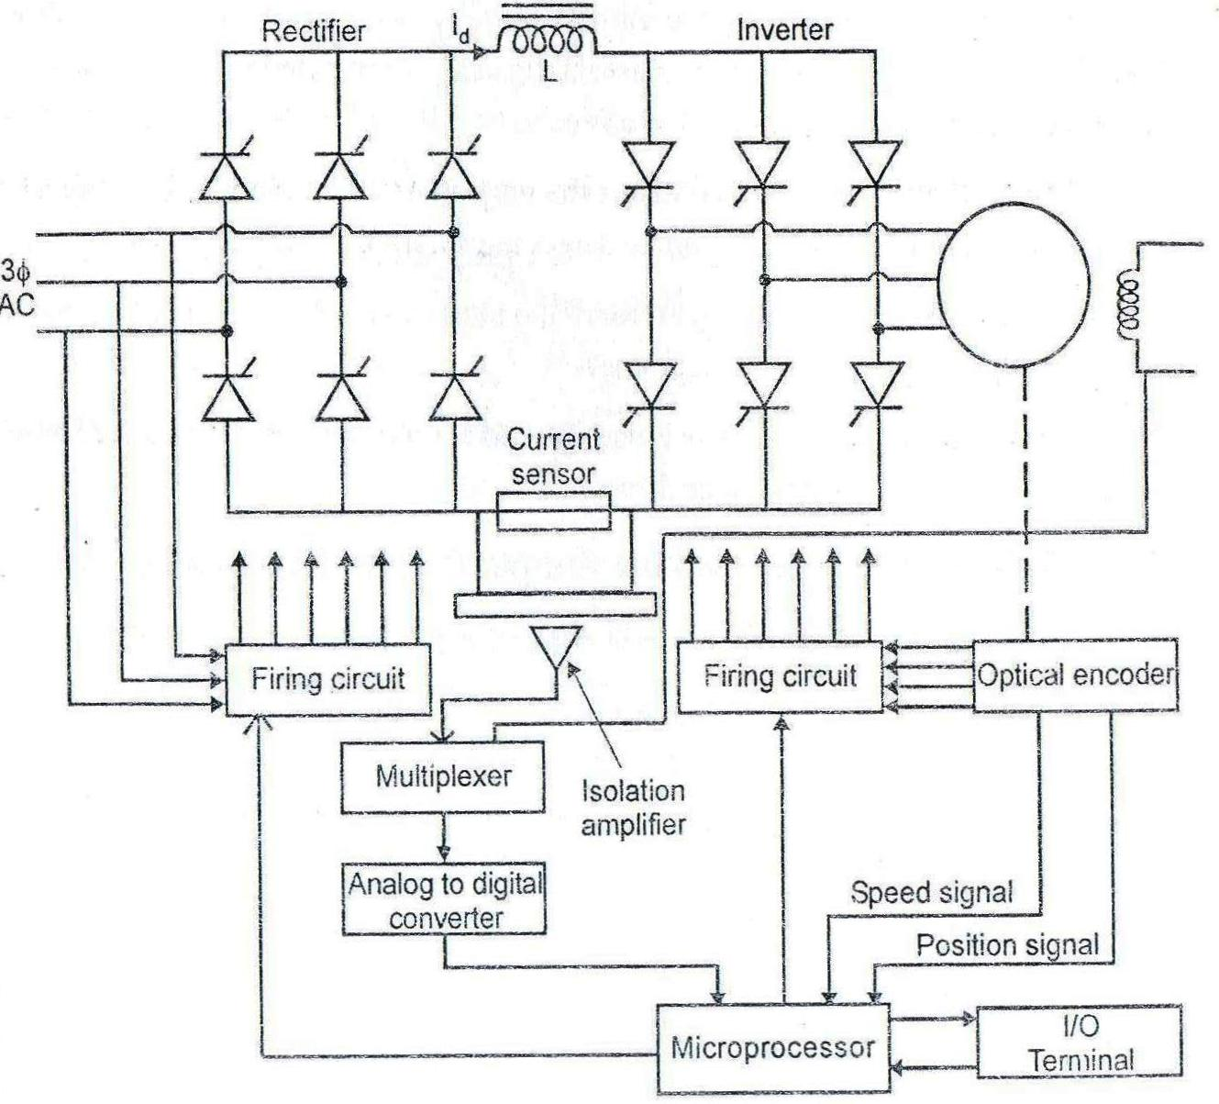
MICROPROCESSOR BASED CONTROL OF SYNCHRONOUS MOTOR

Slide 19
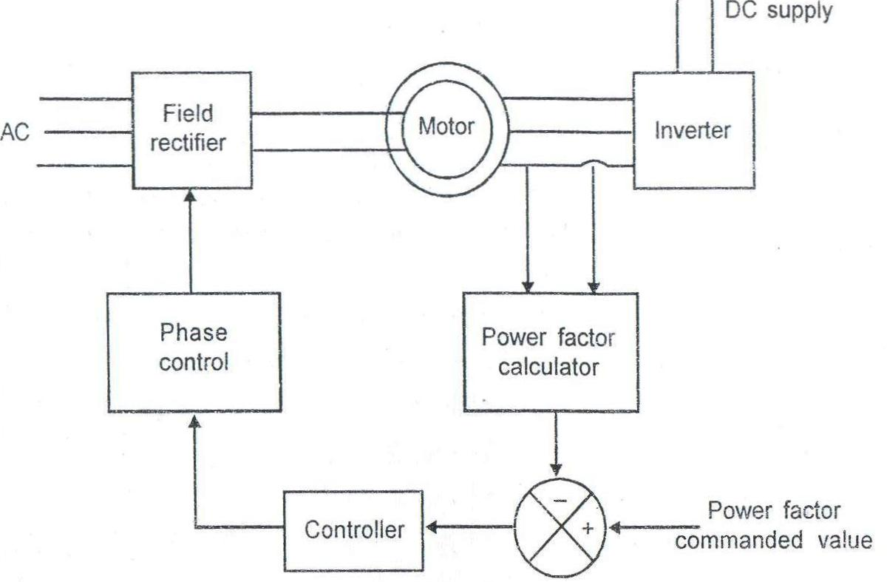
MOTOR POWER FACTOR CONTROL
Motor must have wound field rotor
By varying field current motor power factor can be varied
Power factor calculator receives voltage and current feedback signals and calculates pf of motor.

Slide 20
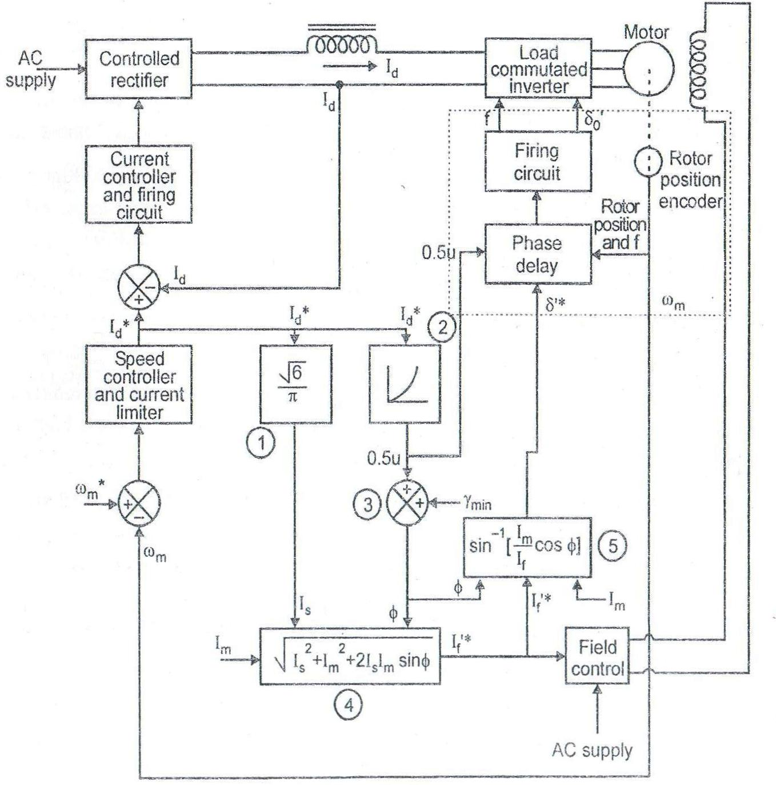
CONSTANT MARGINAL ANGLE CONTROL

Slide 21
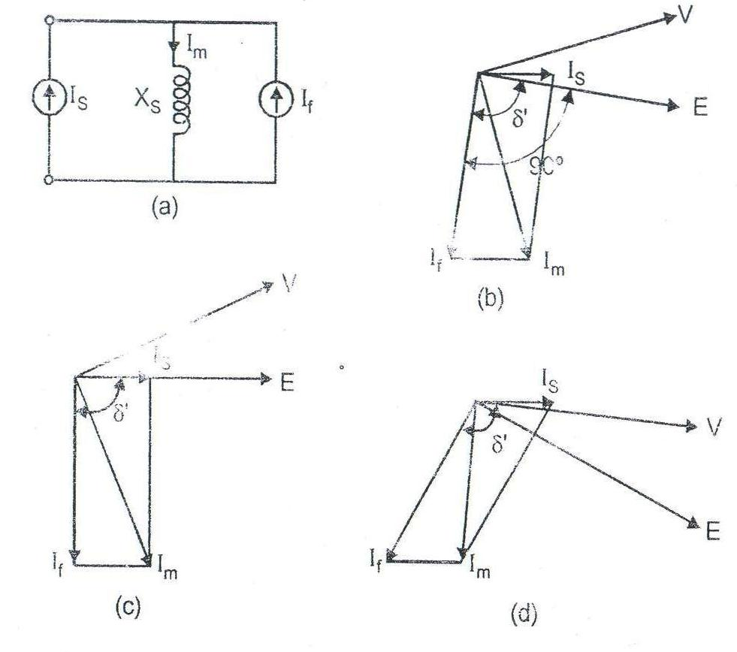
PERMANENT MAGNET SYNCHRONOUS MOTOR DRIVES
EQUIVALENT CIRCUIT AND VECTOR DIAGRAMS:

Slide 22
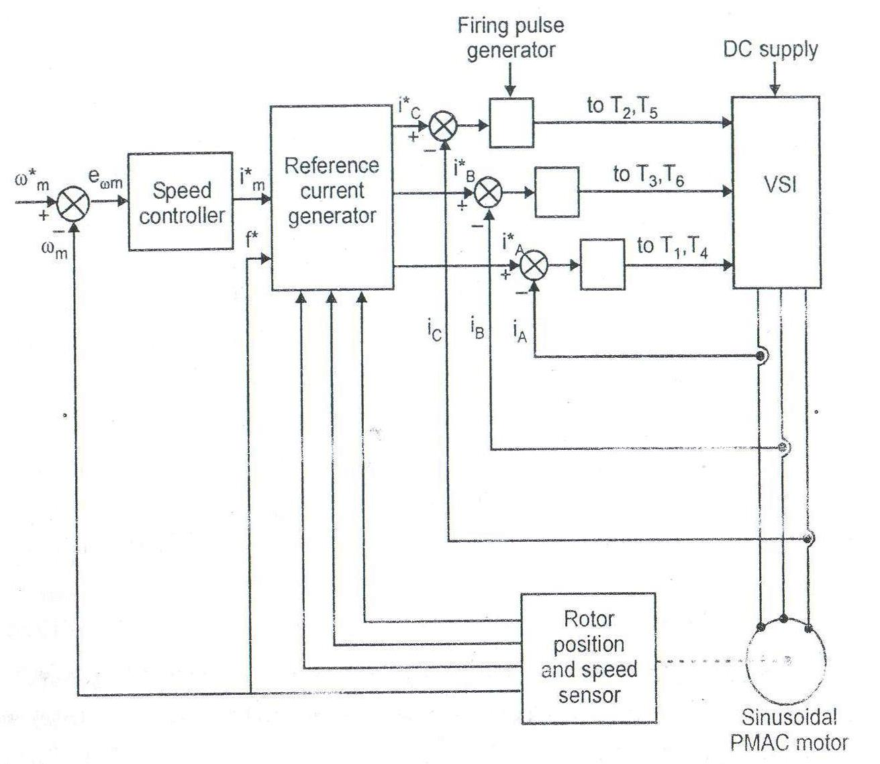
VSI FED SINUSOIDAL PMAC MOTOR DRIVE

Slide 23
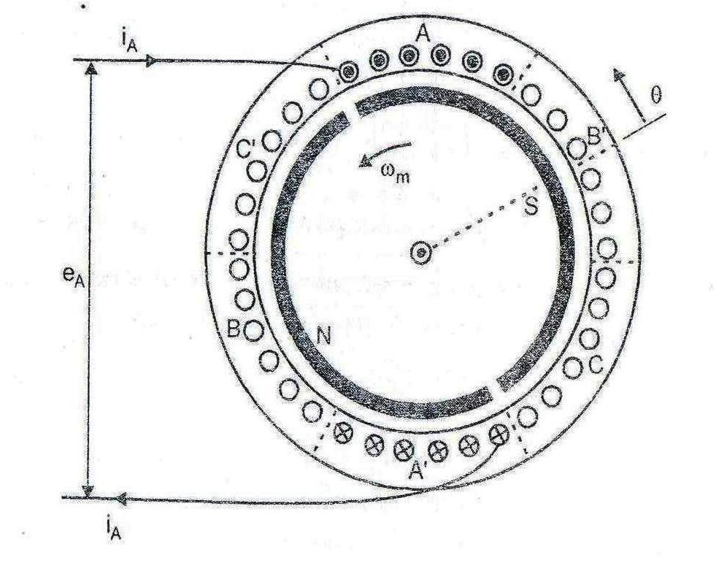
TRAPEZOIDAL PMAC MOTOR DRIVE
Cross sectional view:

Slide 24
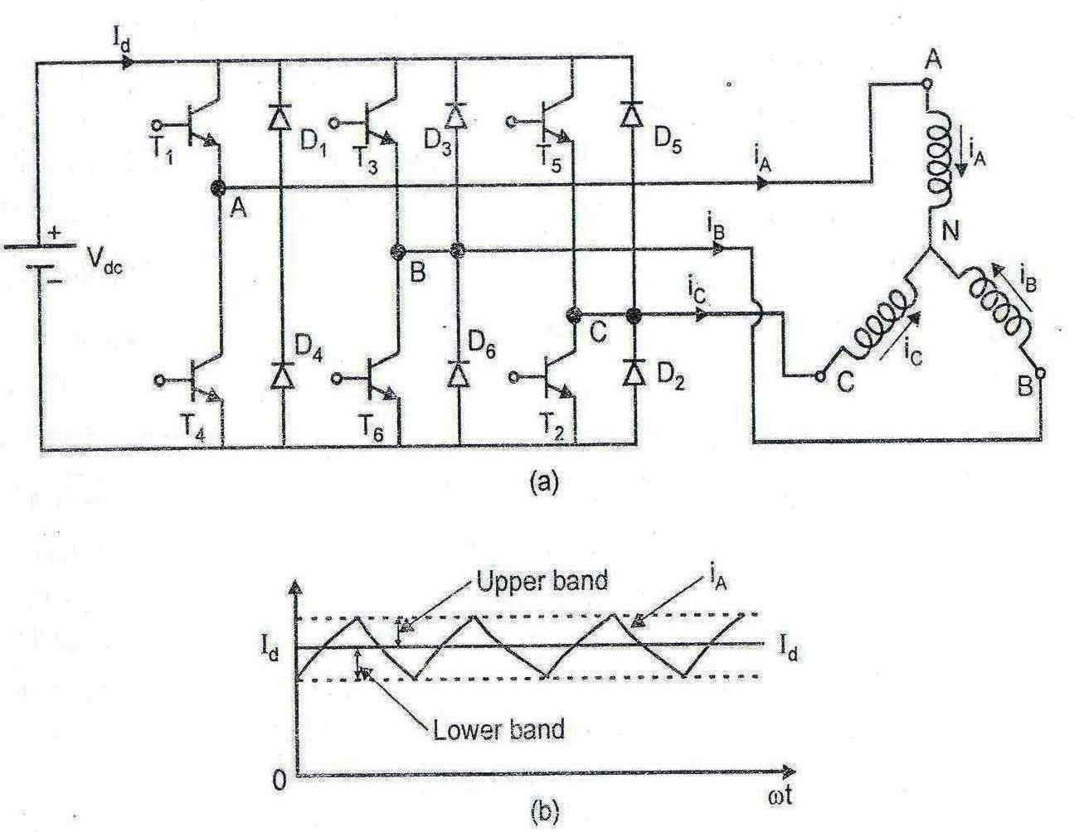
VSI FED TRAPEZOIDAL PMAC MOTOR DRIVE

Slide 25
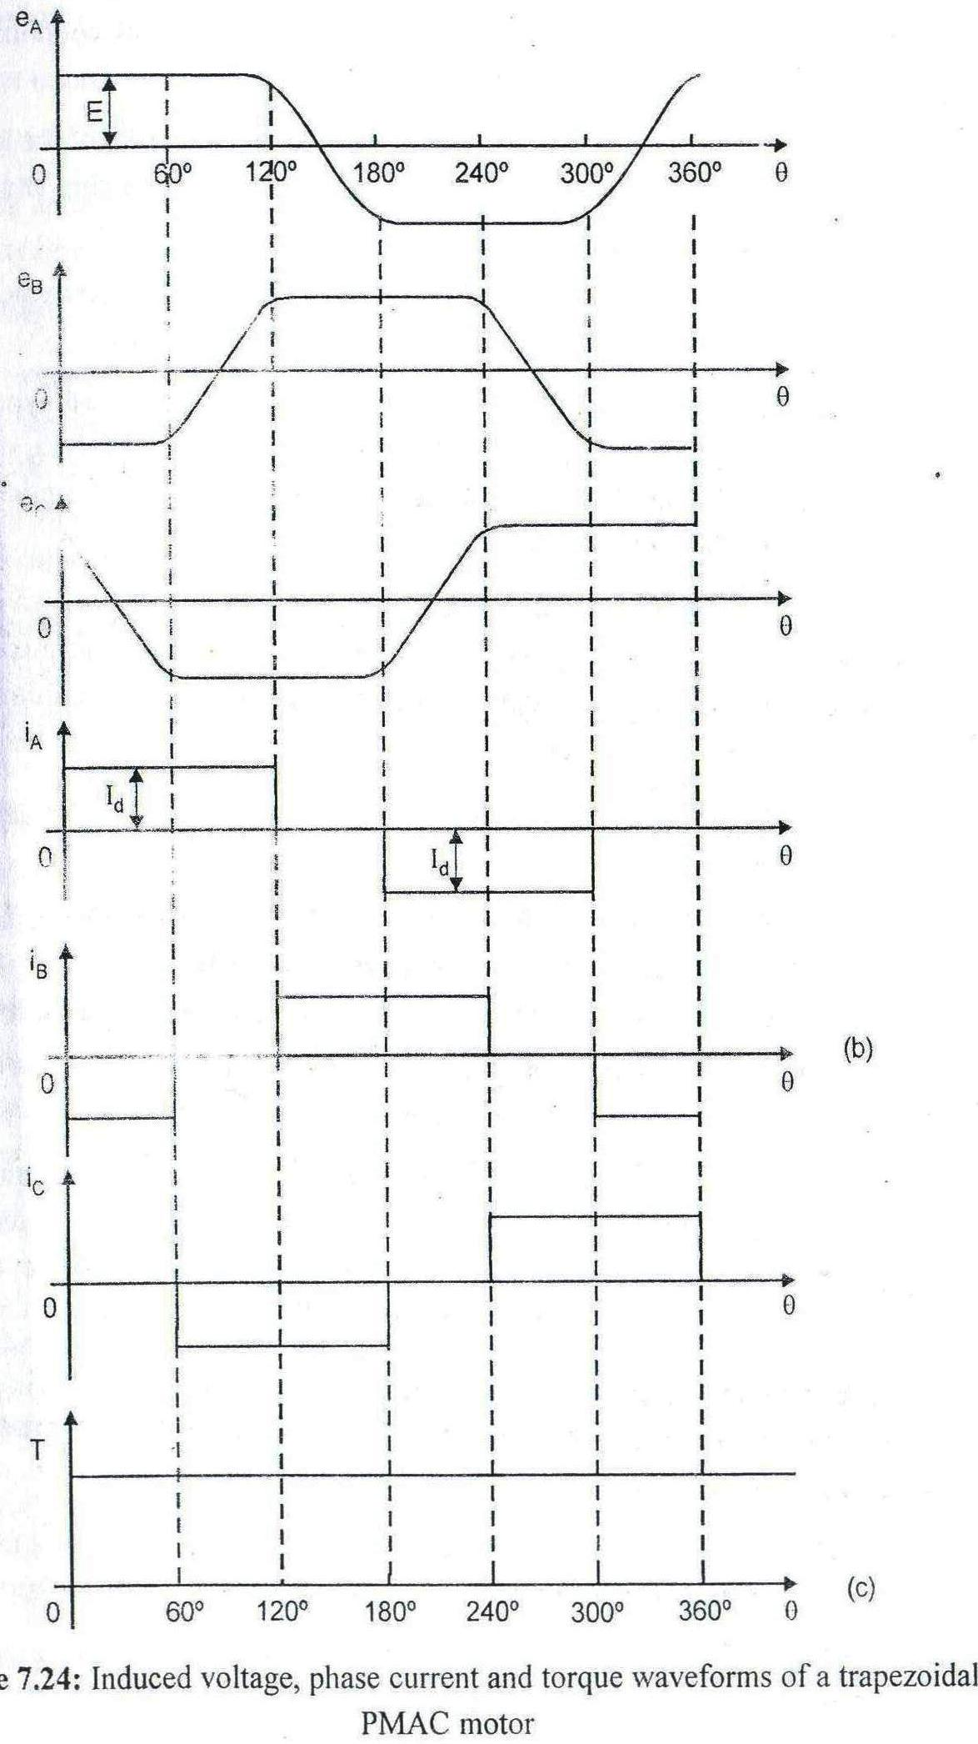
VSI FED TRAPEZOIDAL PMAC MOTOR DRIVE (Cont..)

Slide 26
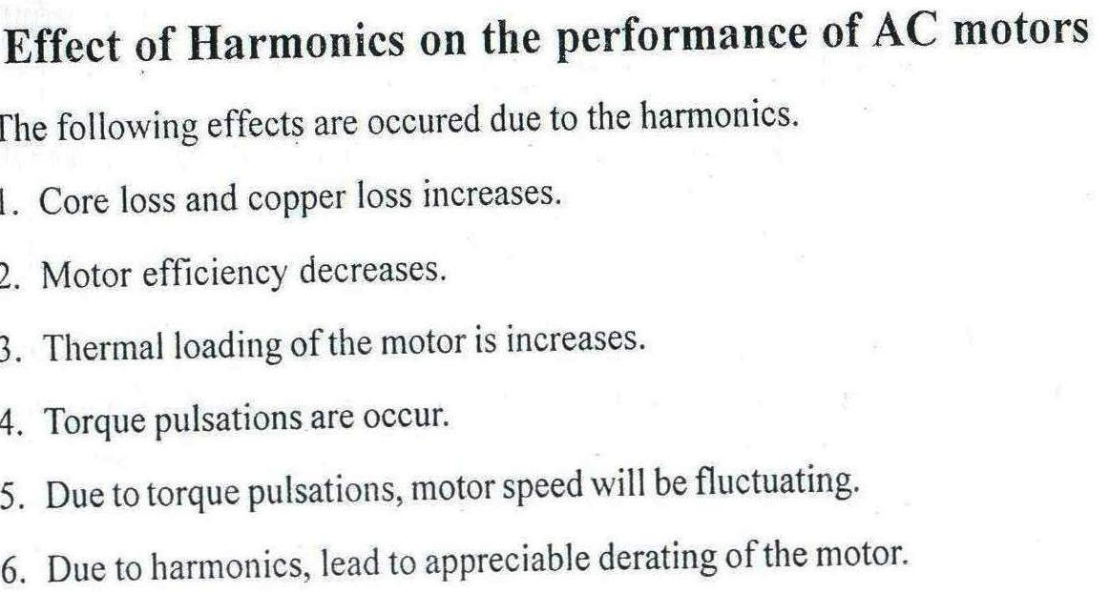

Slide 27
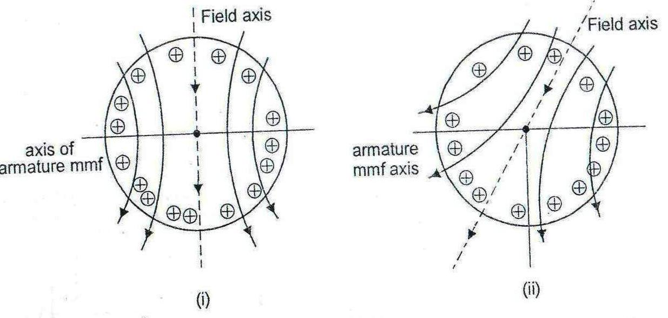
VECTOR CONTROL OF SYNCHRONOUS MOTOR

Slide 28
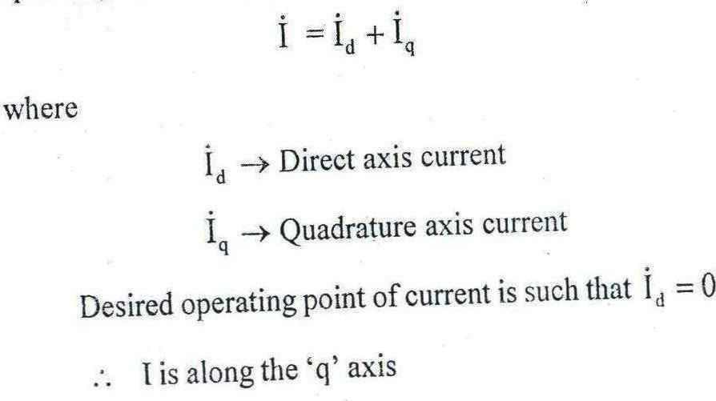
VECTOR CONTROL OF SYNCHRONOUS MOTOR (Cont.)

Slide 29
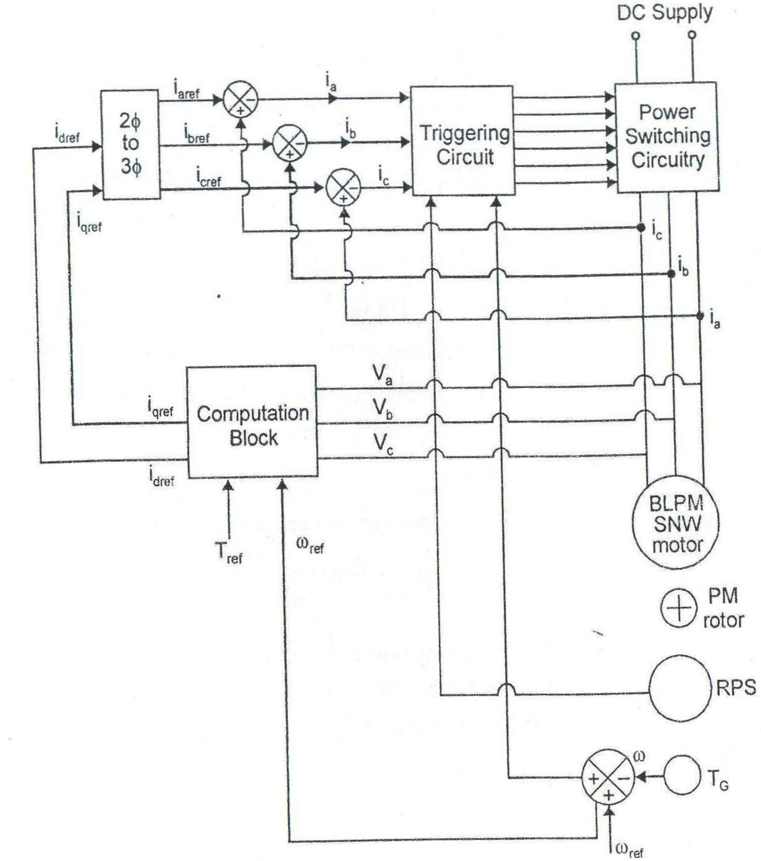
BLOCK DIAGRAM OF VECTOR CONTROL OF BLPM SNW MOTOR (Cont.)

