Slide 1
UNIT-5
SPECIAL MACHINE DRIVES
BLDC MOTOR DRIVE
STEPPER MOTOR DRIVE
SWITCHED RELUTANCE MOTOR DRIVE

Slide 2
STEPPER MOTOR

Slide 3
STEP ANGLE

Slide 4
RESOLUTION & STEPPING ERROR

Slide 5
POSITION ACCURACY

Slide 6
MOTOR SPEED

Slide 10
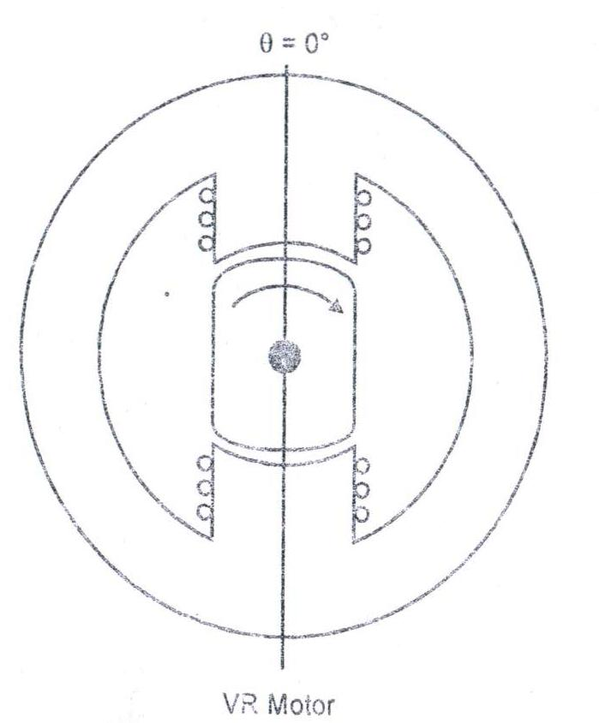
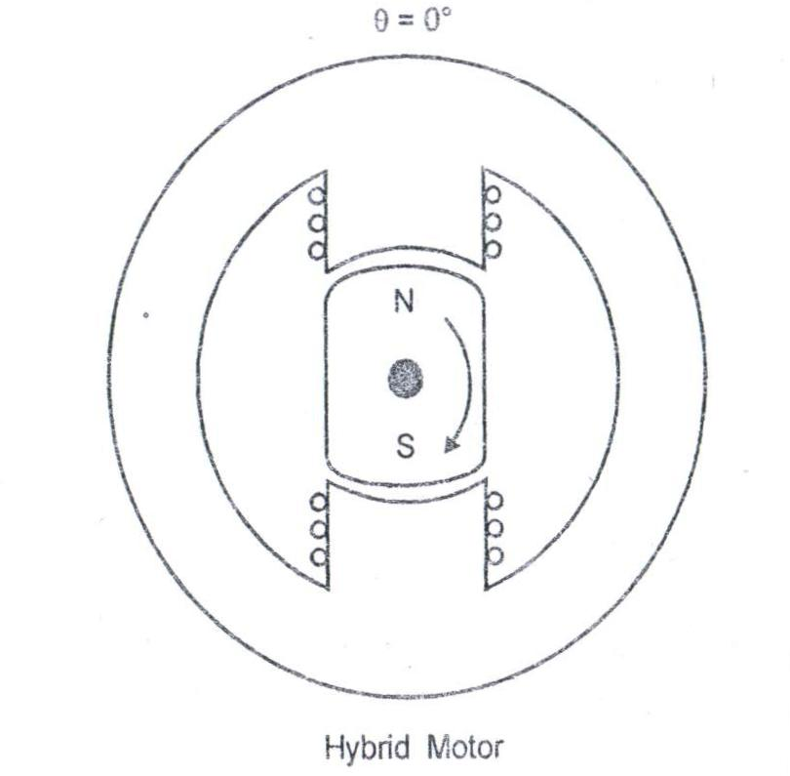
CLASSIFICATION OF STEPPER MOTOR
PM STEPPER MOTOR
VR STEPPER MOTOR
HYBRID MOTOR
TYPES OF STEPPER MOTOR

Slide 11
VARIABLE RELUCTANCE MOTOR
PERMANENT MAGNET STEPPER MOTOR
HYBRID MOTOR
ONLY THE STATOR HAS THE WINDINGS
THE ROTOR HAS FERROMAGNETIC POLE
THE ROTOR HAS SALIENT POLES
THE ROTOR HAS THE PERMANENT MAGNET
THE ROTOR HAS PROJECTIVE POLES
THIS MOTOR HAVING THE FEATURES OF VR STEPPER MOTOR &PM STEPPER MOTOR
ONLY THE STATOR HAS THE WINDINGS
THERE IS NO WINDING IN ROTOR
THERE IS NO WINDING IN ROTOR
THE ROTOR HAS PERMANENT MAGNET& SALIENT POLE
THERE NO WINDINGS IN ROTOR

Slide 12
OPERATION MODES OF VR STEPPER MOTOR

Slide 13
1-PHASE ON OPERATION

Slide 14
SWITCHING SEQUENCES

Slide 15
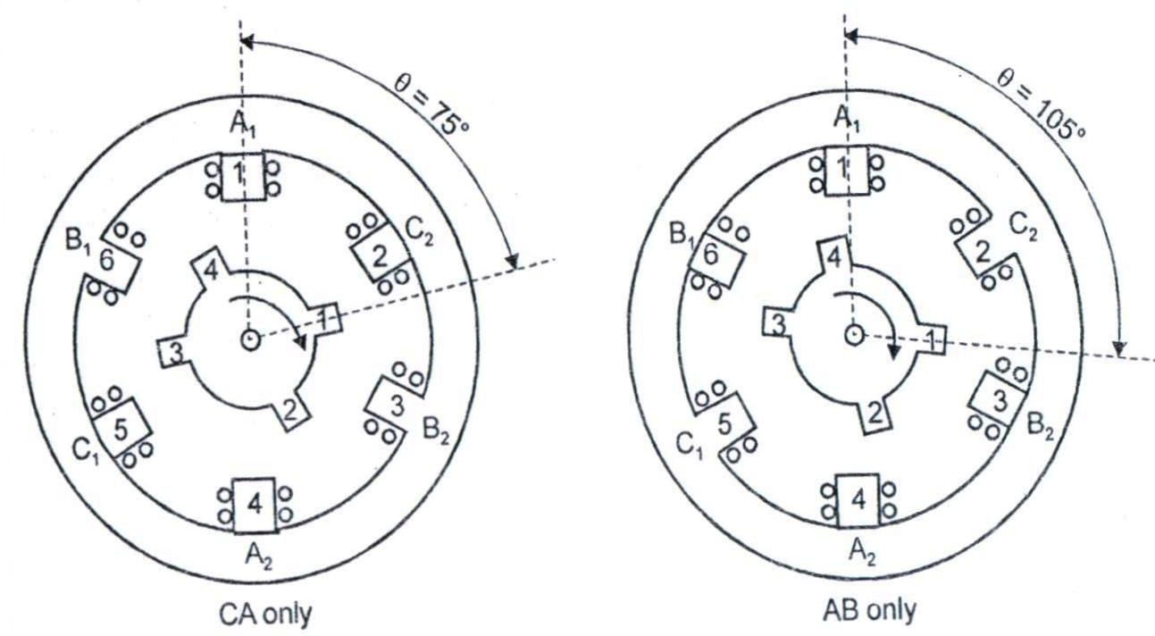
2-PHASE ON OPERATION

Slide 16
SWITCHING SEQUENCES

Slide 17
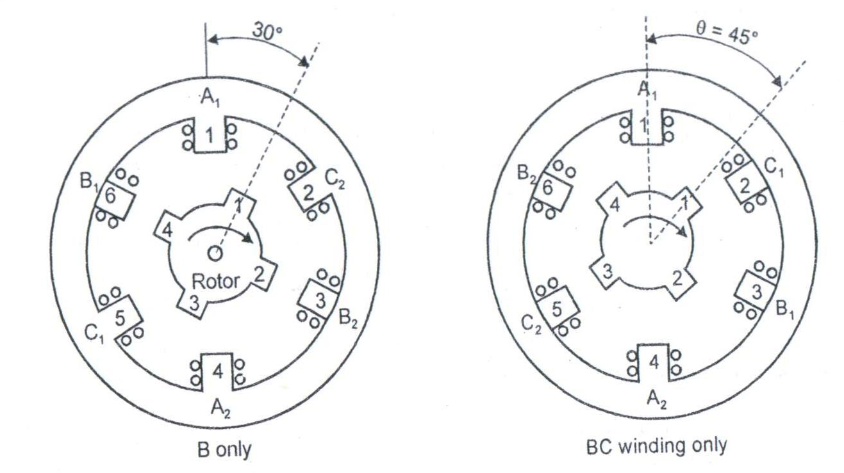
ALTERNATE 1-PHASE & 2-PHASE ON

Slide 18
SWITCHING SEQUENCES

Slide 19
4.MICRO STEPPING (MULTISTACK)
The micro stepping process only available in the multi stack variable reluctance motor

Slide 20
4.MICRO STEPPING

Slide 22
MODES OF OPERATION OF PERMANENT MAGNET STEPPER MOTOR

Slide 23
SWITCHING SEQUENCES

Slide 24
2-PHASE ON MODE

Slide 25
SWITCHING SEQUENCES

Slide 26
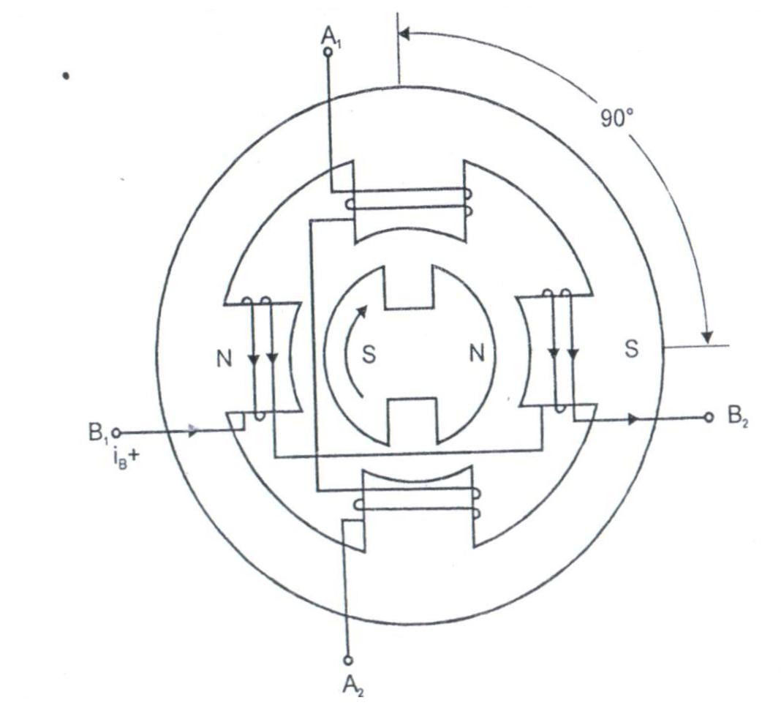
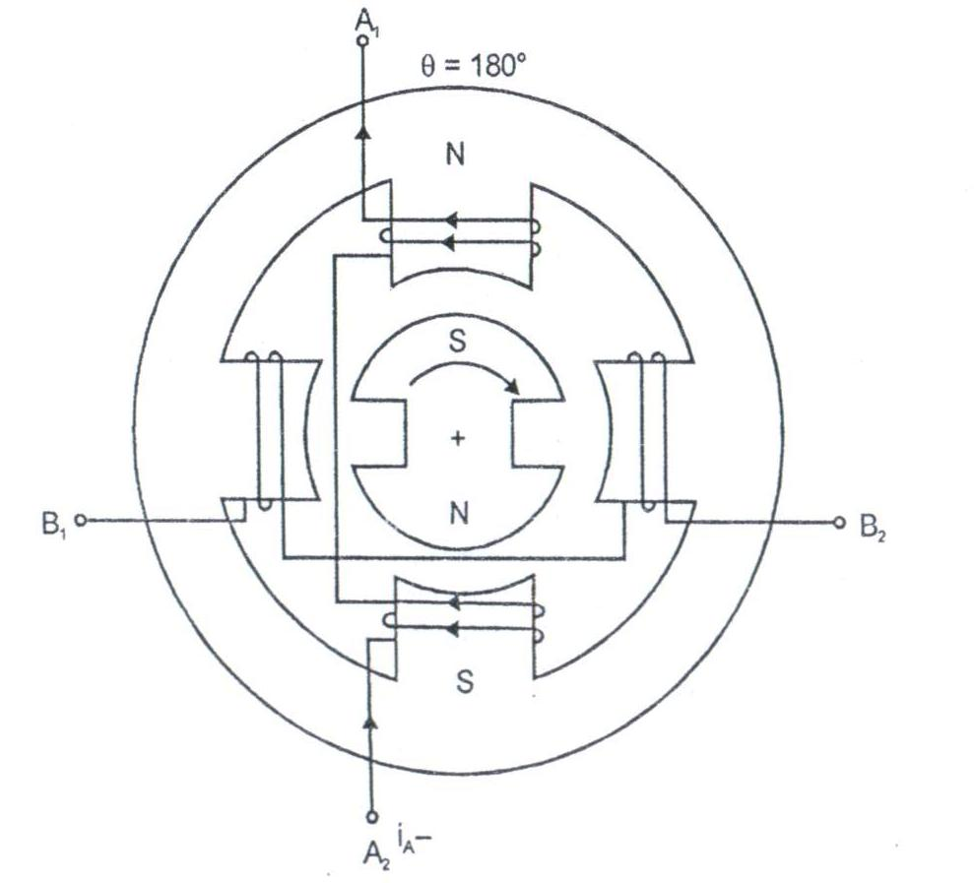
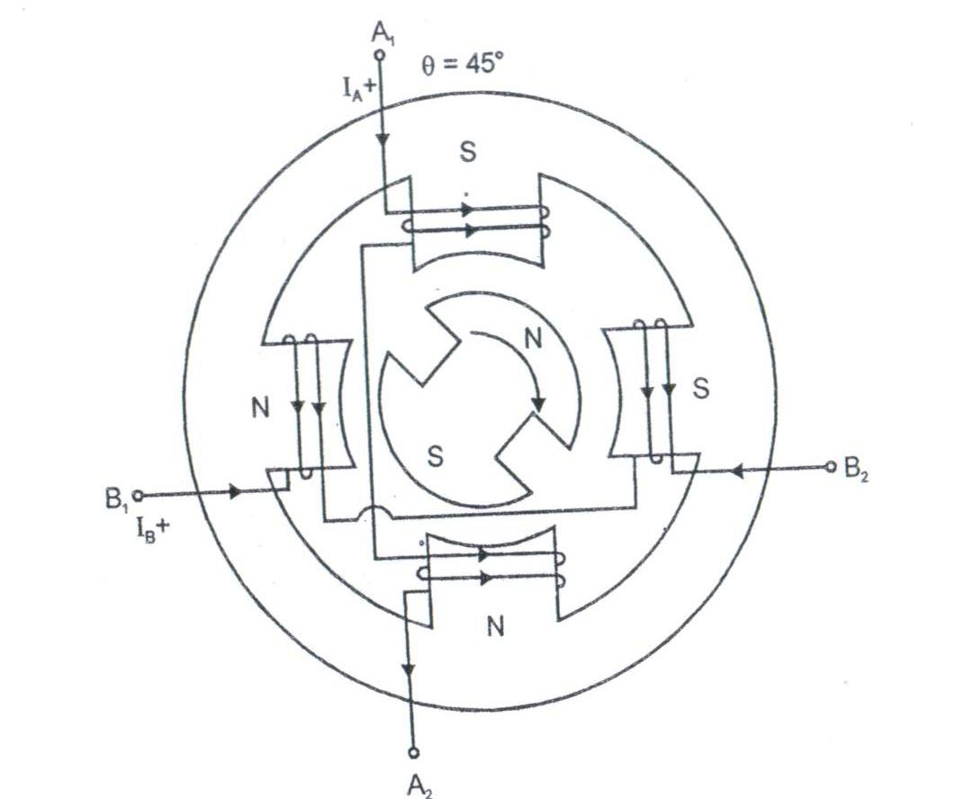
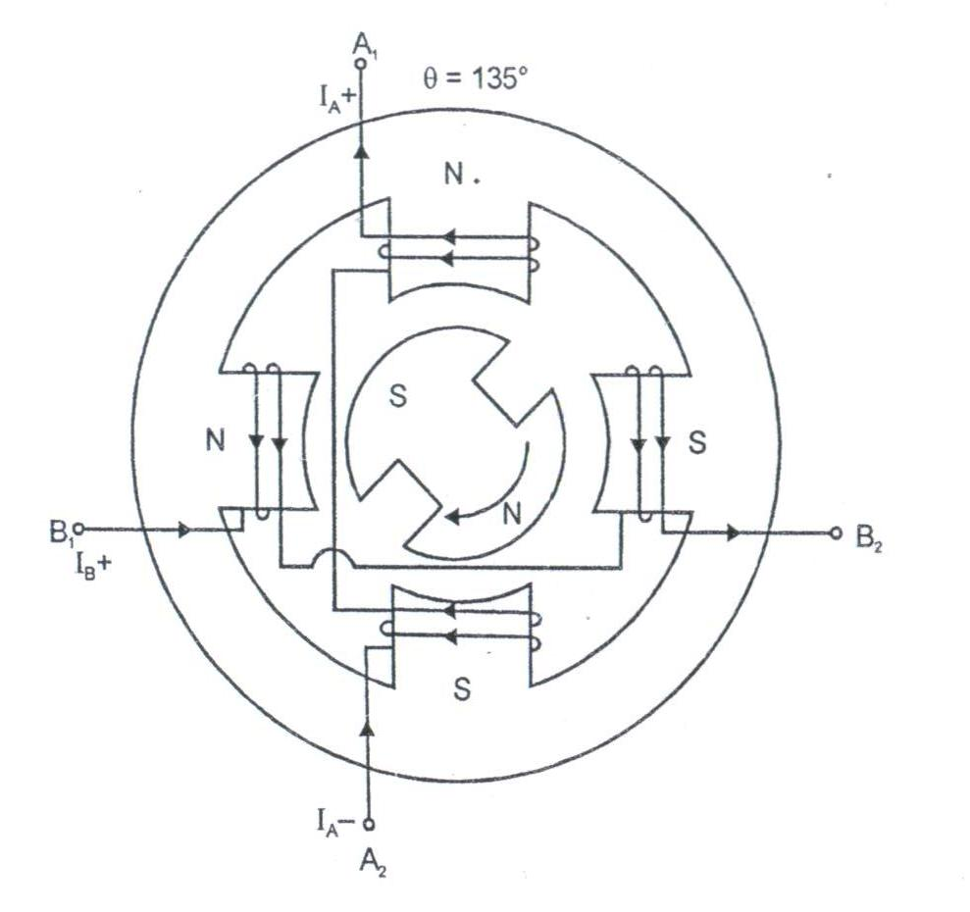
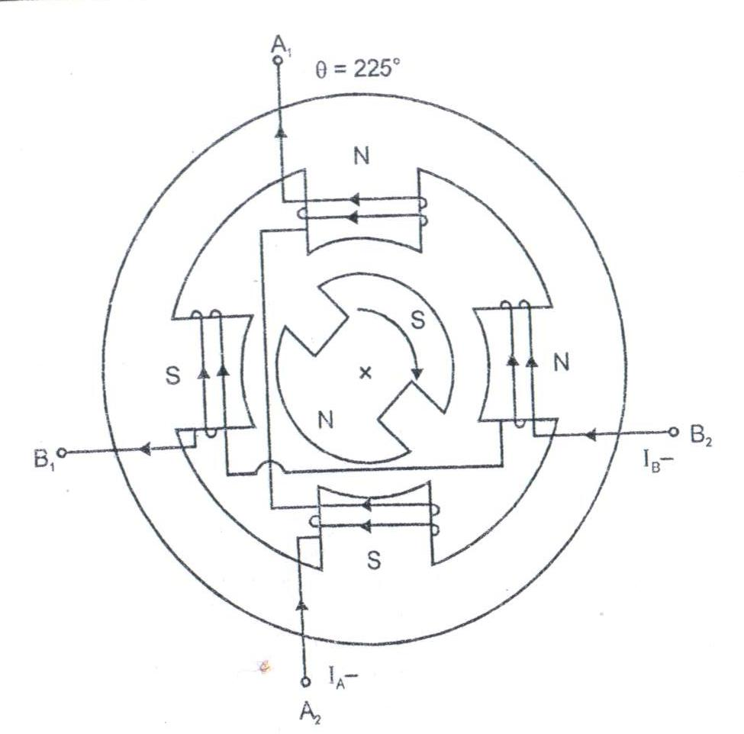
ALTERNATE 1-PHASE & 2-PHASE ON

Slide 27
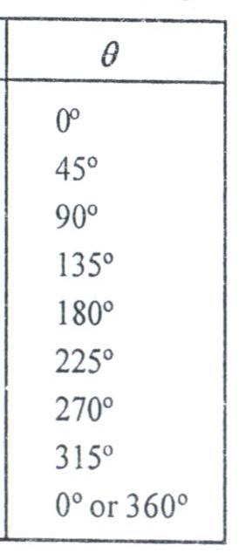
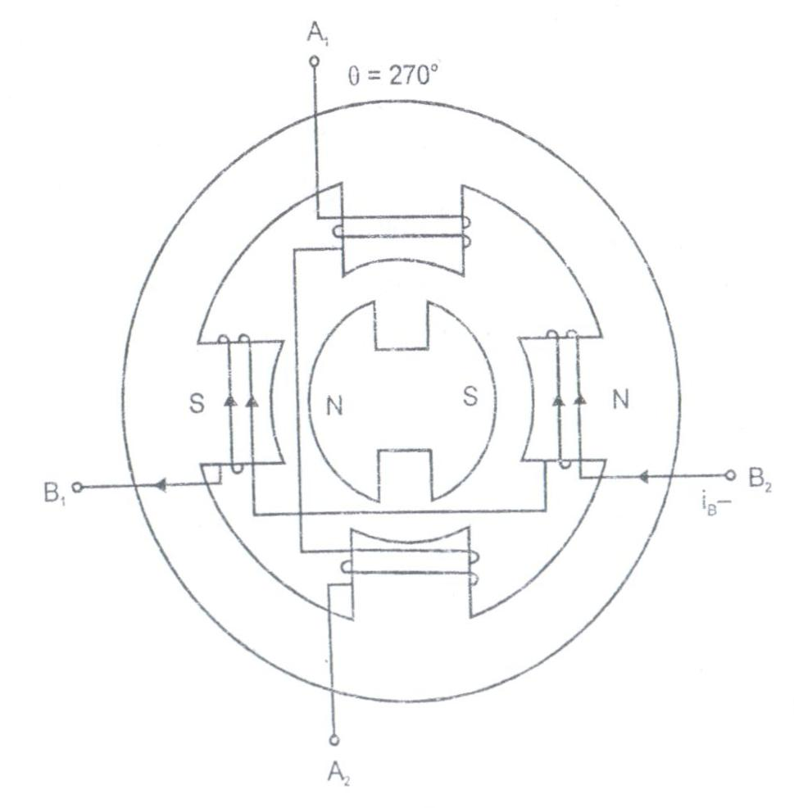
SWITCHING SEQUENCES

Slide 29
HYBRID MOTOR
The hybrid motor is combination of the VR stepper motor & PM stepper motor

Slide 30
OPERATION

Slide 35
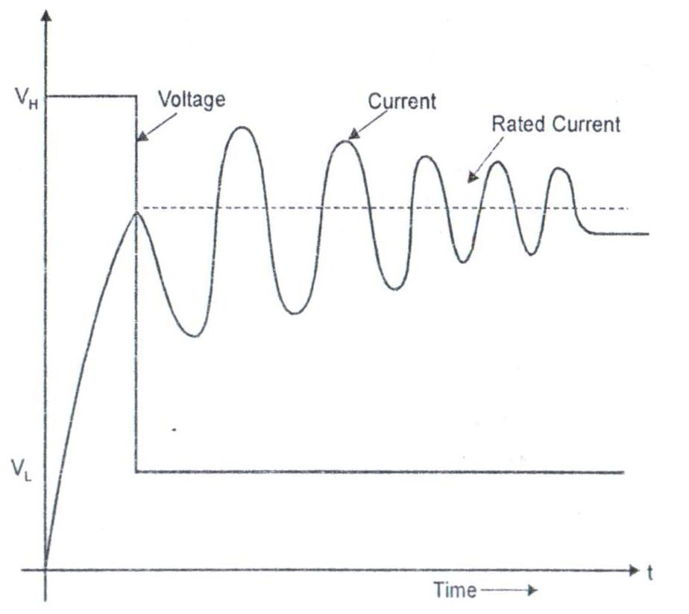
DUAL VOLTAGE DRIVE
CHARACTERISTICS OF DUAL VOLTAGE DRIVE

Slide 36
DUAL VOLTAGE DRIVE FOR 2-PHASE OPERATION MODE IN 4 PHASE MOTOR

Slide 37
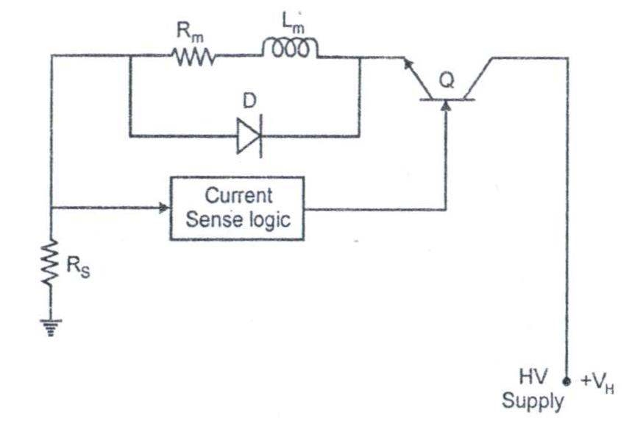

Slide 38
CHOPPER DRIVE CHARTERISTICS

Slide 39
BIPOLAR DRIVES FOR STEPPER MOTOR
BASIC BIPOLAR DRIVES
BIPOLAR CHOPPER DRIVES
UNI POLAR POWER SUPPLY USED
IT CONSISTS 4 DIOES 4 TRANSISTERS & 2 POWER SUPPLY
THERE ARE 2 WINDINGS
BIPOLAR POWER SUPPLY USED
THERE ARE 2 WINDINGS
UNI POLAR POWER SUPPLY USED
THERE IS NO WINDINGS
IT CONSISTS 2 DIOES 2 TRANSISTERS &2 POWER SUPPLY
IT CONSISTS 4 DIOES ,4 TRANSISTERS & 2 POWER SUPPLY
BIPOLAR L/R DRIVES

Slide 40
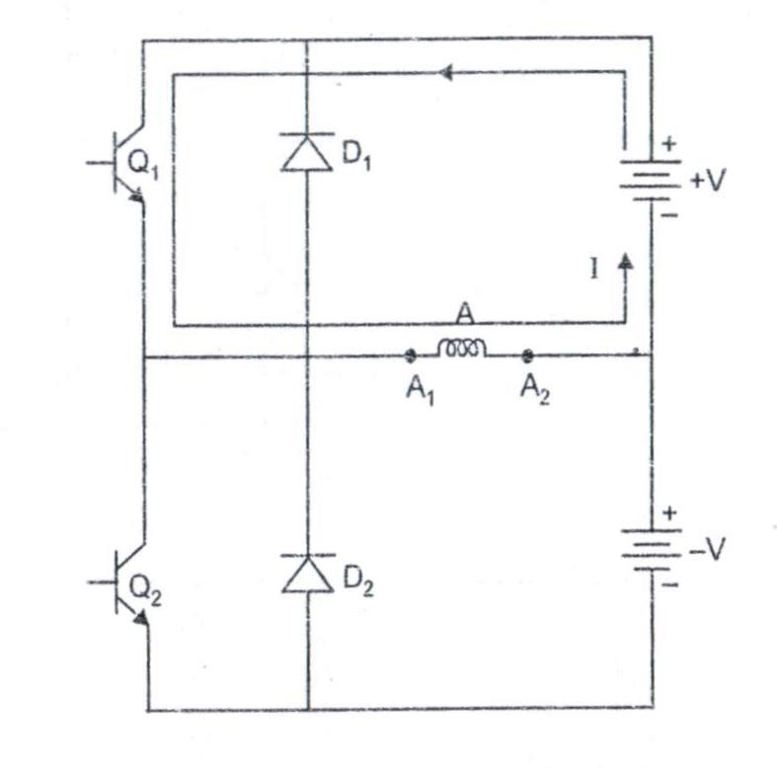
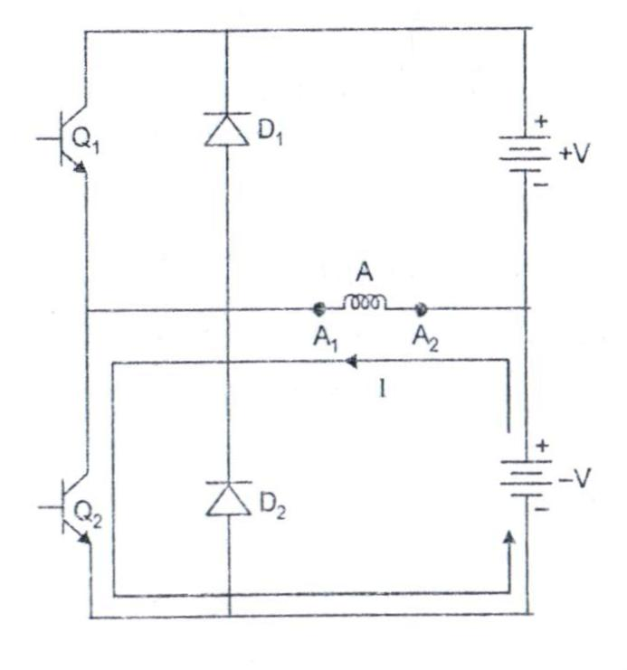
BASIC BIPOLAR DEVICES
V-SOURCE1 ACTIVE
NORMAL POSITION V-SOURCE1 ACTIVE

Slide 41
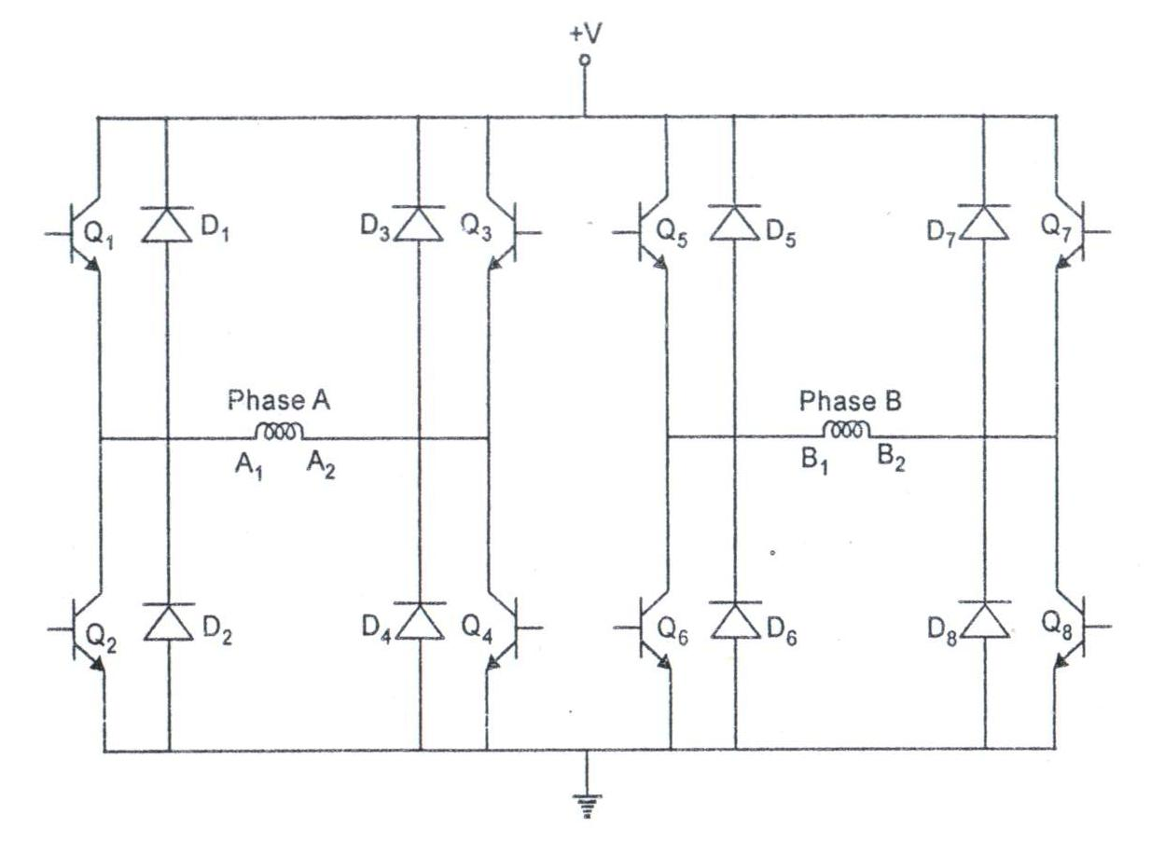
BASIC BIPOLAR DEVICES FOR 2 PHASE ON MODE

Slide 42
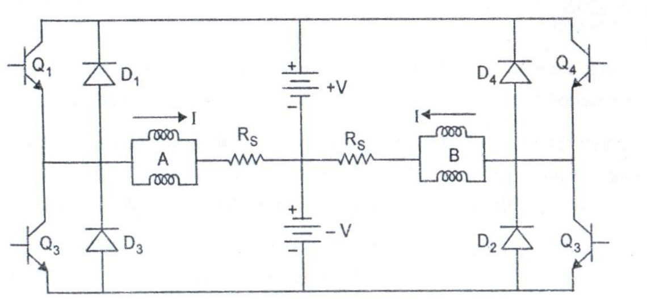
BIPOLAR L/R DRIVES
BIPOLAR L/R DRIVES WITH 2 VOLTAGE SOURCE

Slide 43
BIPOLAR L/R DRIVES WITH SINGLE VOLTAGE SOURCE

Slide 44
BIPOLAR CHOPPER DRIVES

Slide 45
COMPARISION BETWEEN BIPOLAR & UNIPOLAR DRIVES

Slide 47
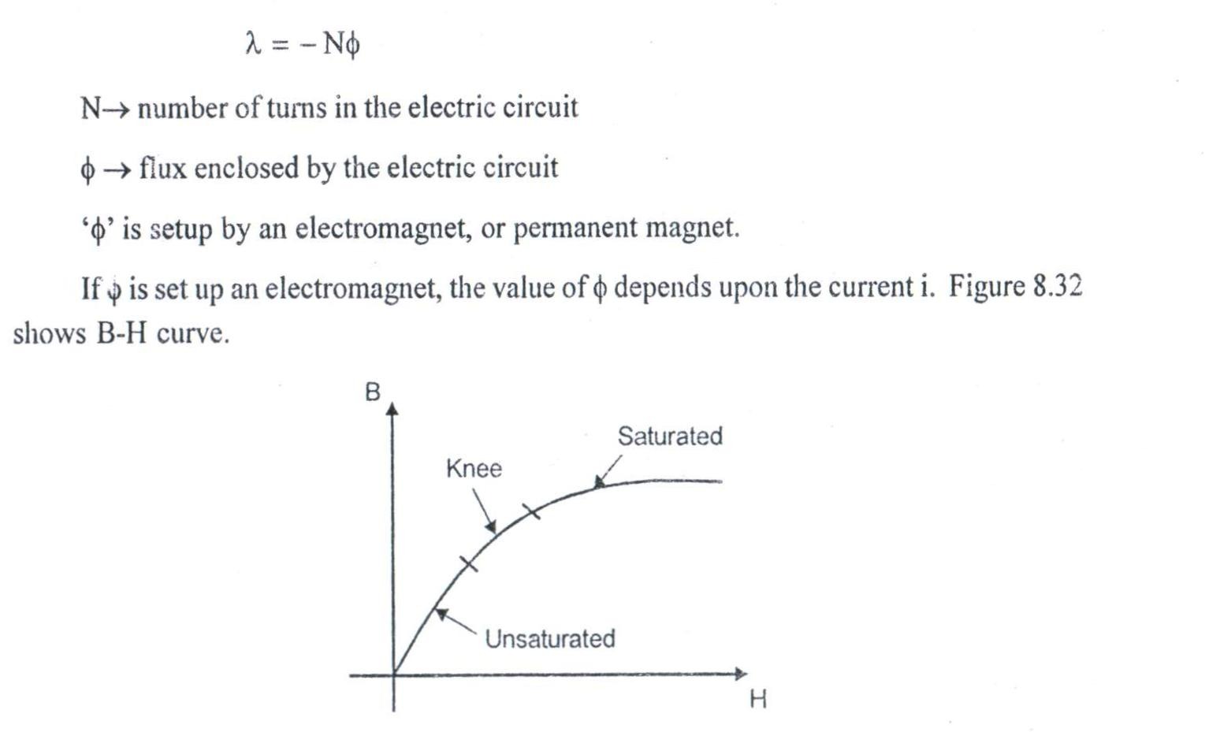
Faraday’s law of electromagnetic induction
B-H CURVE

Slide 48
FLUX LINKAGE

Slide 50
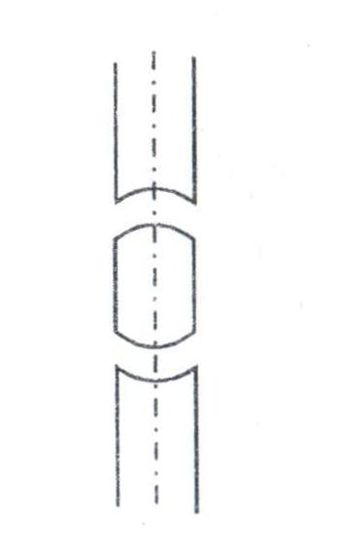
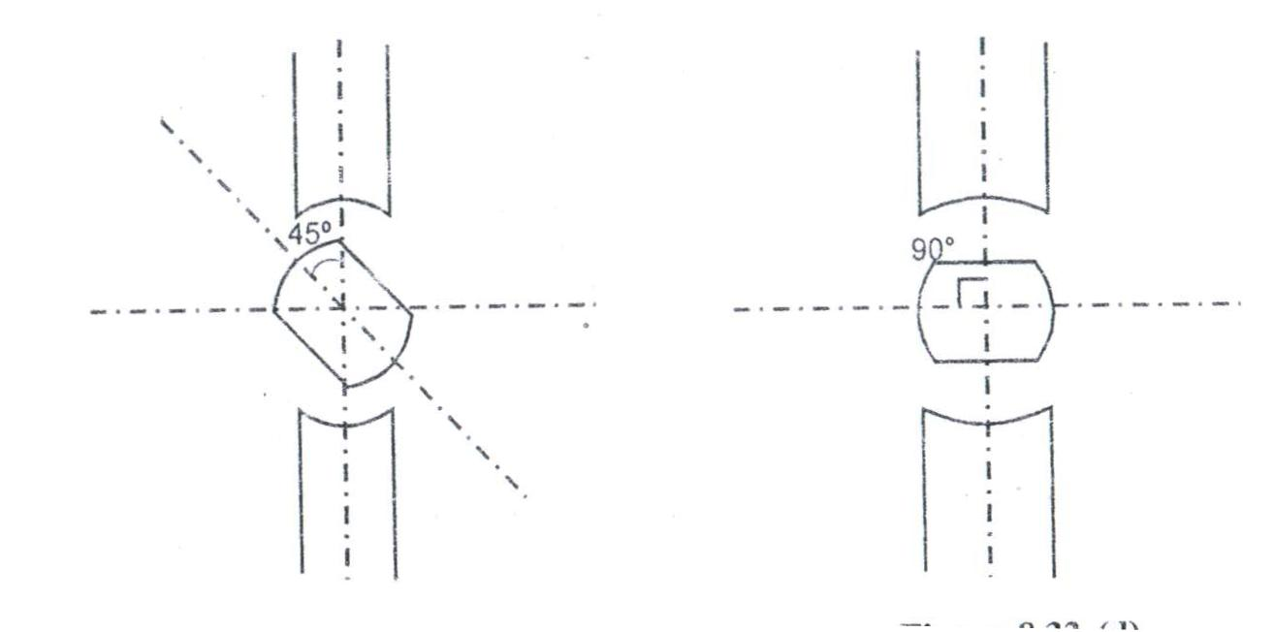
CASE 1:Ө=0°
CASE 1:Ө=45°
CASE 3:Ө=90°
AIRGAP IS SMALL
RELUTANCE IS MINIMUM
L IS MAXIMUM (LMAX)
AIRGAP IS SMALL
RELUTANCE IS INCREASED
L IS DECREASED
AIRGAP IS LARGE
RELUTANCE IS MAXIMUM
L IS MINIMUM

Slide 51
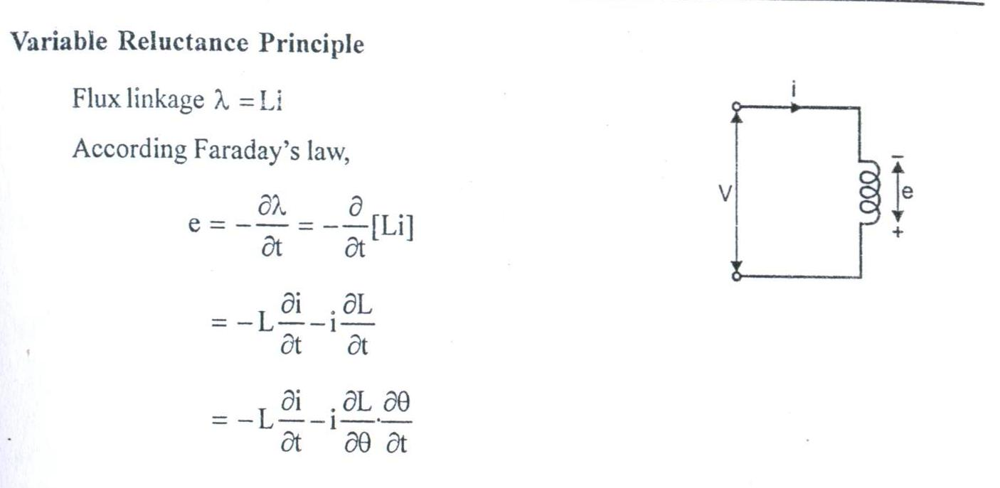
INDUCTANCE PROPERTY OF SRM

Slide 54
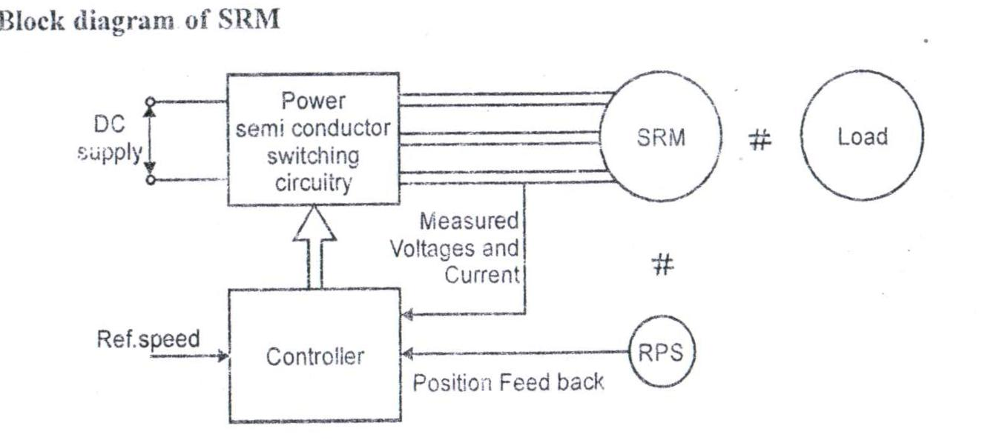

Slide 55
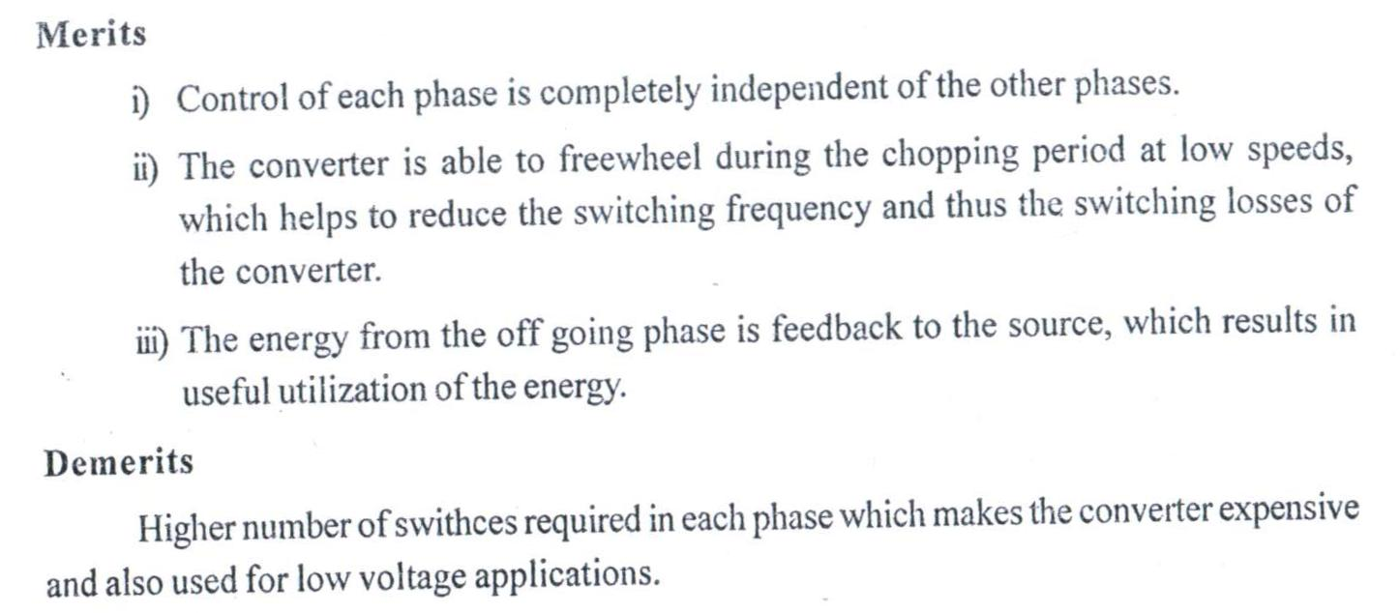
DRIVES FOR SRM

Slide 56
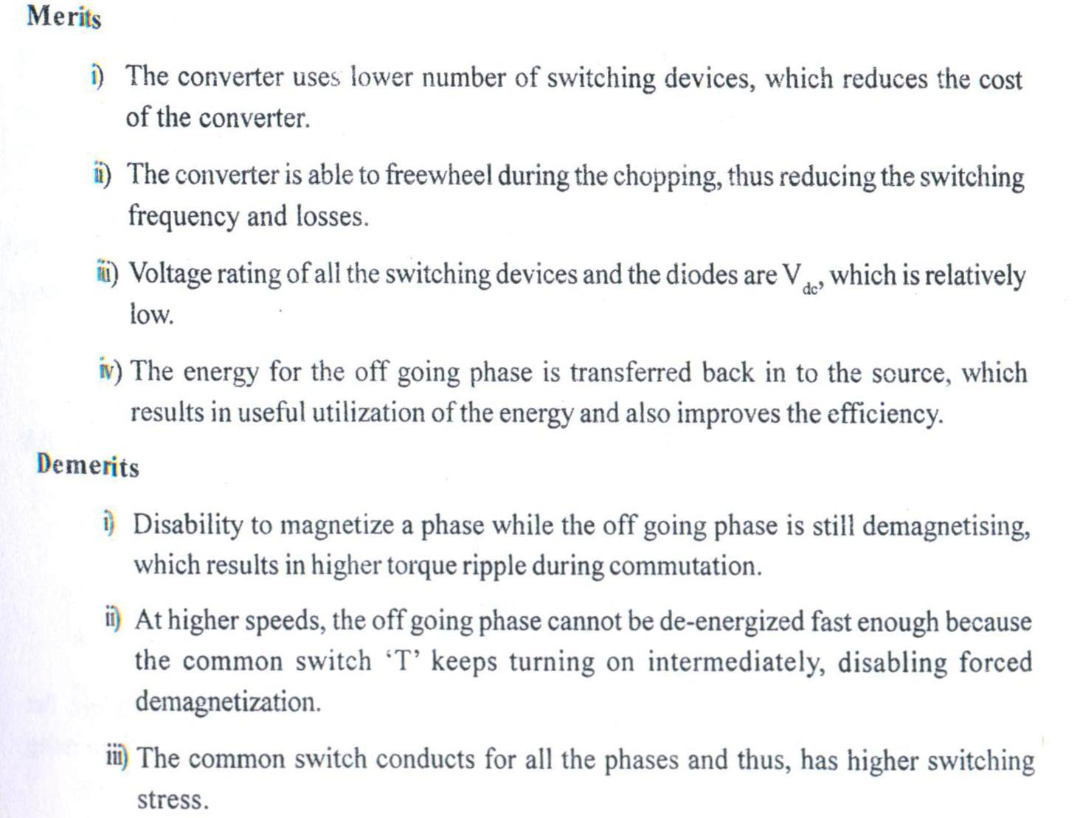

Slide 57
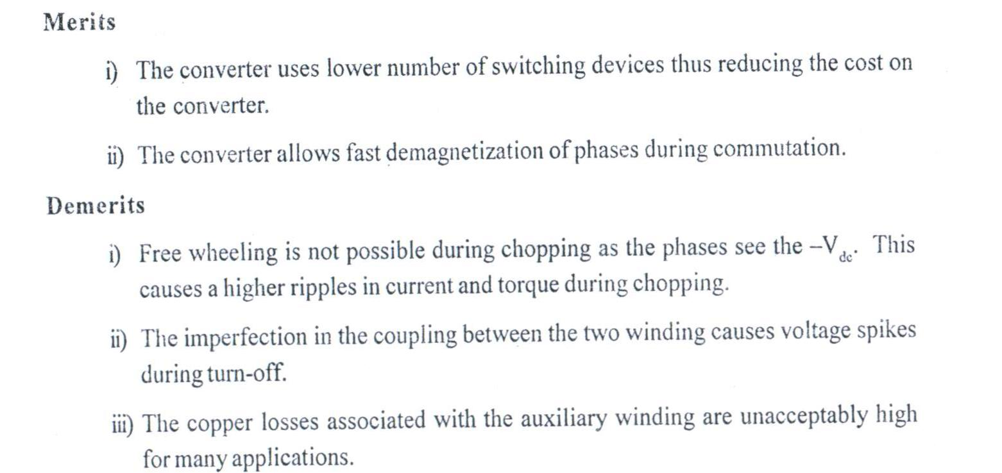

Slide 58
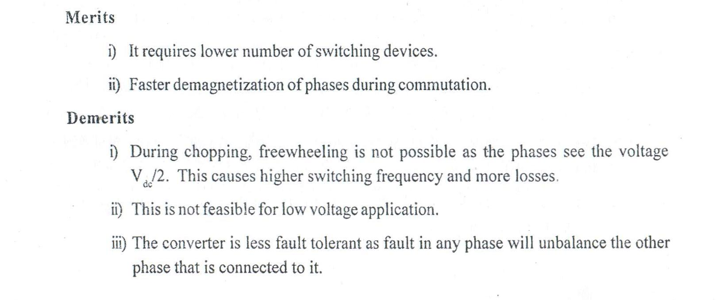

Slide 59
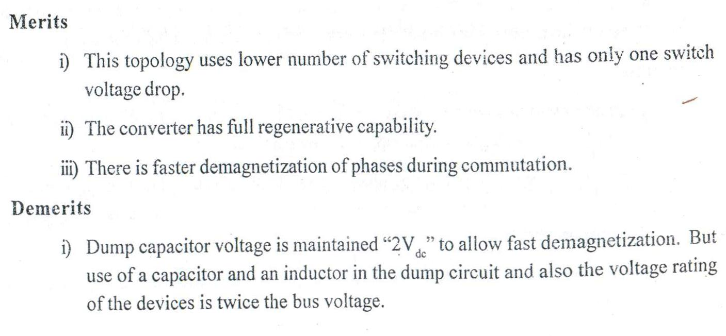

Slide 62
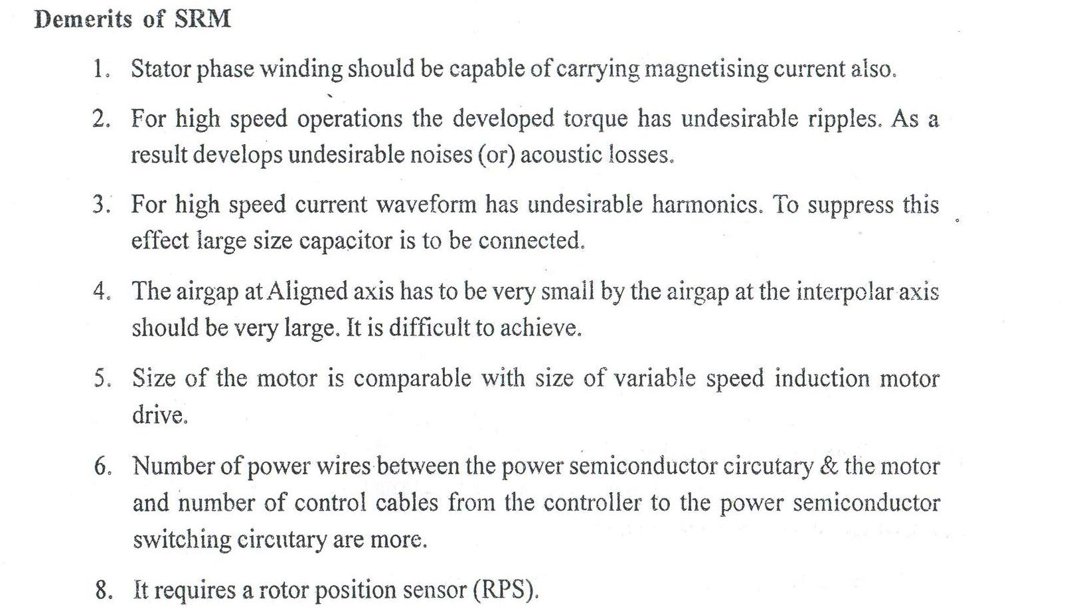

Slide 63
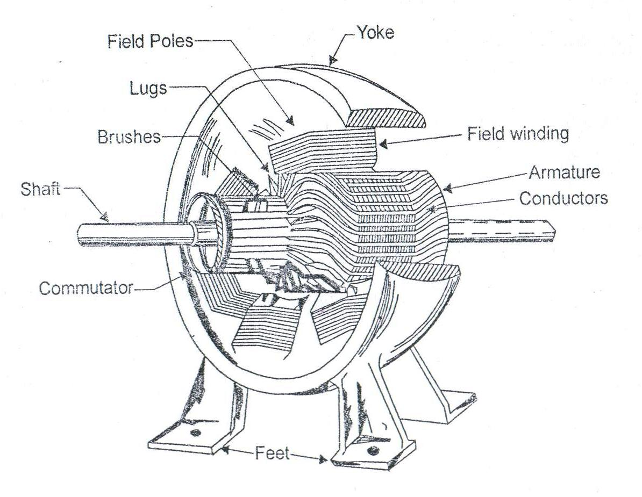
Conventional DC Motor

Slide 65
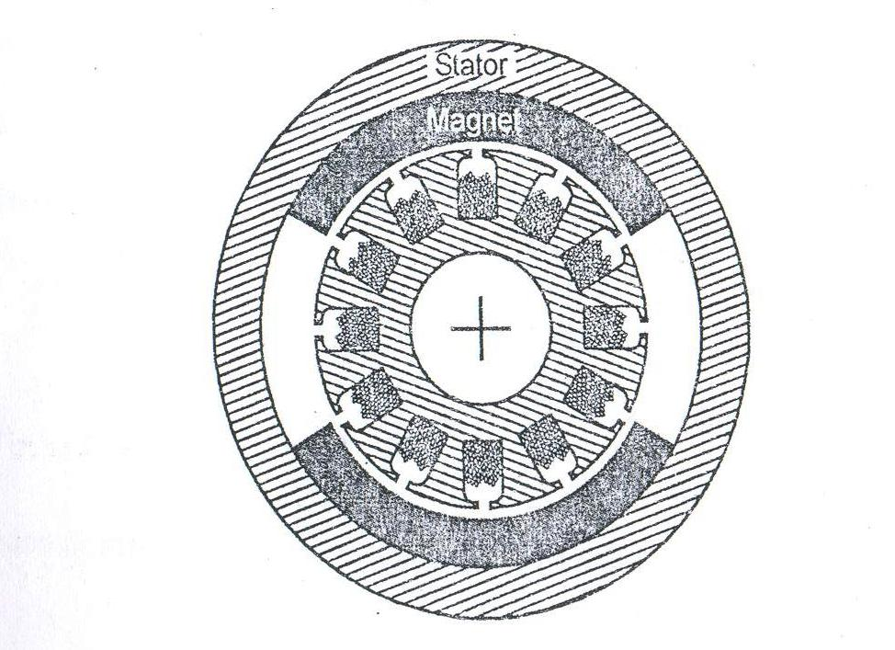
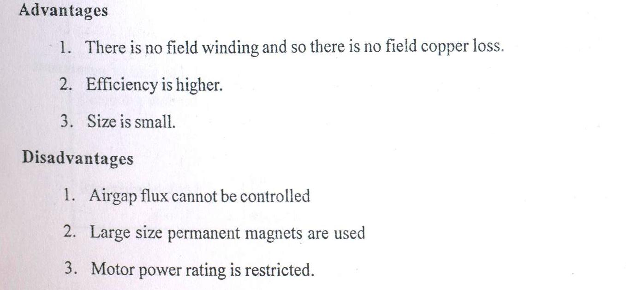
PERMANENT MAGNET DC MOTOR (SECOND STAGE EVOLUTION)

Slide 66
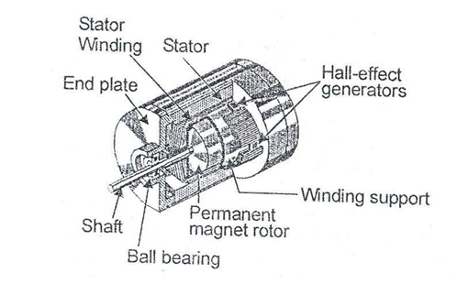
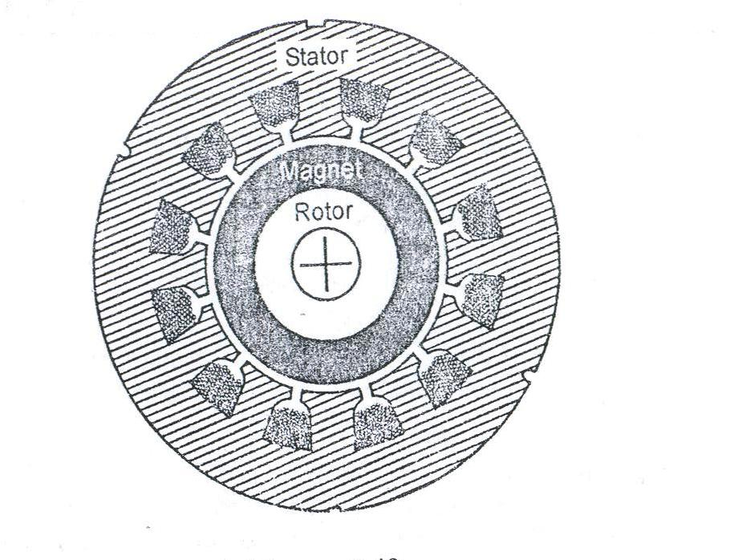
PERMANENT MAGNET BRUSHLESS DC MOTOR (THIRD STAGE EVOLUTION)

Slide 69
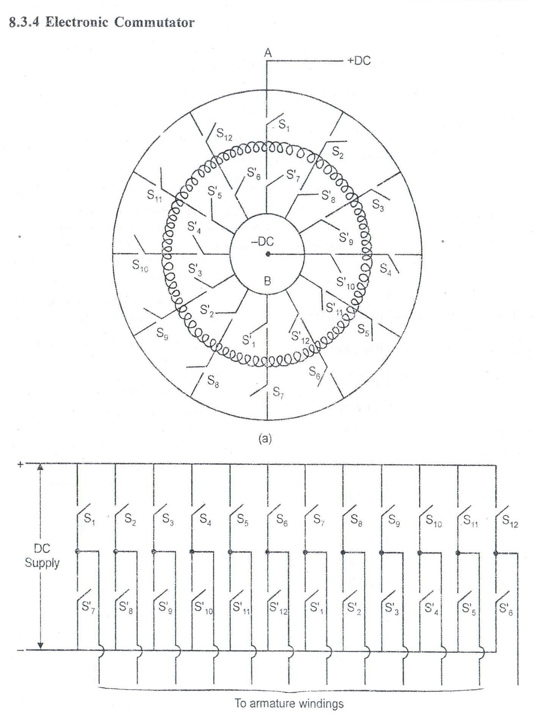
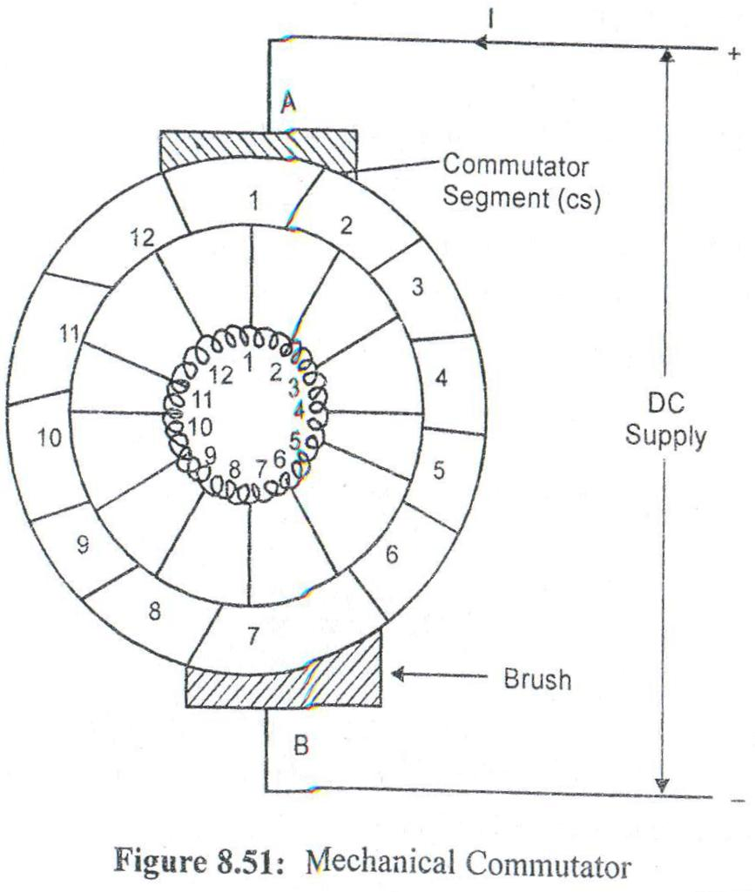
COMMUTATOR

Slide 70
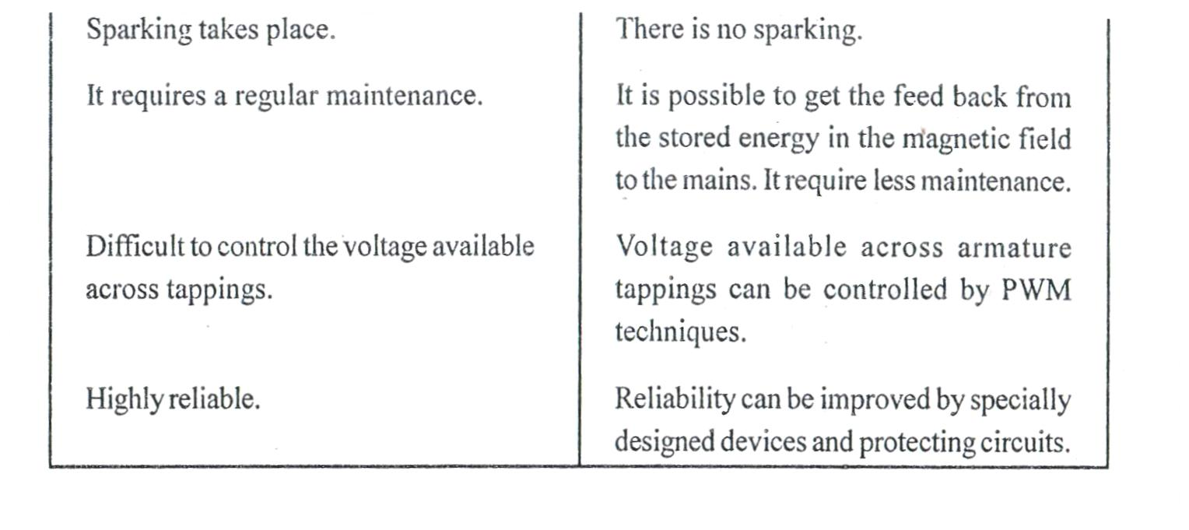

Slide 71
180 POLEARC
120 POLEARC

Slide 72
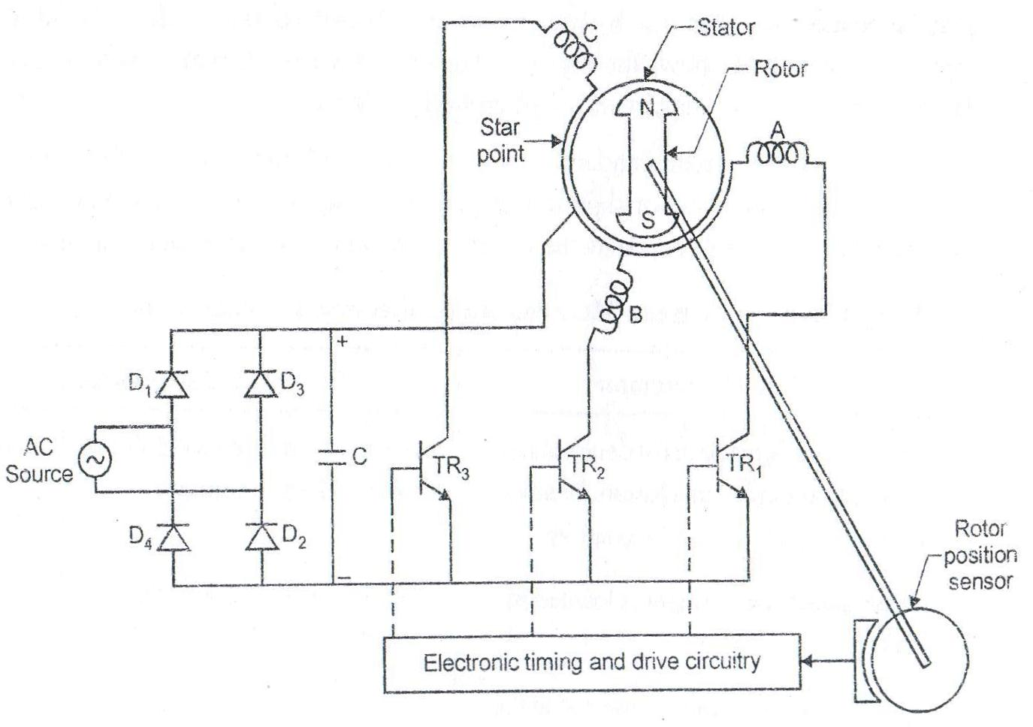
BLPM SNW MOTOR
3PHASE 3PULSE BLPM MOTOR
SIN WAVE FLUX WITH RESPECT TO STEP ANGLE

Slide 73
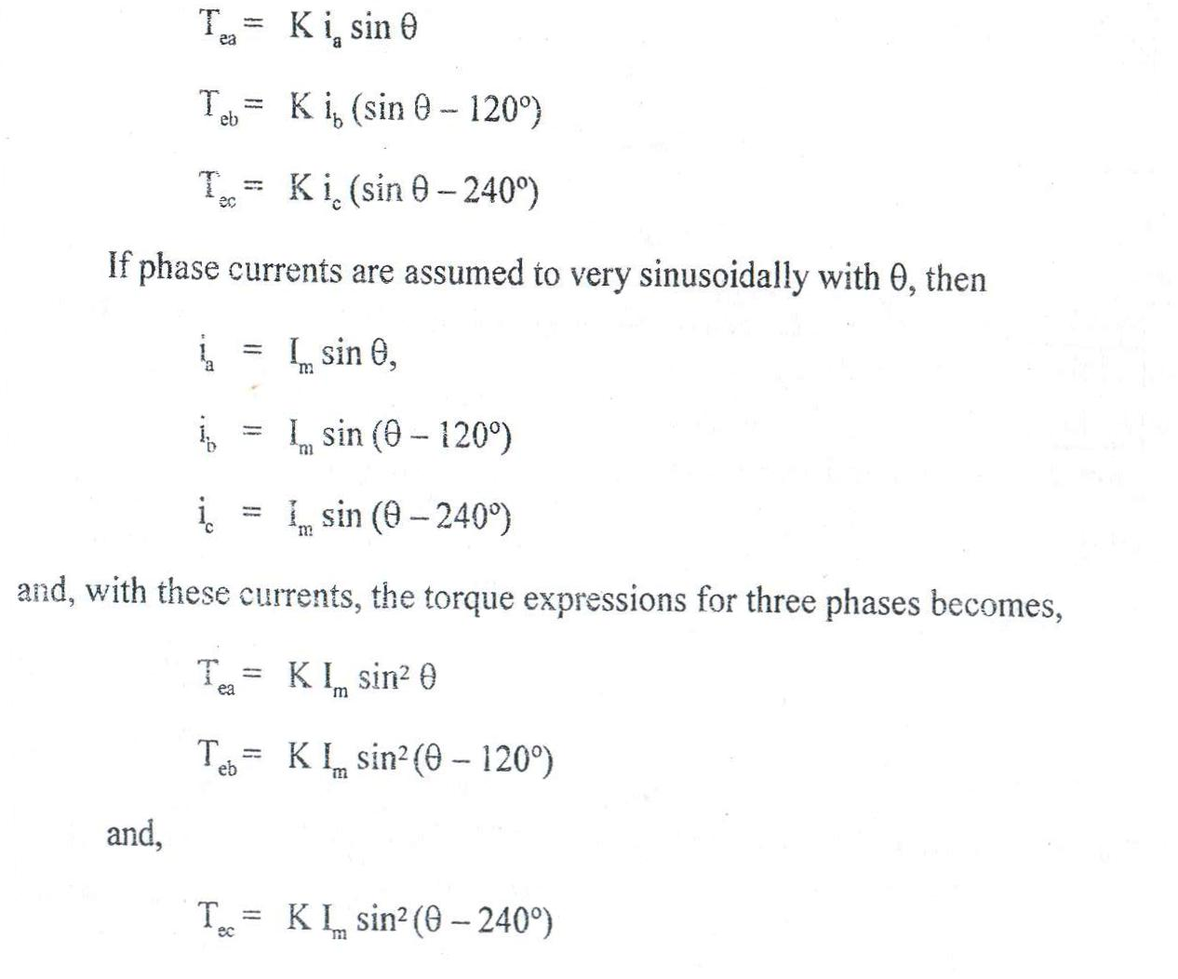
OPERATION OF BLPM SNW MOTOR

Slide 74
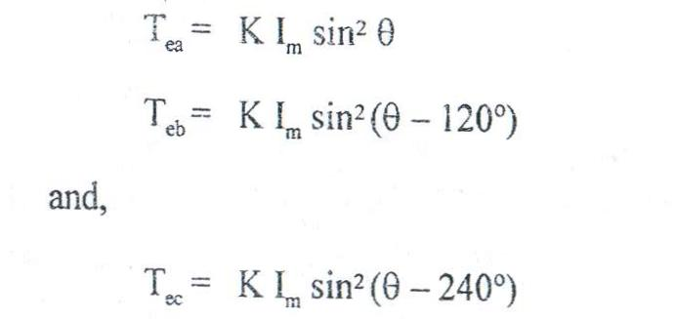
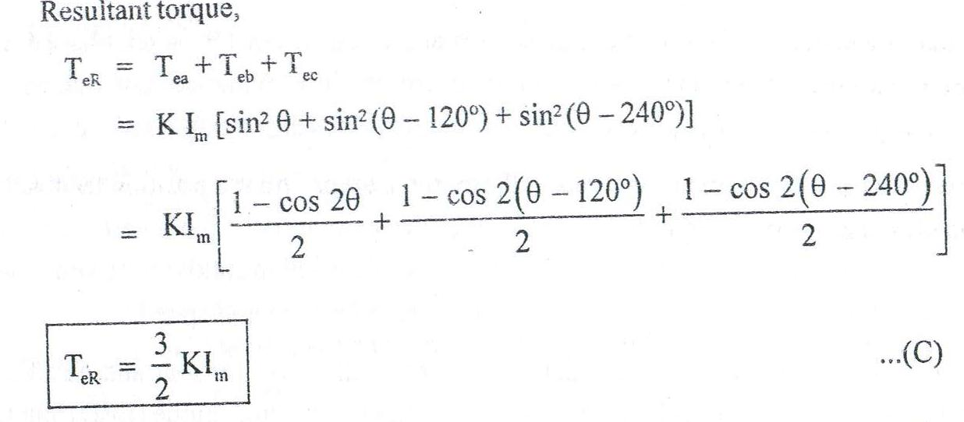
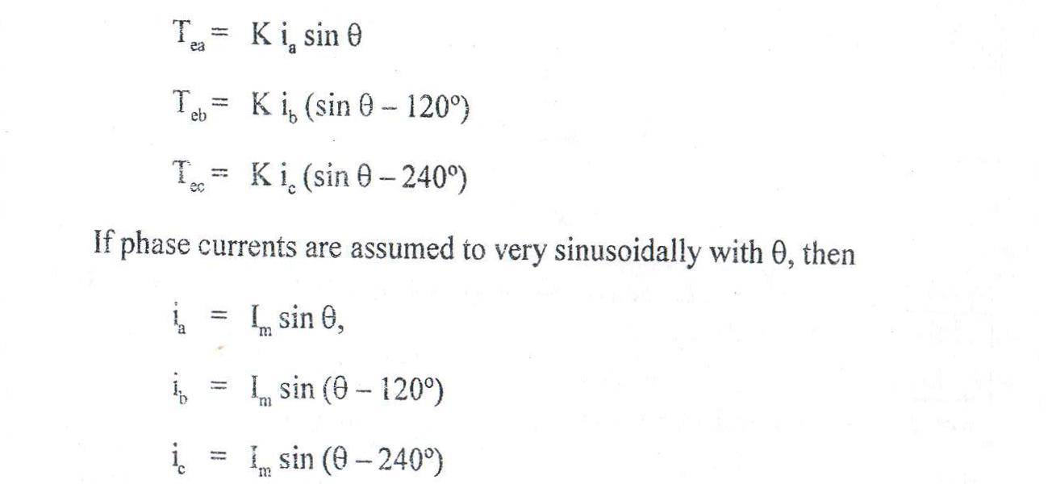
TORQUE EQUATION

Slide 75
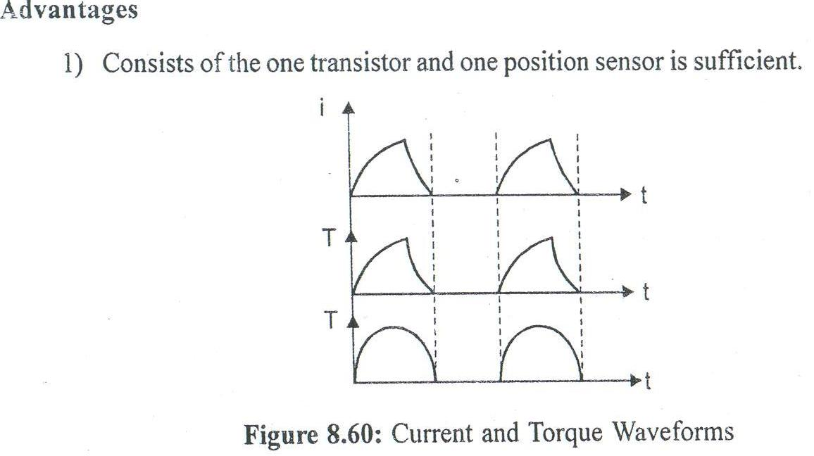
ONE PHASE WINDING –ONE PULSE BLPM DC MOTOR
ONE PHASE WINDING –TWO PULSE BLPM DC MOTOR
Torque wave forms

Slide 76
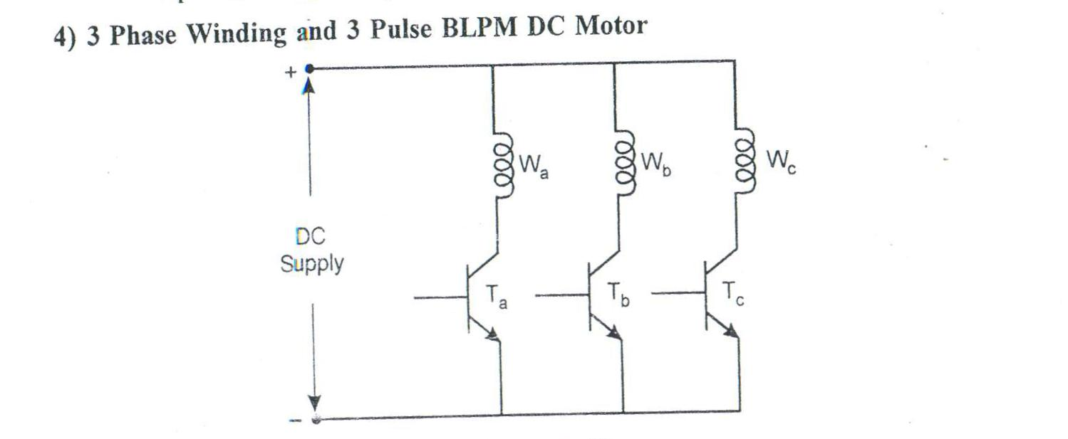

Slide 78
POWER CONTROLLER OF BLPM DC MOTOR

