Slide 1
UNIT 2
CONVERTER AND CHOPPER FED DC DRIVES
Steady state and transient analysis of the single and three phase fully controlled converter fed separately excited D.C motor drive – Continuous and discontinuous conduction mode
Multi quadrant operation – Converter control
Chopper-fed D.C drive – Steady state analysis
Block diagram of closed loop dc drive.

Slide 2
SINGLE PHASE FULL CONVERTER FED SEPARATELY EXCITED DC MOTOR

Slide 3
Motor speed is given by ,
Modes of operation
The single phase full converter with motor load has two modes of operation.
1) Motoring mode
Discontinuous conduction mode
Continuous conduction mode
2) Regenerative braking mode
Discontinuous conduction mode
Continuous conduction mode

Slide 4
MOTORING MODE
The condition for making the full converter with RLE load as motoring mode is firing angle should be less than 90 degree. So the net armature terminal voltage or full converter output voltage is positive and relatively high compare to the back emf Eg. So the current flowing through the armature is Positive

Slide 5
(a)Discontinuous conduction mode in motoring

Slide 7
(b)Continuous conduction mode in motoring

Slide 8
Speed verses torque characteristics

Slide 9
            Regenerative braking mode
The condition for making the full converter with RLE load as regenerative braking mode is firing angle should be greater than 90 degree.
So the net armature terminal voltage or full converter output voltage is negative and the magnitude of back emf is greater than magnitude of full converter output..
So the current flowing through the armature is negative. This operation is called inversion. So the power is fed from dc to ac source is Negative.

Slide 10
Equivalent circuit of regenerative braking mode

Slide 12
Output voltage Verses firing angle for full converter with RLE load

Slide 13
Three phase full converter fed dc drive

Slide 14
Wave form for 3-phase full converter with R or RL or RLE load at firing angle =30 Degree Motoring operation (Continuous conduction)

Slide 15
Wave form for 3-phase full converter with RLE load at firing angle=120 degree braking operation (Continuous conduction)

Slide 16
Three phase full converter with RLE load (Discontinuous conduction)

Slide 17
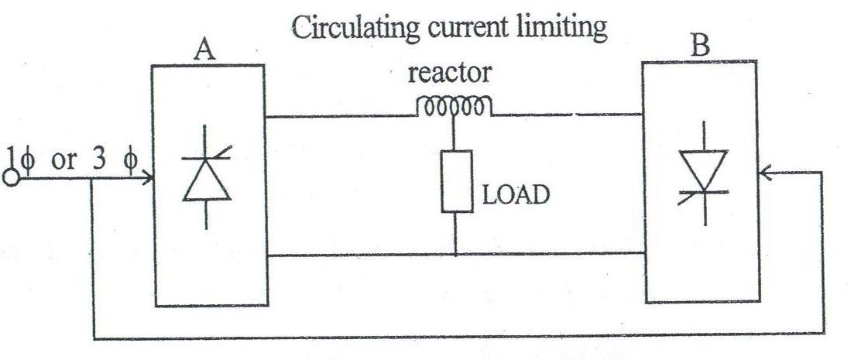
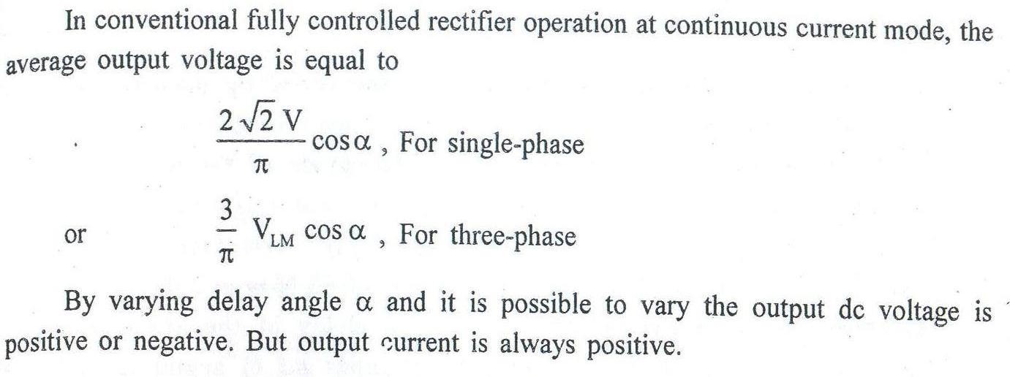
FOUR QUADRANT OPERATION OF DC DRIVES
Block diagram of dual converter:

Slide 18
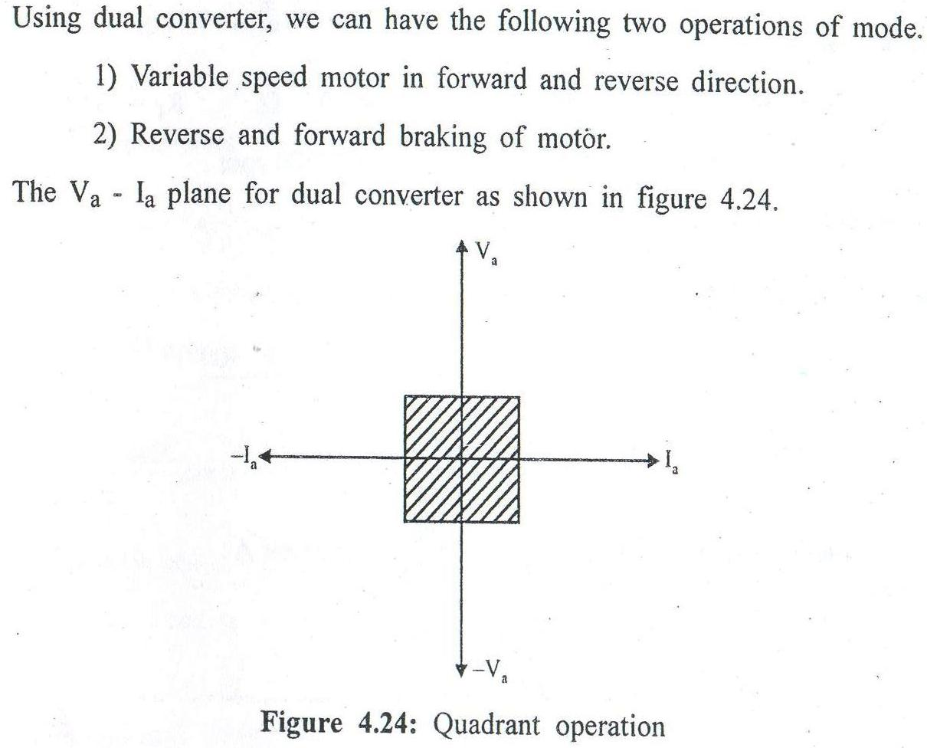


Slide 19
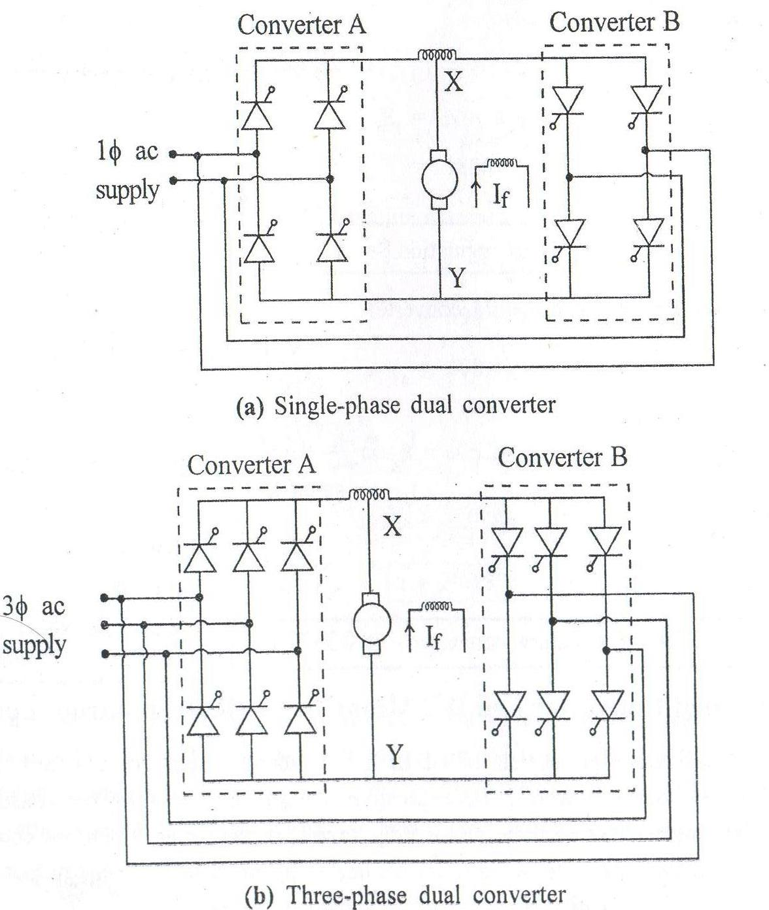

Slide 20
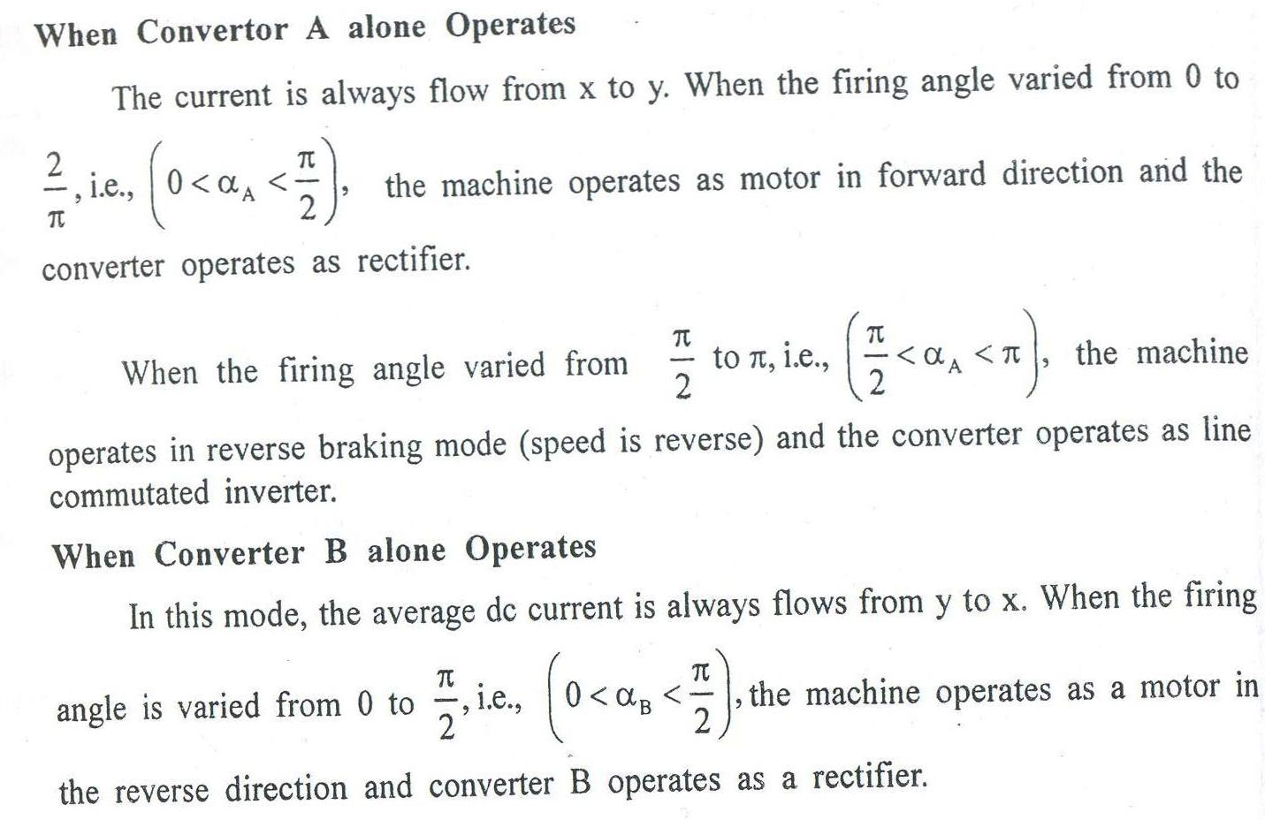
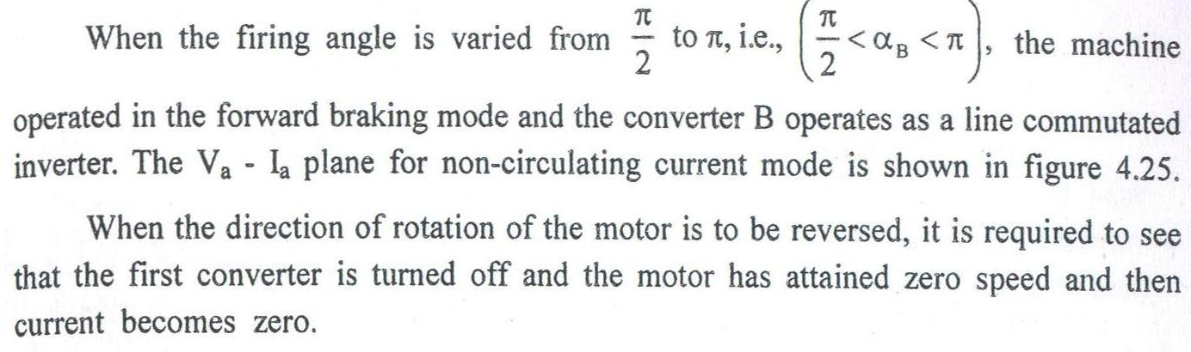
NON CIRCULATING CURRENT MODE
( ONE CONVERTER OPERATES AT A TIME)

Slide 21
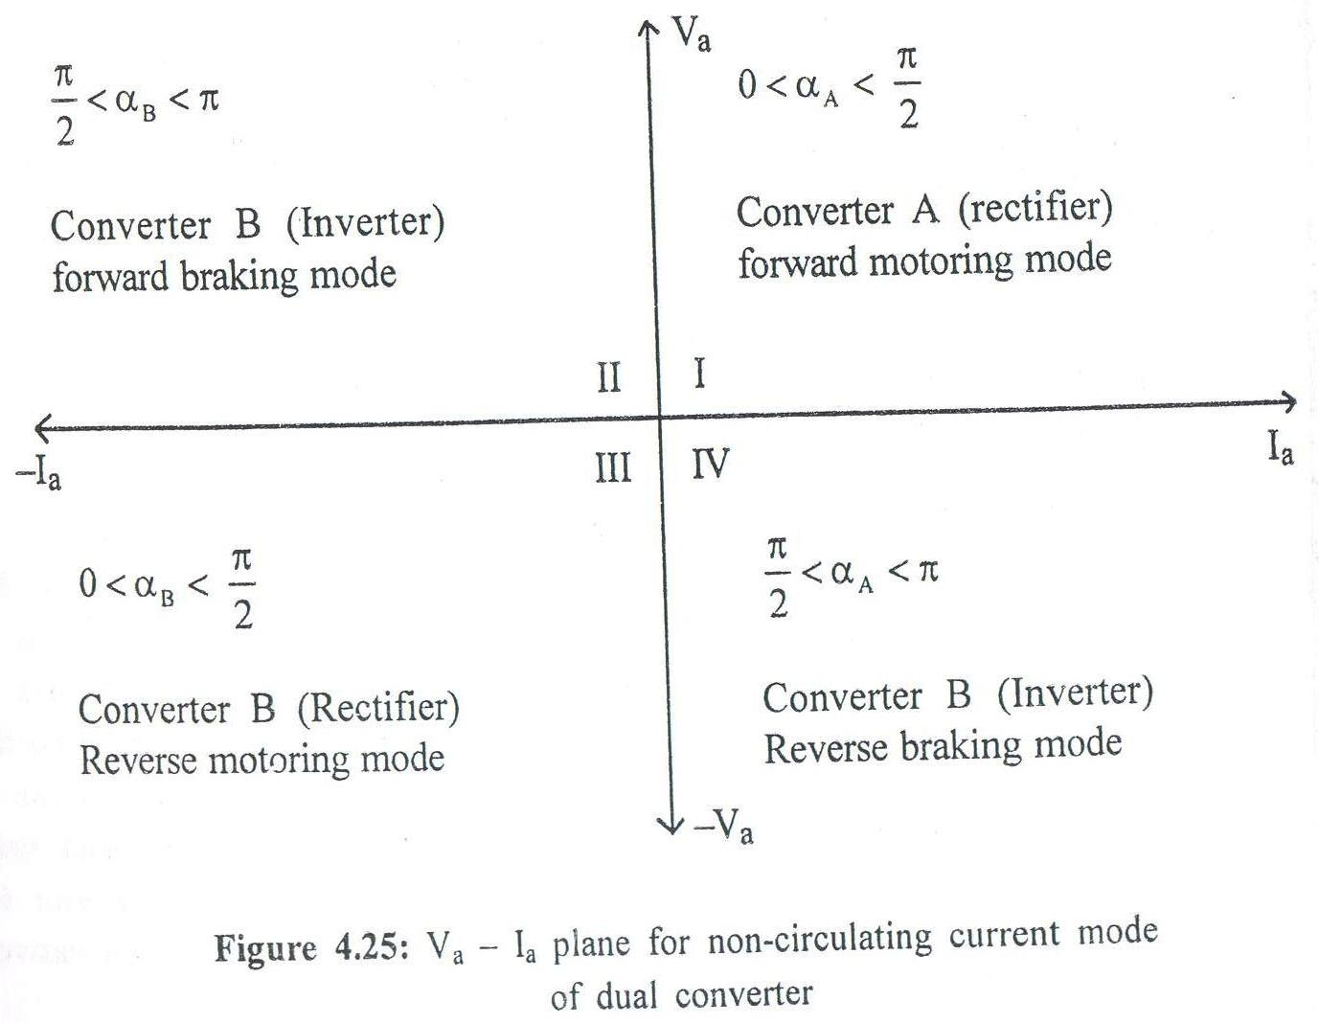

Slide 22
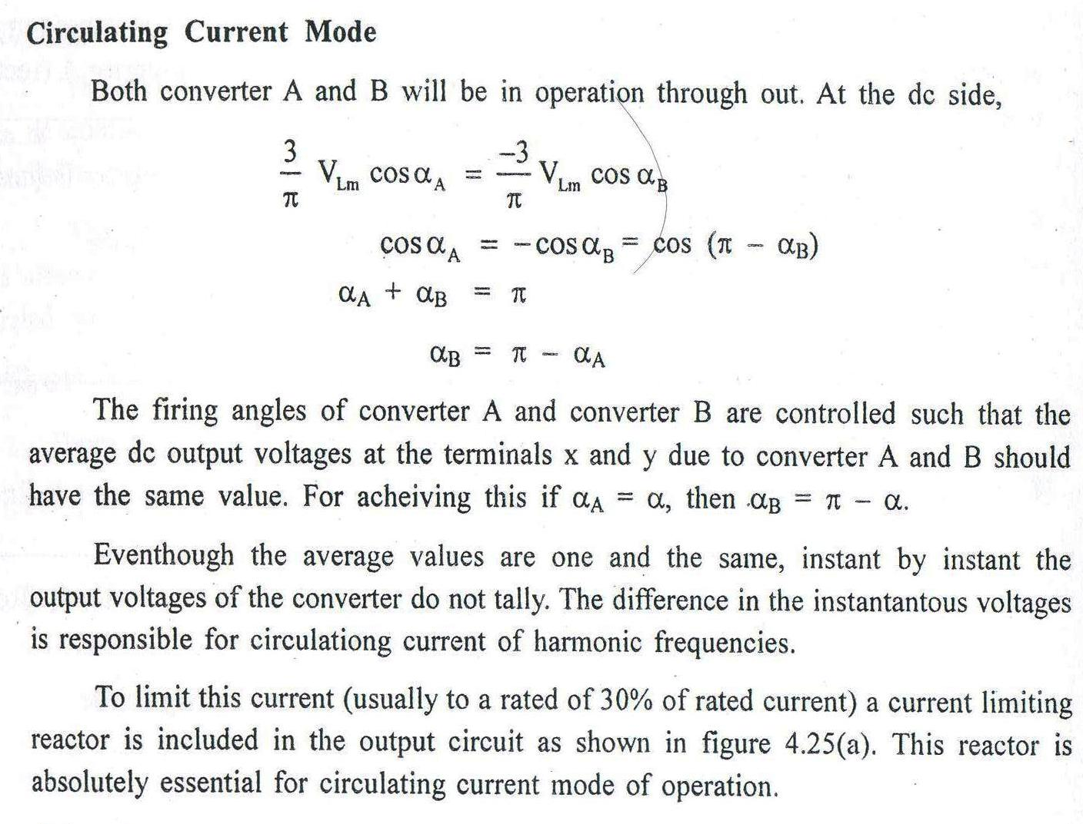

Slide 23
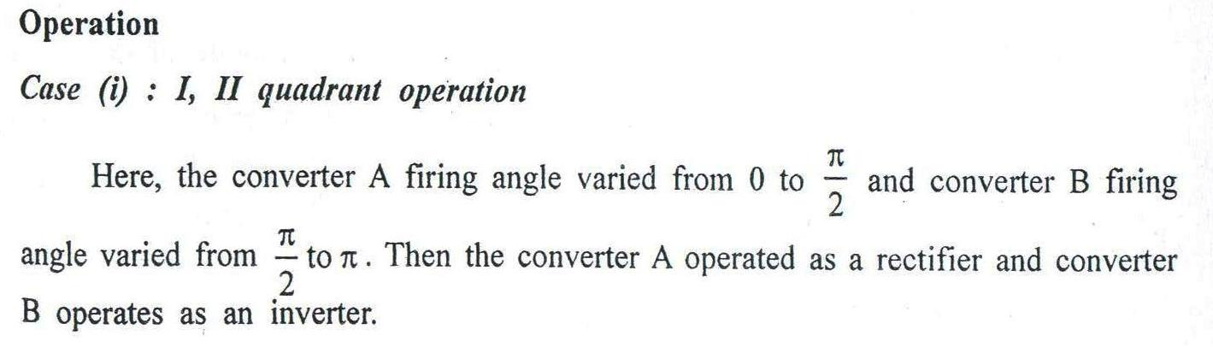
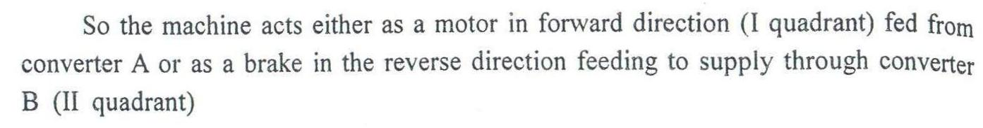
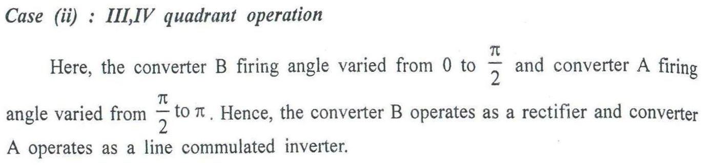
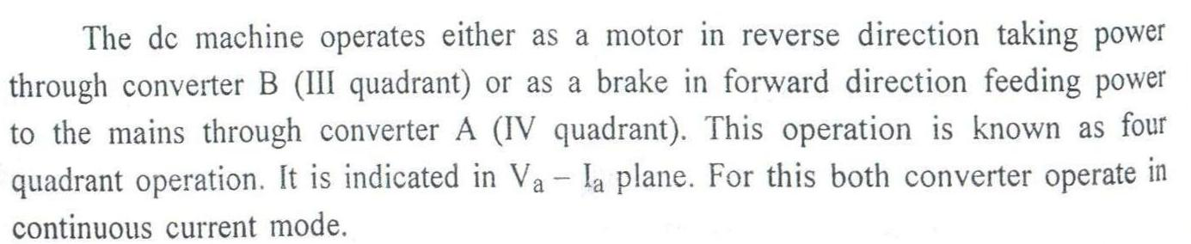

Slide 24
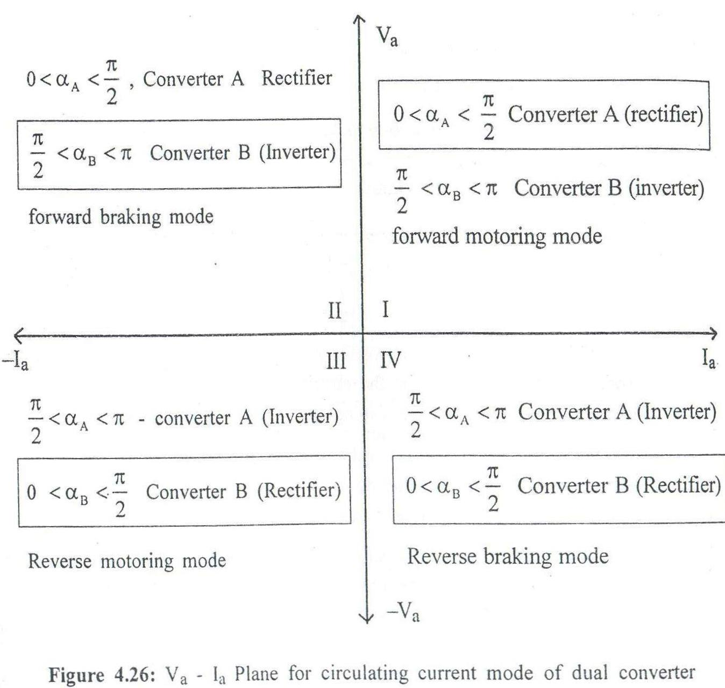

Slide 25
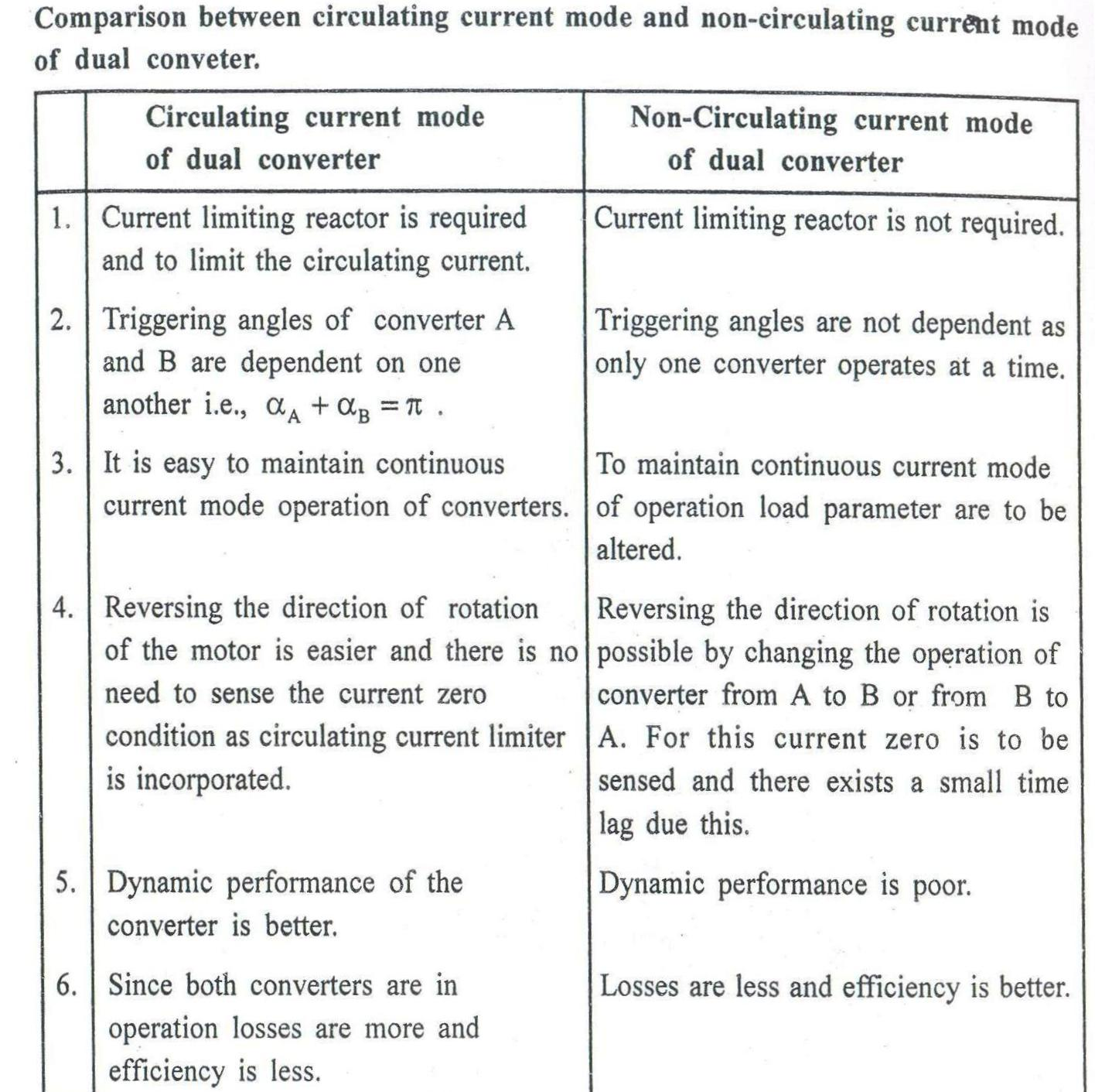

Slide 26
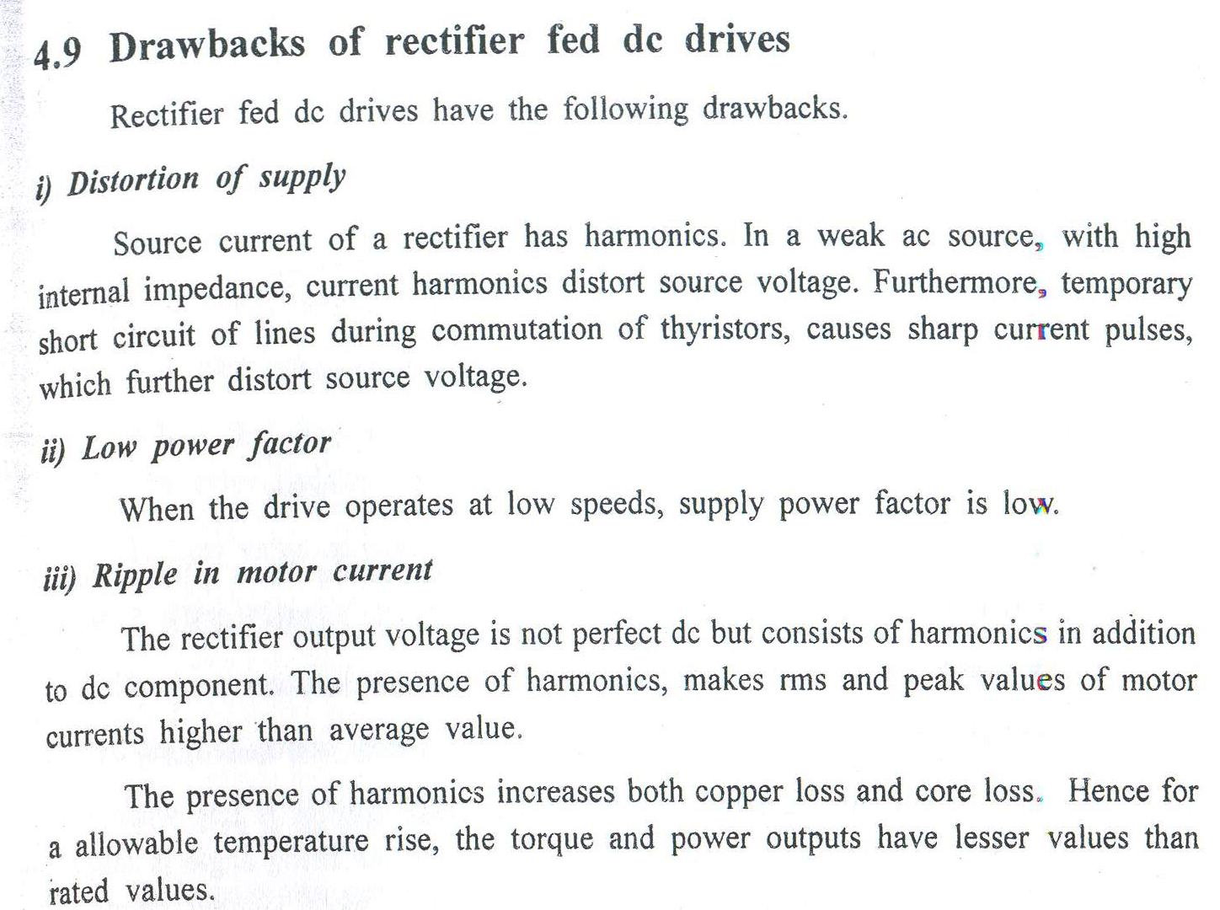

Slide 27
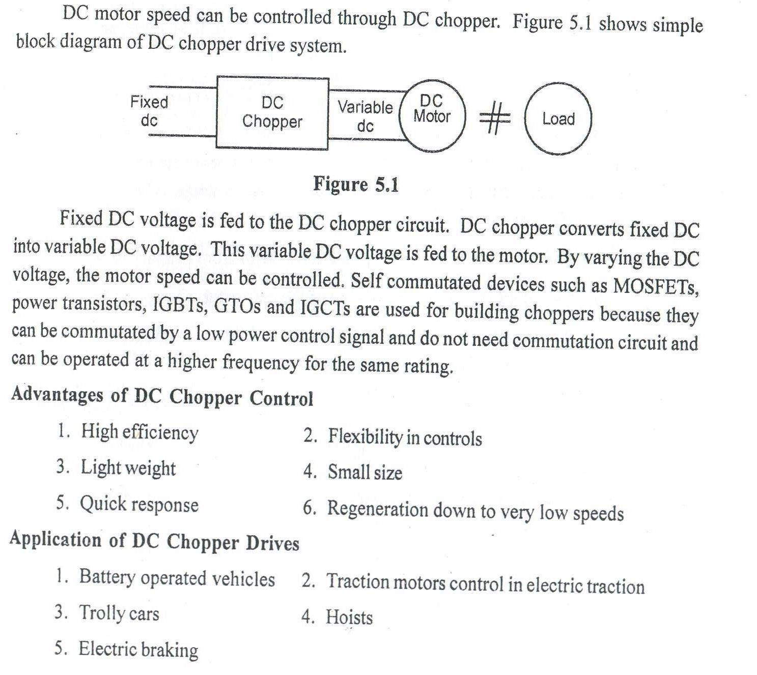
CHOPPER FED DC DRIVE:

Slide 28
Basic configuration of chopper (step-down chopper)
During the period “Ton”, or when chopper is on, the supply terminals are connected to the load terminals.
During the interval of Toff or when chopper is in off, load current flows through the free wheeling diode D, because of the energy delivering of load inductor and the load terminals are shorted.

Slide 29
OPERATION OF STEP-DOWN CHOPPER
Total time T= Ton + Toff
Therefore, dc output voltage ,
=
=
Duty cycle =
The load voltage is controlled by the duty cycle of the chopper.

Slide 30
OUTPUT VOLTAGE CONTROL
*Time ratio control and Current limit control
*The time ratio-control is further classified as in to
Constant frequency system
Variable frequency system
Time ratio control
In the time ratio control, the value of or the ratio of the turn on time to the total time is varied. This is effected in two ways .The are constant frequency operation and variable frequency operation
Constant frequency system
The total time T is kept constant and on-time Ton is varied. The chopping frequency is constant. This may be called as pulse width modulation.

Slide 31
CONSTANT FREQUENCY SCHEME

Slide 32
VARIABLE FREQUENCY SYSTEM
In the variable frequency scheme, the chopping period T is varied, either by on time is kept constant or off-time is kept constant. This may be called as frequency modulation

Slide 33
The constant frequency scheme is thus preferred scheme because of the disadvantages of frequency modulation technique. The disadvantages are
The frequency has to be varied over a wide range to provide the full output voltage range. Filter design for variable frequency operation is difficult.
The possibility of interference with signaling and telephone line is greater.
The large off-time at low output voltage will make the current of a dc motor load discontinuous.

Slide 34
CURRENT LIMIT CONTROL
The chopper is switched ON and OFF so that the current in the load is maintained between two limits such as upper limit I2 and lower limit I1.
When the current exceeds the upper limit, the chopper is switched off. During off period, the load current freewheels and decrease exponential.
When it reaches the lower limit, the chopper is switched ON.
Current limit control is possible either with constant frequency or with constant Ton.
The current limit control is used only when the load has energy storage element especially inductor.

Slide 35
CURRENT LIMIT CONTROL

Slide 36
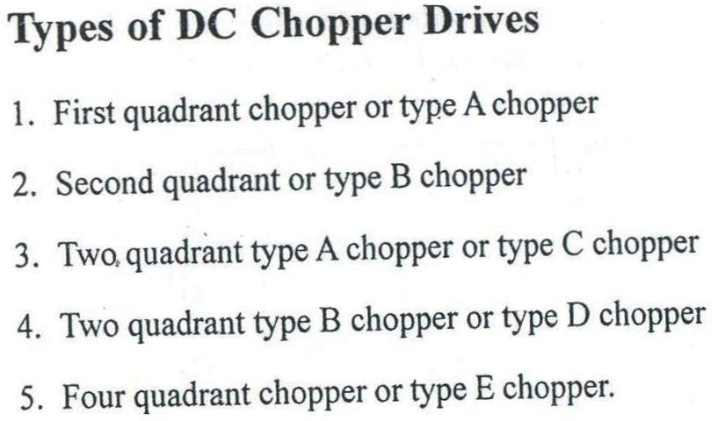

Slide 37
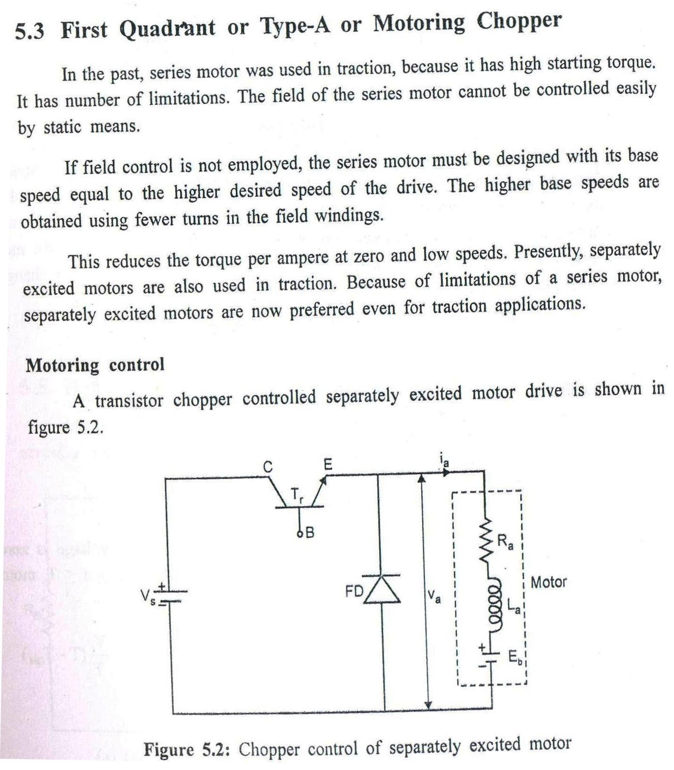

Slide 38
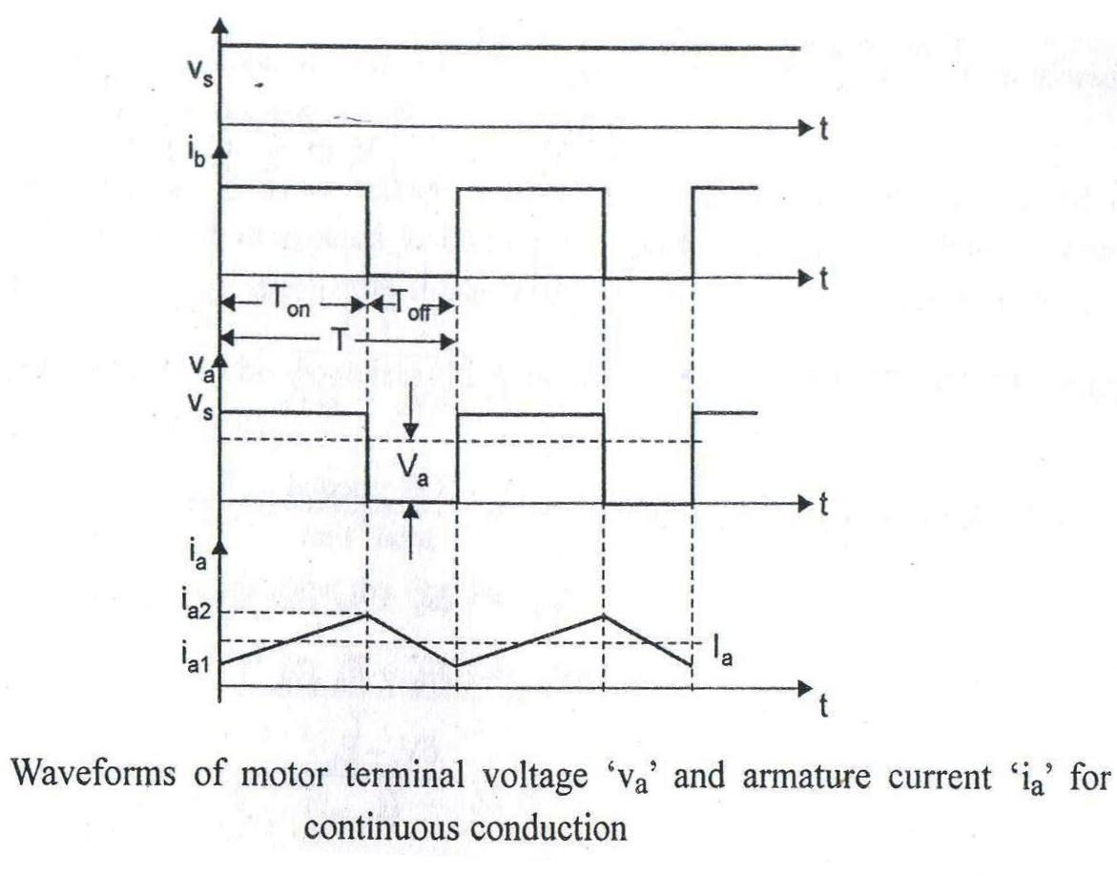

Slide 39
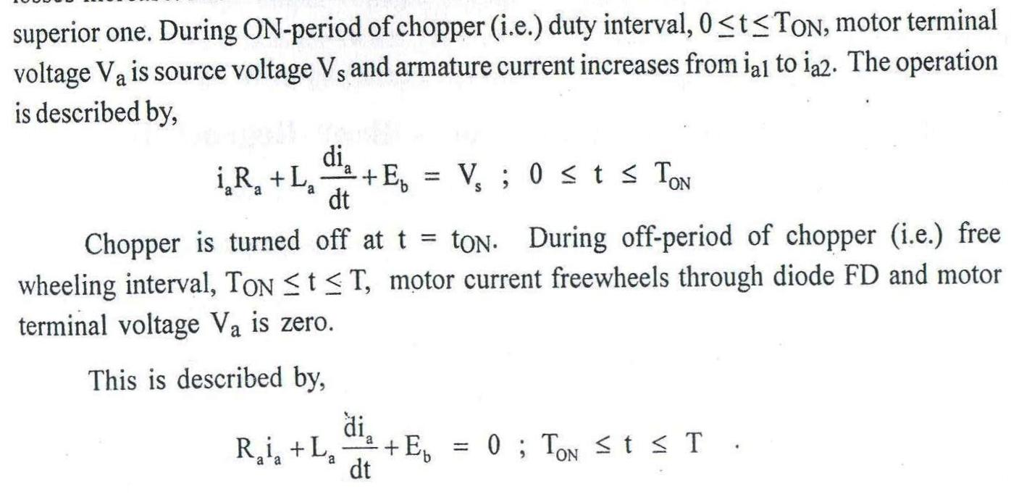
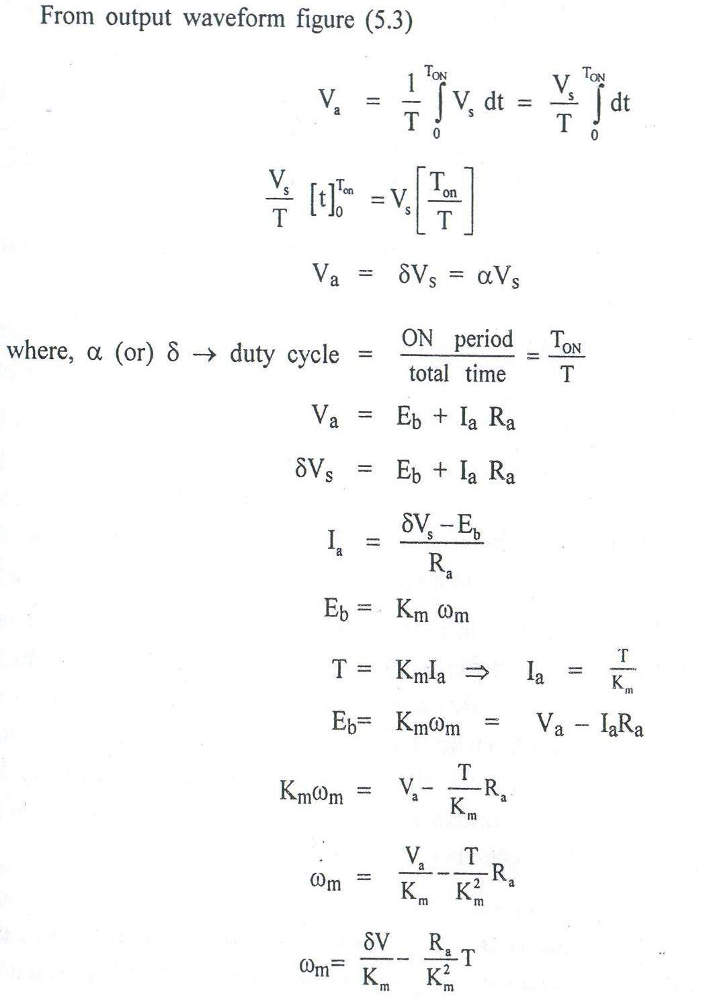

Slide 40
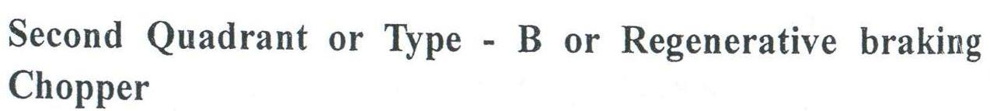
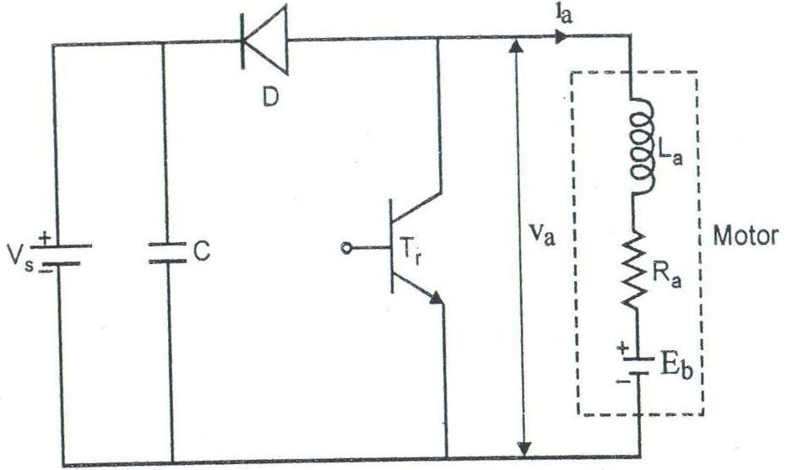
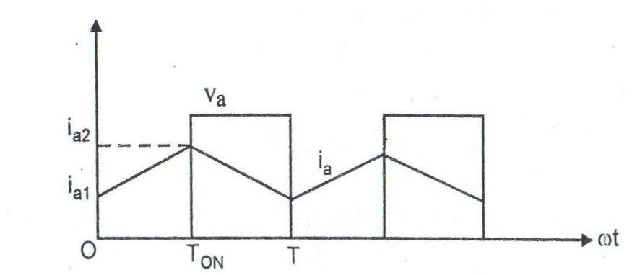

Slide 41
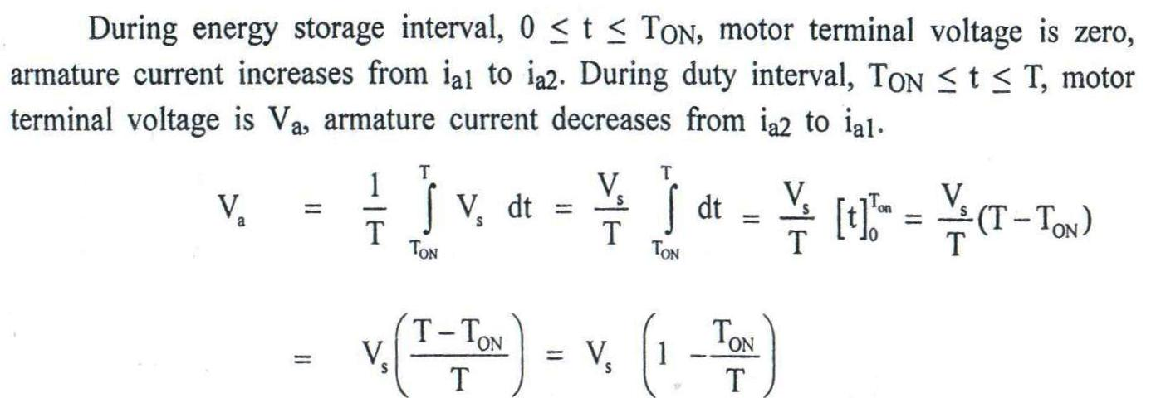
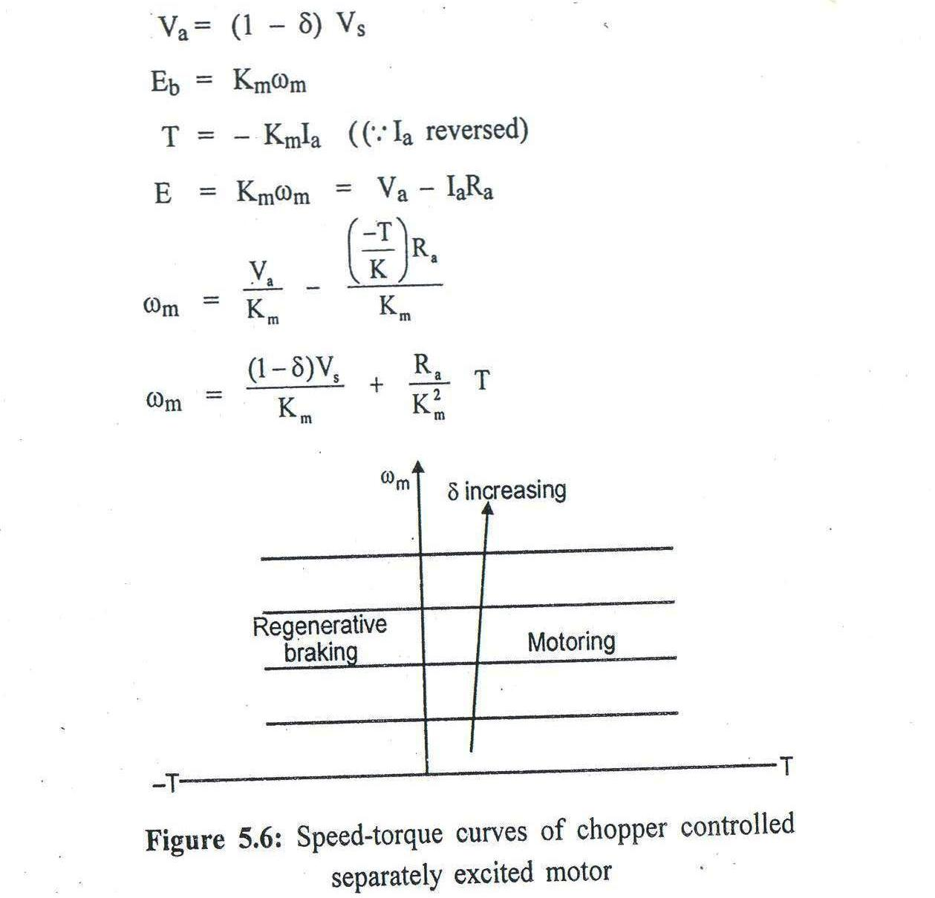

Slide 42
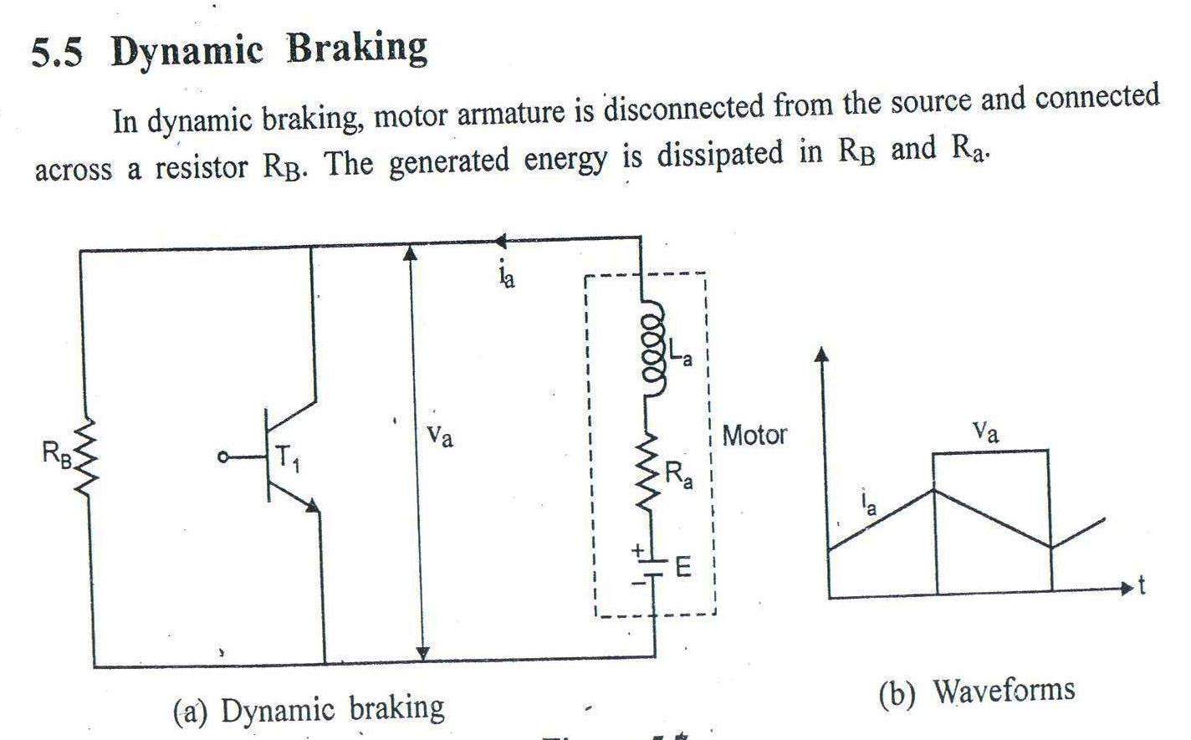
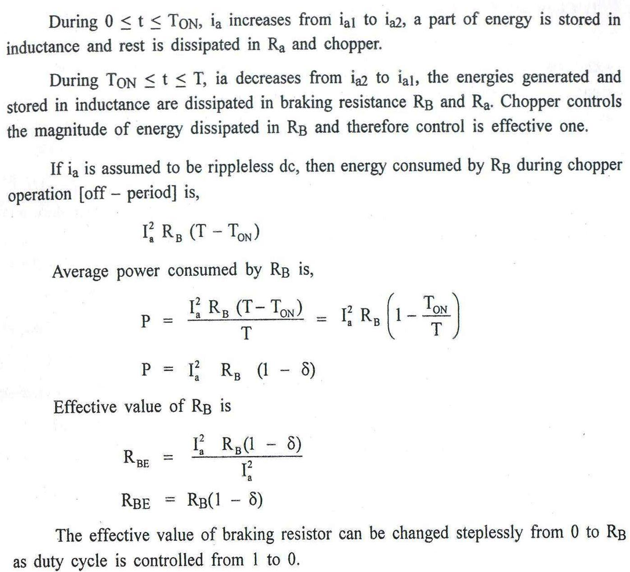

Slide 43
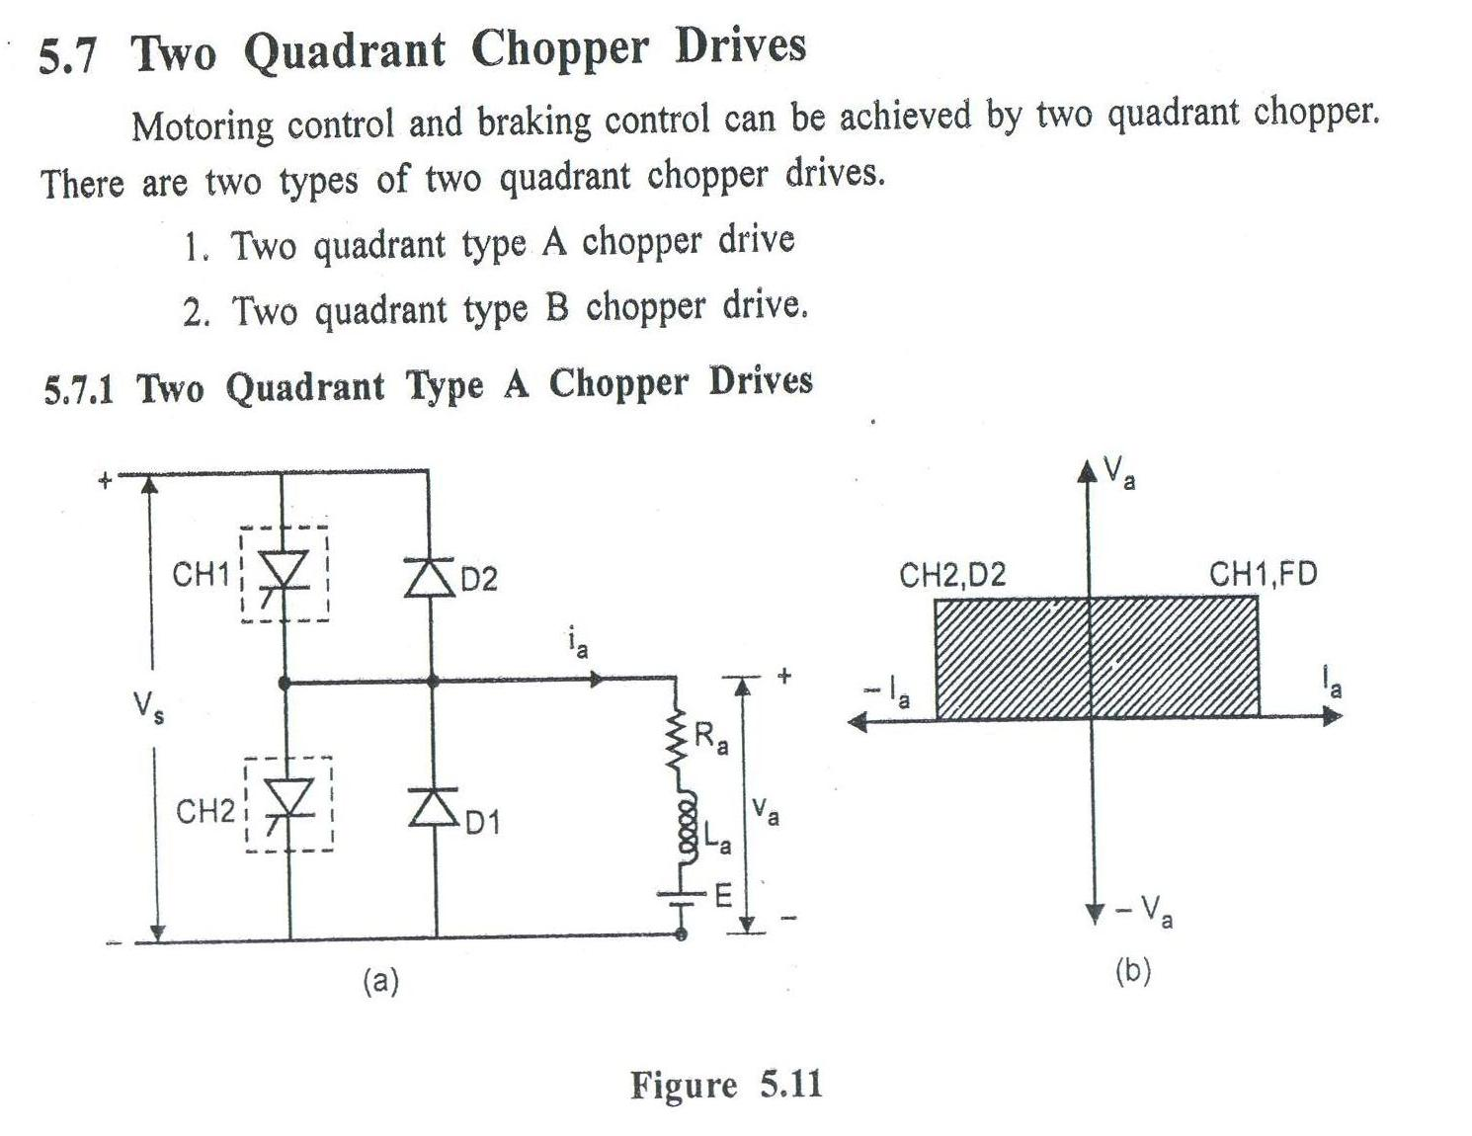

Slide 44
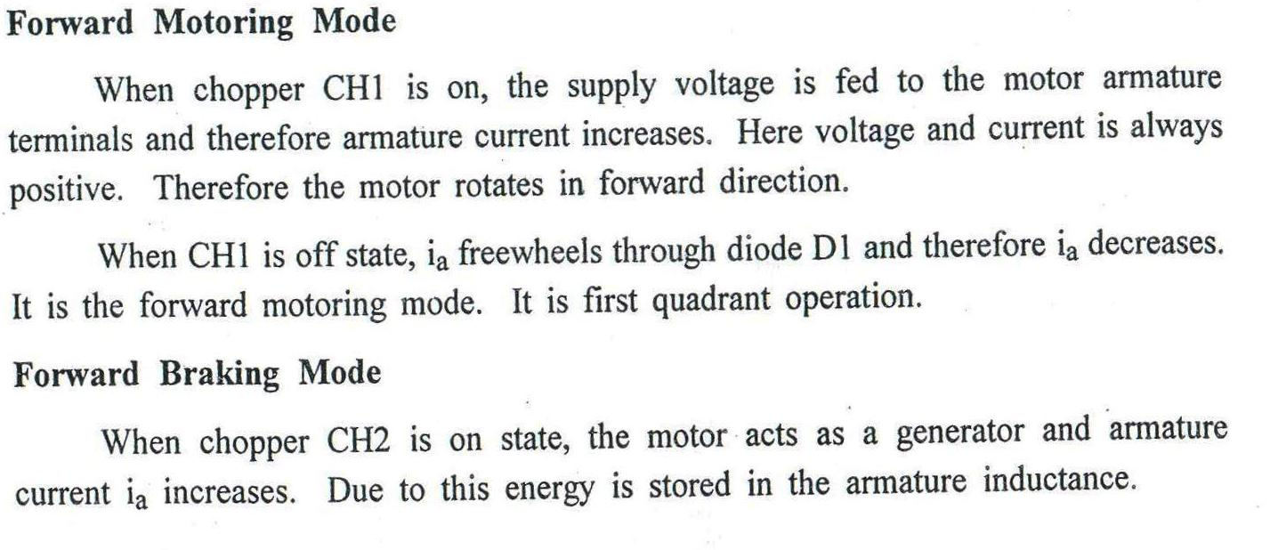
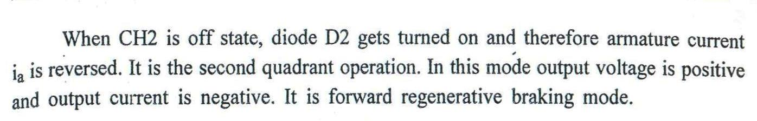
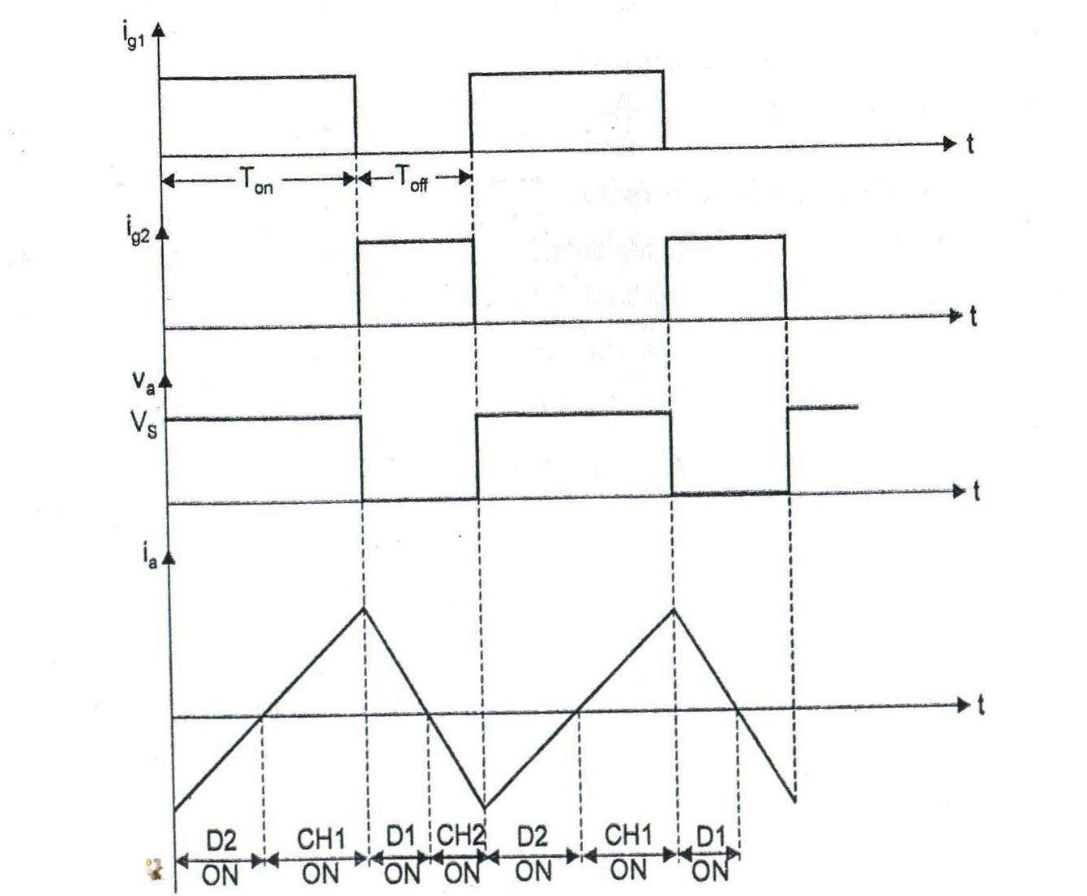

Slide 45
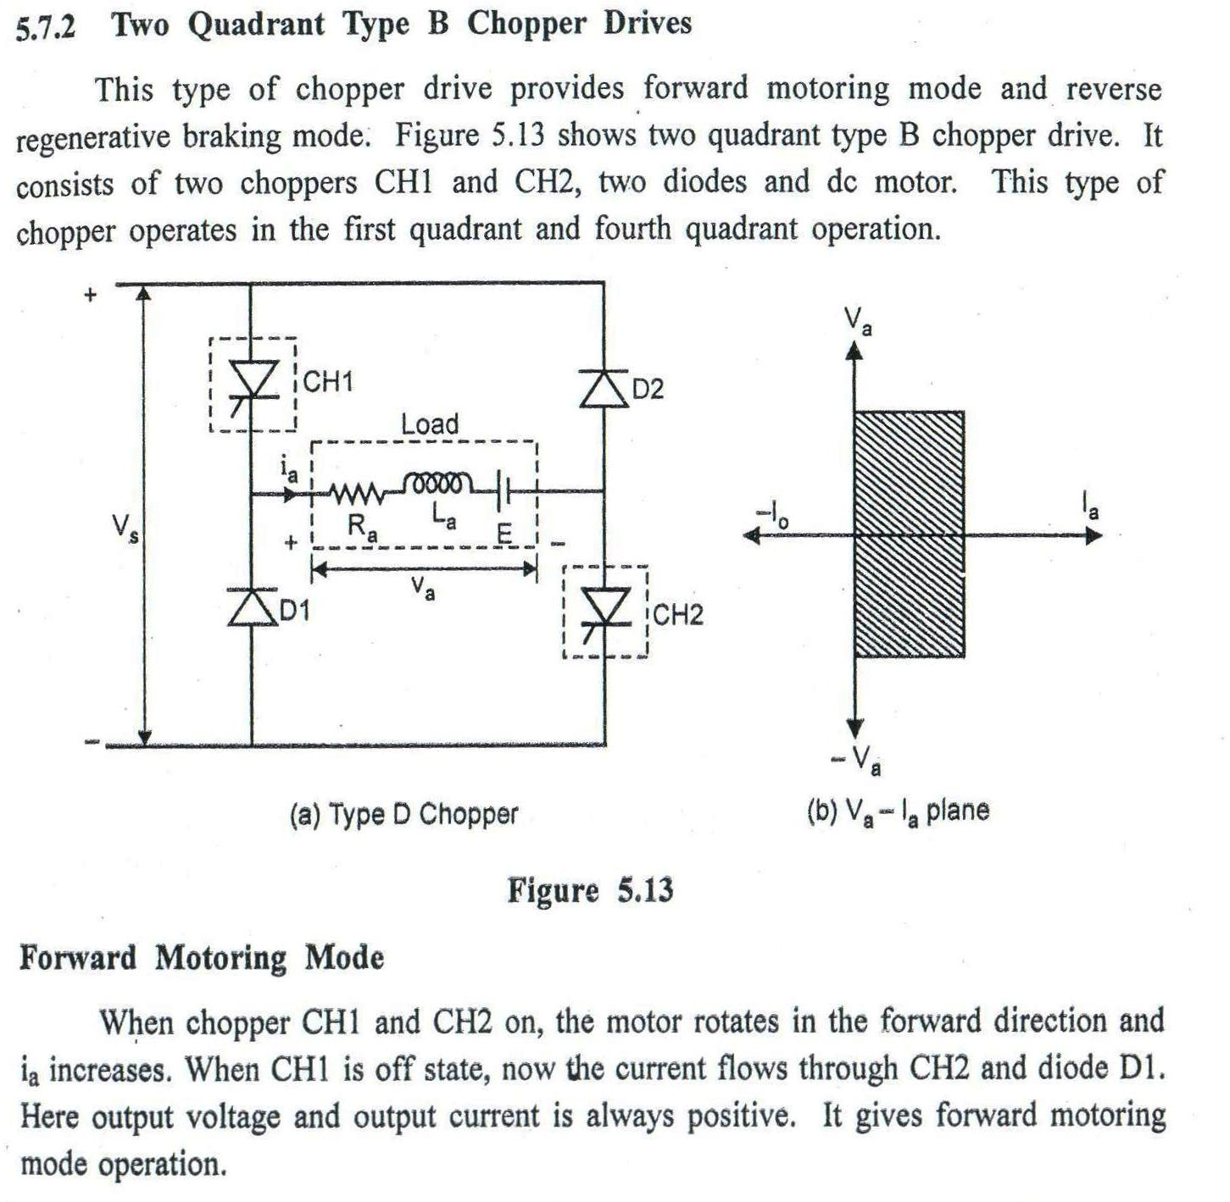

Slide 46
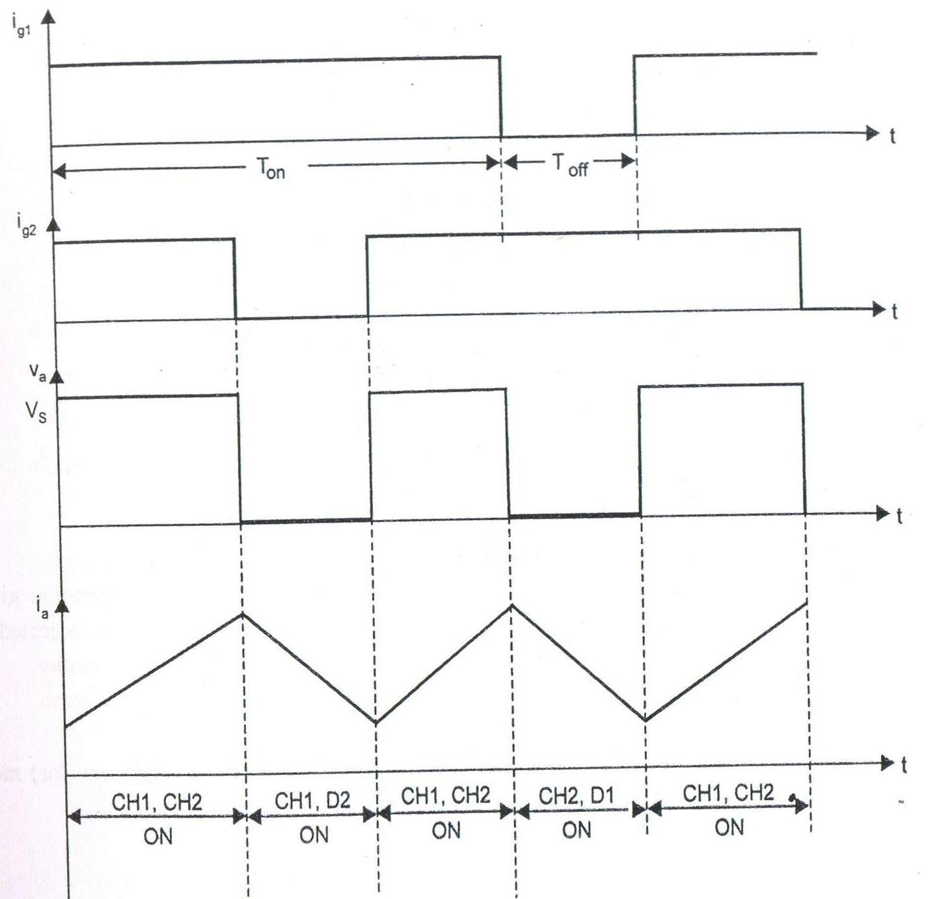

Slide 47
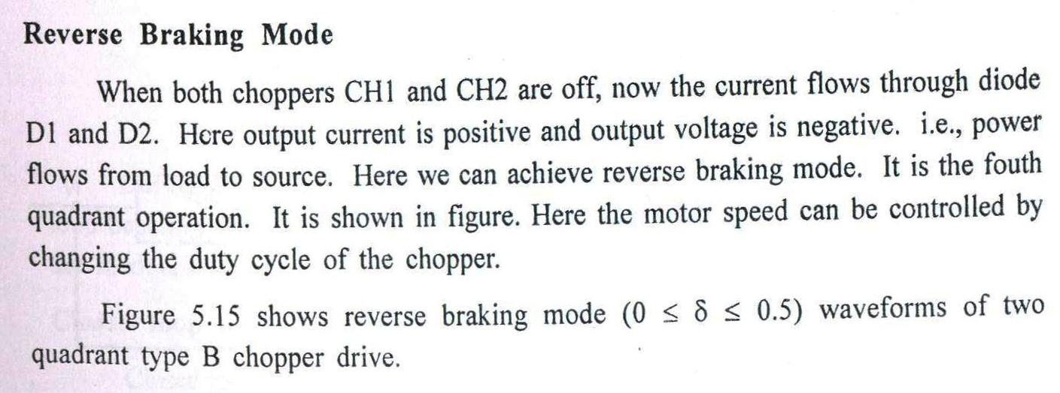
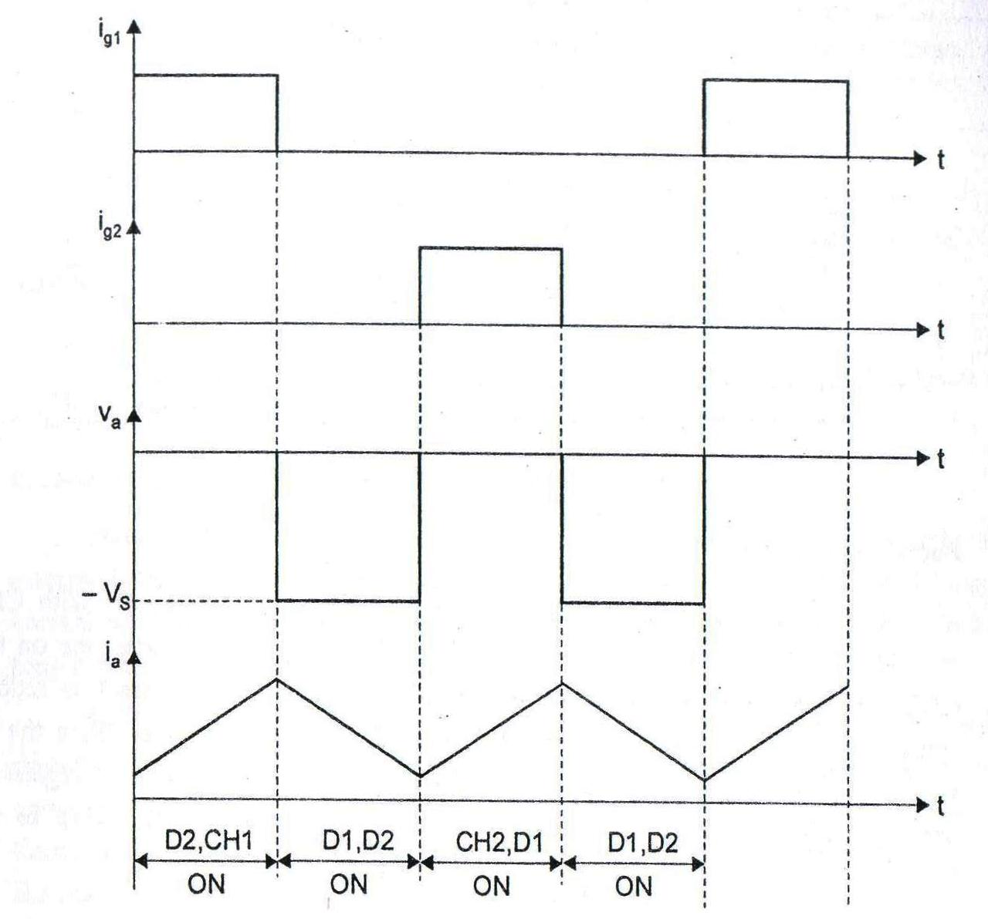

Slide 48
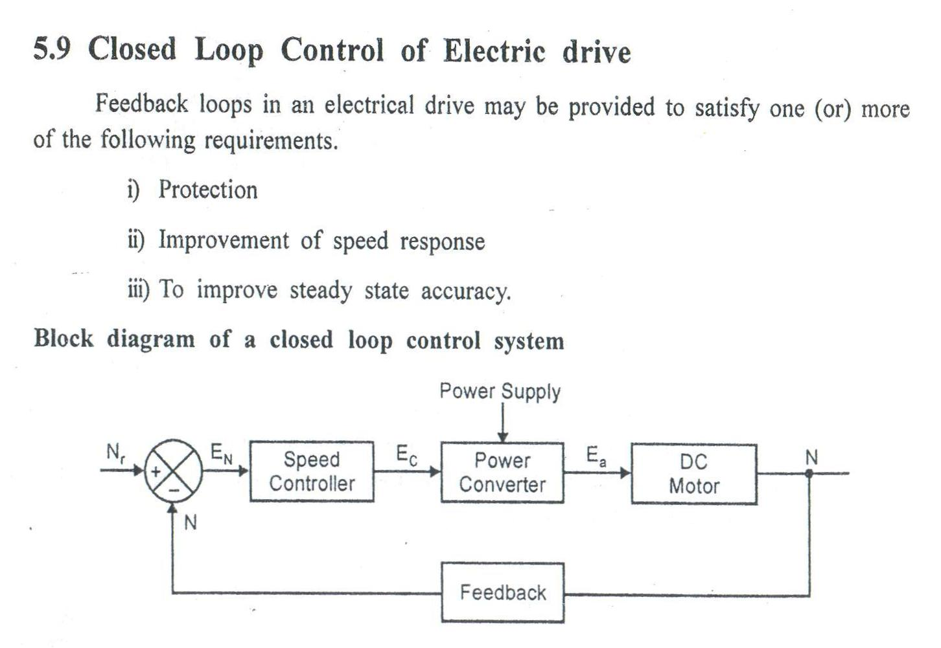

Slide 49
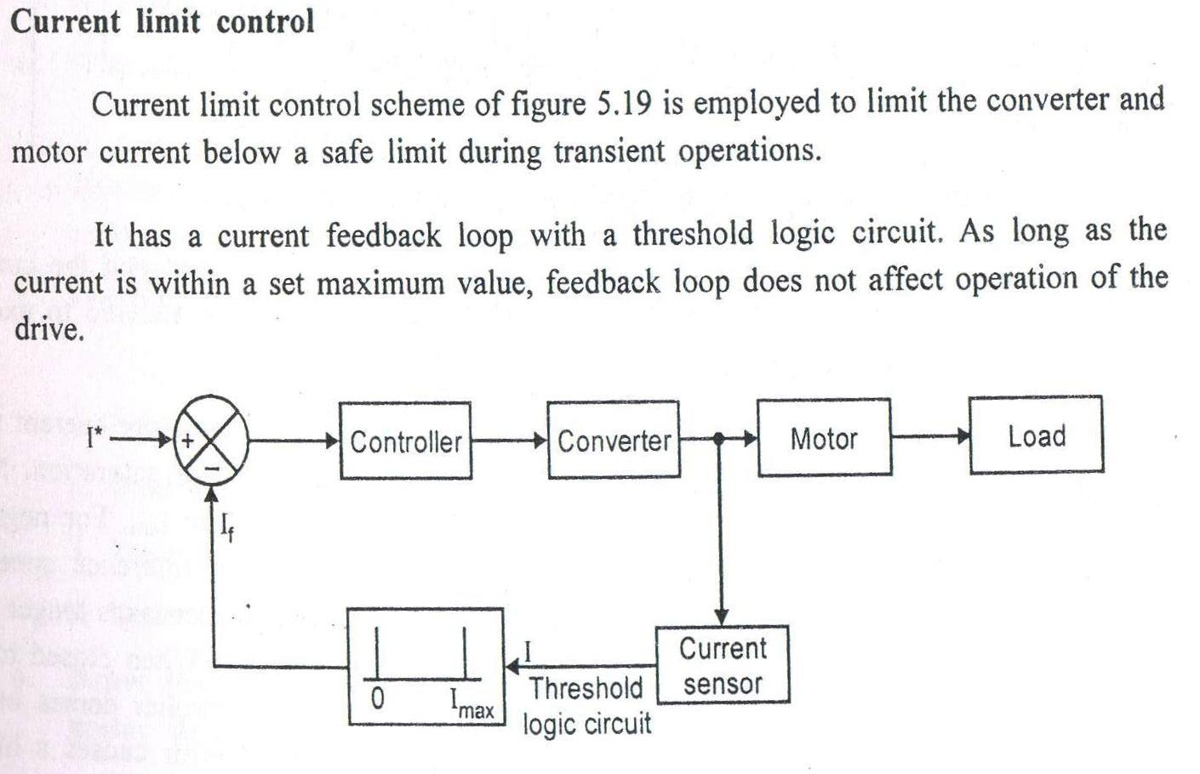

Slide 50
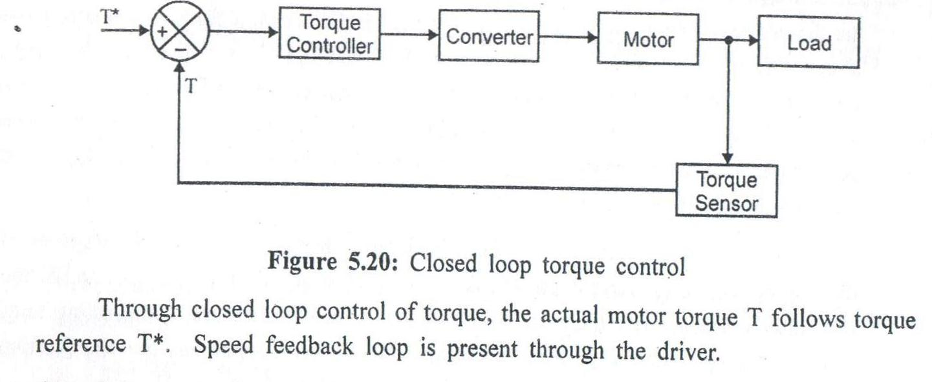
Closed loop torque control

Slide 51
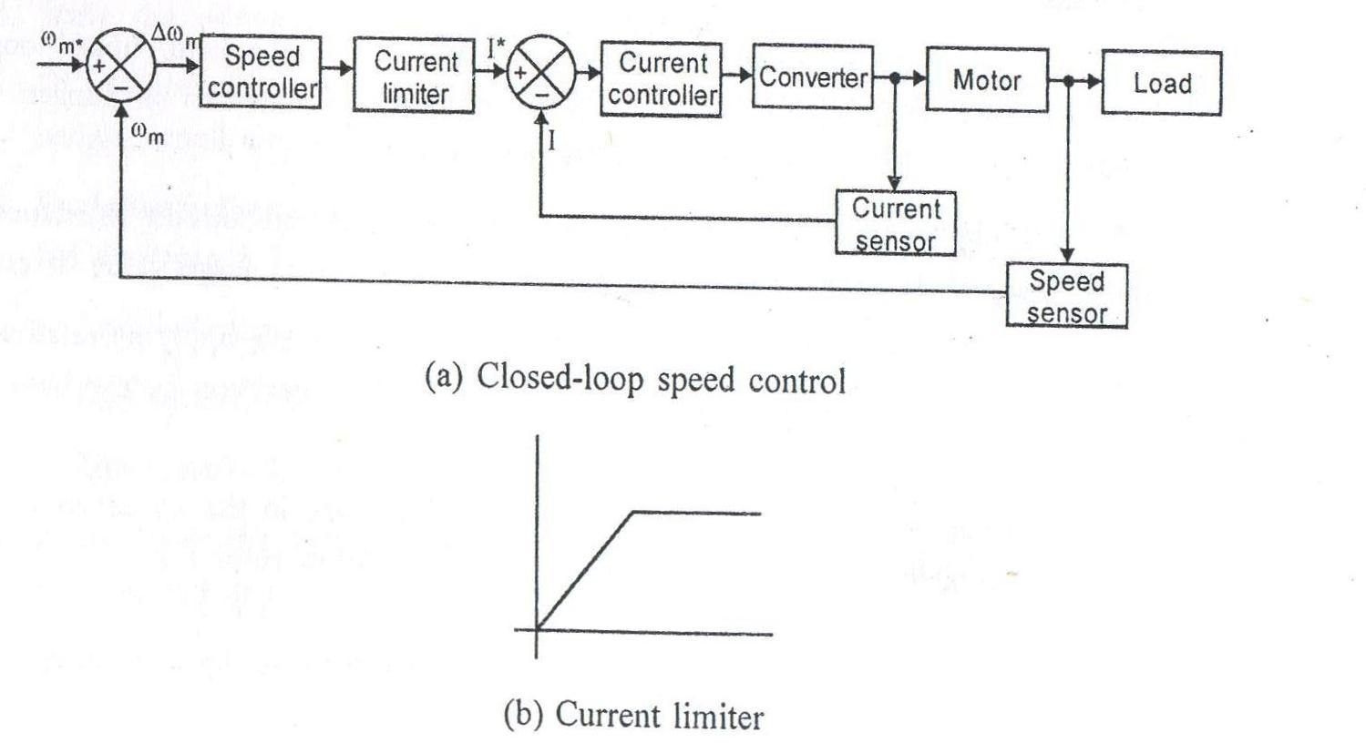
Closed loop speed control

Slide 52
